Slide 1
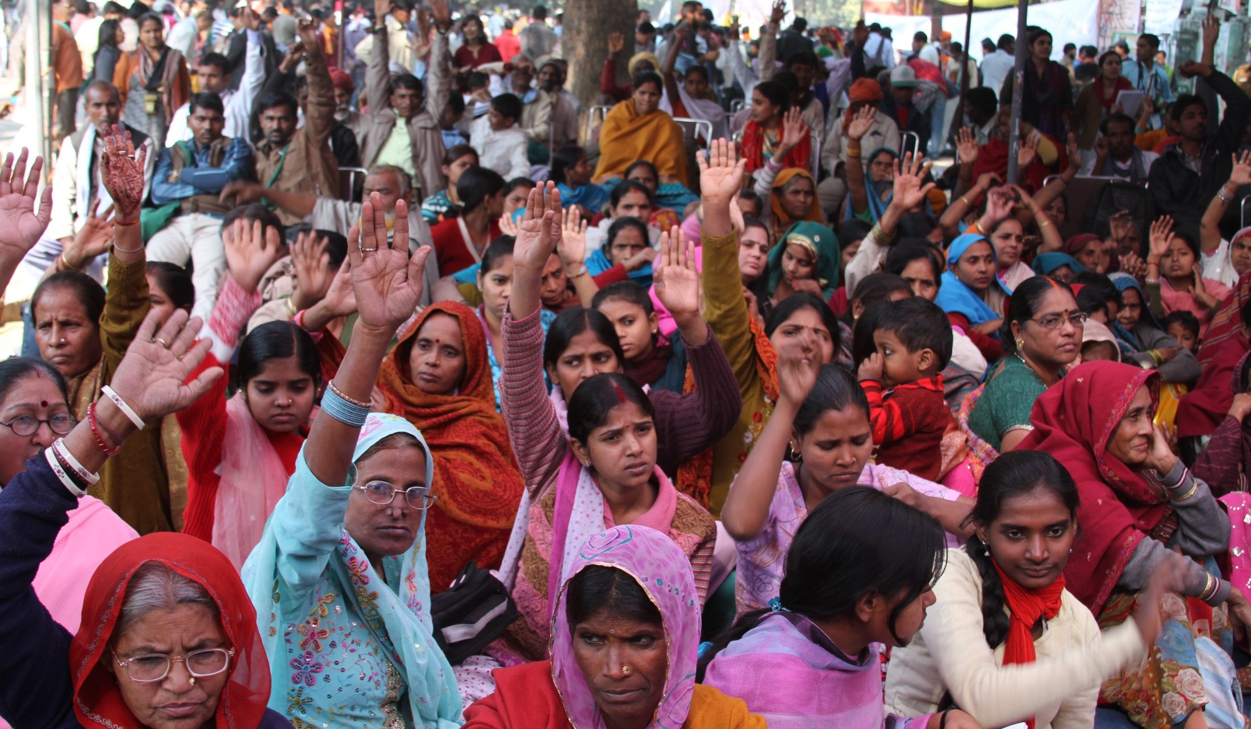
Satark Nagrik Sangathan
Accountability Tools

Slide 2
Satark Nagrik Sangathan (SNS)
Independent citizen’s group set up in 2003
Not affiliated to any political party
Aim: to promote transparency and accountability in governance
Strategy: build capacities of citizens to use their Right to Information to access their rights and entitlements from the government
Works mainly in slum communities in Delhi

Slide 3
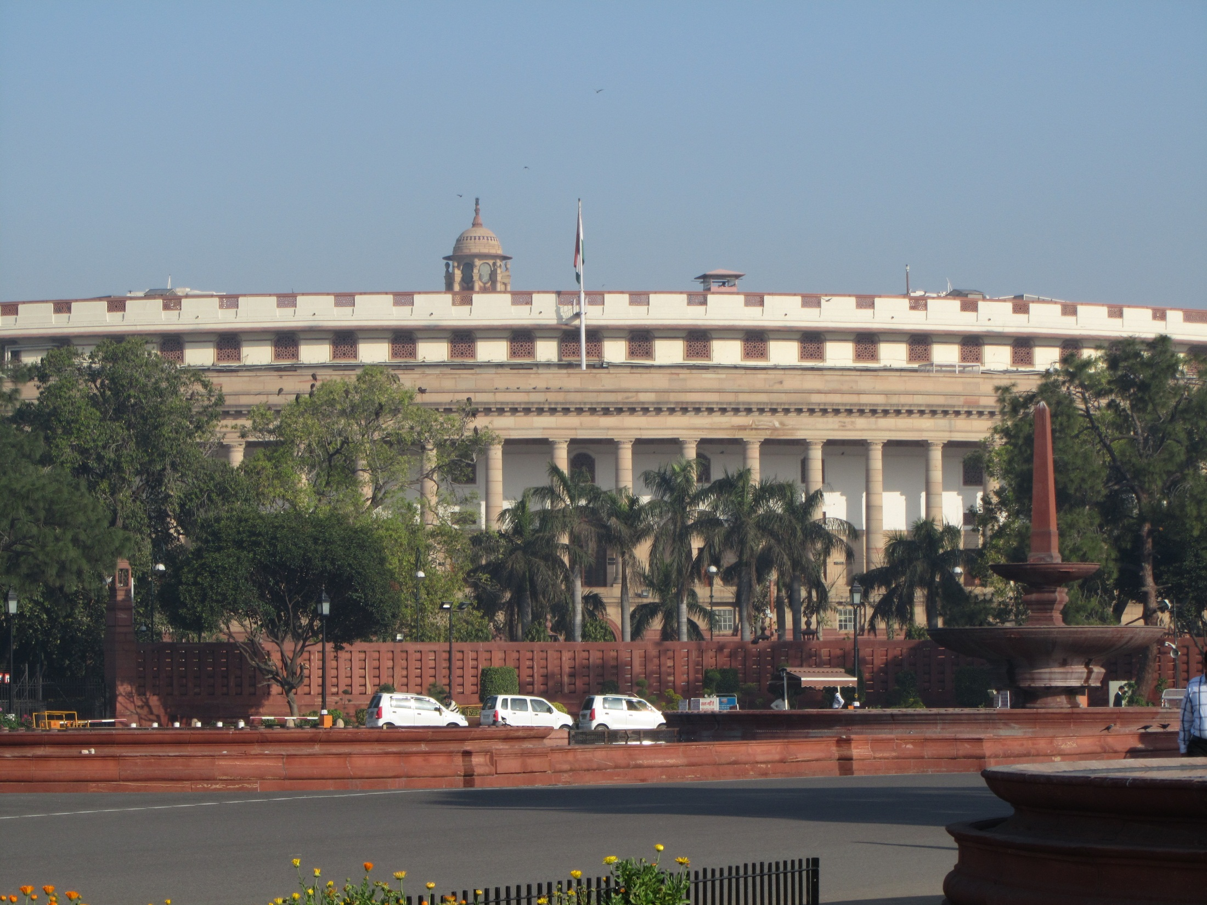
Accountability of elected representatives

Slide 4
Lack of information on elected representatives
Stated roles and functions of elected representatives not in public domain
No information on what elected representatives do once elected
No interaction with people once elected
Misinformation and rumors by politicians as a pre-election ploy to garner votes
Easy accessibility of elected representatives but no way to hold them accountable

Slide 5
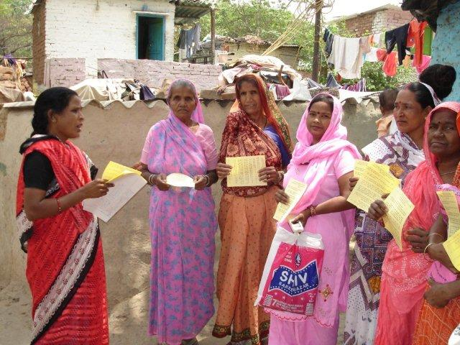
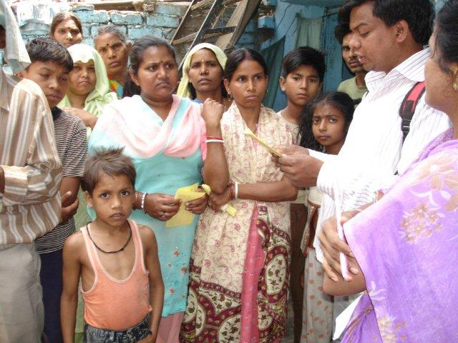
Awareness campaign in slums
Roles of elected representatives obtained from the Constitution, Representation of the People Act etc

Slide 6
Roles and responsibilities of elected representatives
As members of the Legislature/ Parliament
Deciding the allocation of discretionary development funds
As representatives of people on committees formed by the Government

Slide 7
Report Cards of Elected Representatives
Report Cards provided a snapshot of the performance of individual elected representative in relation to their roles:
  Attendance and participation in the Assembly/Parliament
  Allocation of Local Area Development Fund
  Participation in various government committees
  Transparency in the utilisation of Local Area Development Fund

Slide 8
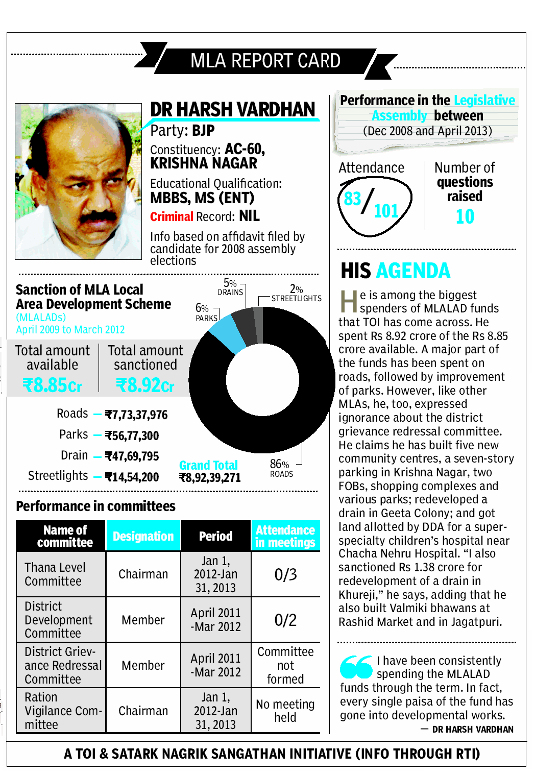
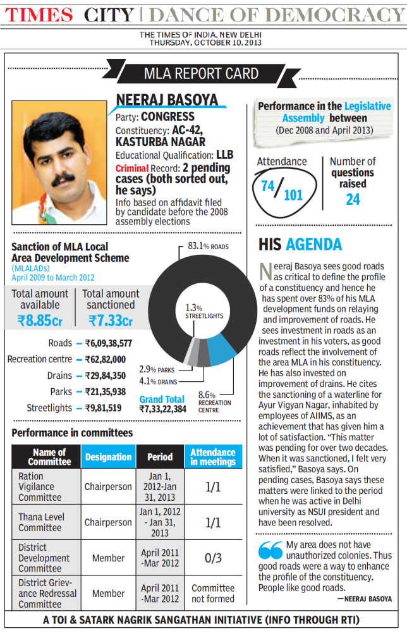
mla report cards
Notes:
As objective information on performance of individual ERs like the Report Cards had never been done before
Report Card campaigns done for:
Members of Parliament prior to the General Elections in May 2009
Members of the Legislative Assembly of Jharkhand prior to the Assembly polls in December 2009
Municipal Councillors of Delhi in May 2010 (mid-term report cards)
Members of the Legislative Assembly of Bihar in October 2010
MCD Councillor report cards in 2012

Slide 9
Delhi MLA Report Card in Hindustan
(Delhi 2008)

Slide 10
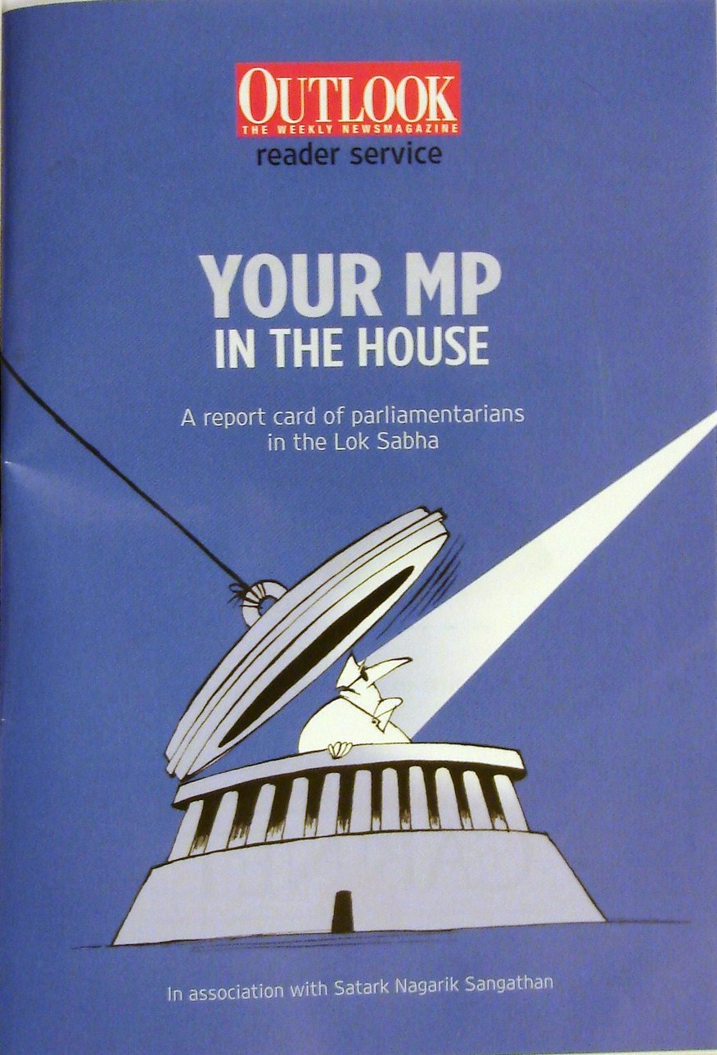
MP Report Card in Outlook
(May 2009)

Slide 11
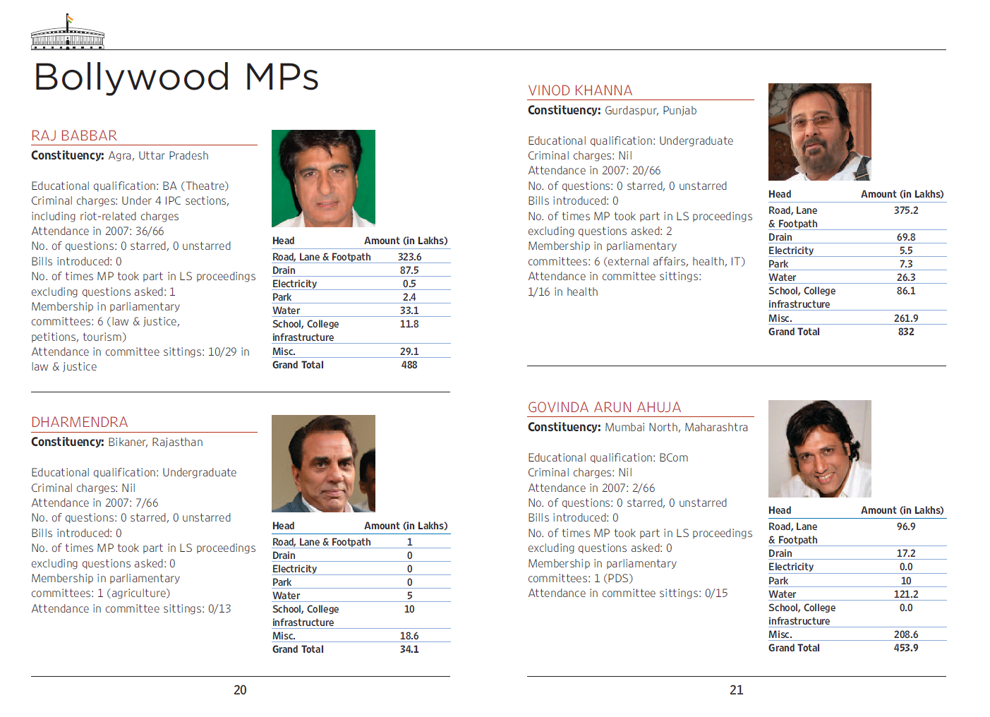

Slide 12
Report Cards of Elected Representatives
Report Card campaigns done for:
Members of Parliament prior to the General Elections in May 2009
Members of the Legislative Assembly of Jharkhand prior to the Assembly polls in December 2009
Municipal Councillors of Delhi in May 2010 (mid-term report cards)
Members of the Legislative Assembly of Bihar in October 2010
MCD Councillor report cards in 2012
Notes:
as objective information on performance of individual ERs like the Report Cards had never been done before

Slide 13
Performance of MLAs of Delhi
Between 2009-2013
22 meetings of the Delhi Legislative Assembly for less than 70 hours per year on average
17 MLAs never raised a question
0 out of 6 stipulated meetings of the Police Vigilance Committee held
0 District Grievance Redress Committees set up
28 constituencies with 0 meetings of the Ration Vigilance Committee

Slide 14
Impact
  Awareness creation about the role and relevance of elected representatives and the need to monitor their functioning
Tool for demanding accountability:
  Information used to engage with elected representatives and get development needs addressed
  Carry out social audit and file complaints about corruption/malpractices
Public pressure:
  Created pressure on ERs to improve their performance
Notes:
as objective information on performance of individual ERs like the Report Cards had never been done before

Slide 15
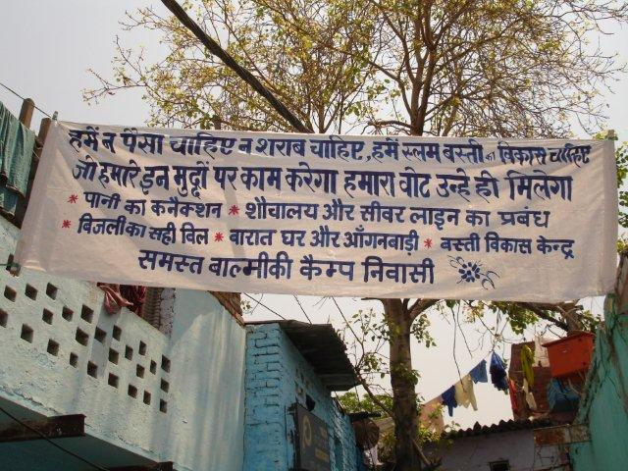
We don’t want money or alcohol, we want development for our slum. We will vote for the candidate who works for our development.

Slide 16
Proactive disclosure
Proactive disclosure:
  Public hearings held to demand proactive disclosure of information on roles and performance of elected representatives through websites, boards etc.
  Information on funds
  Information on the legislative assembly
Notes:
as objective information on performance of individual ERs like the Report Cards had never been done before

Slide 17
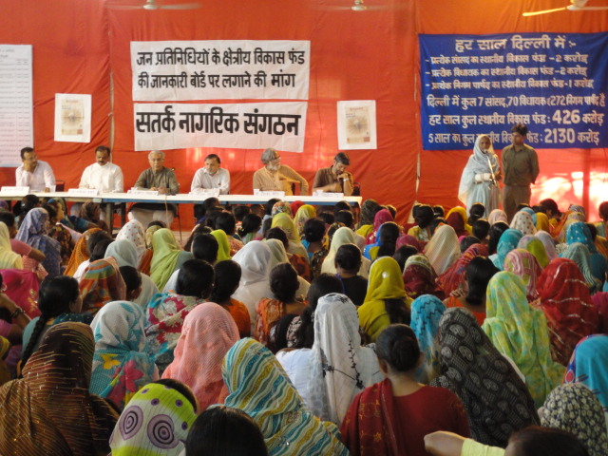
Jan Sunwai in September 2010

Slide 18
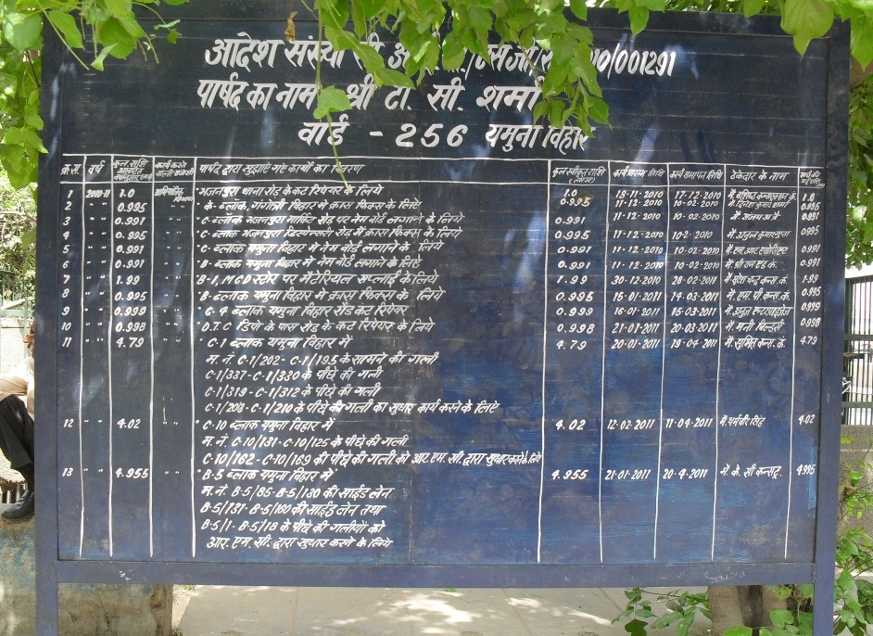
Board displaying details of LAD Funds

Slide 19
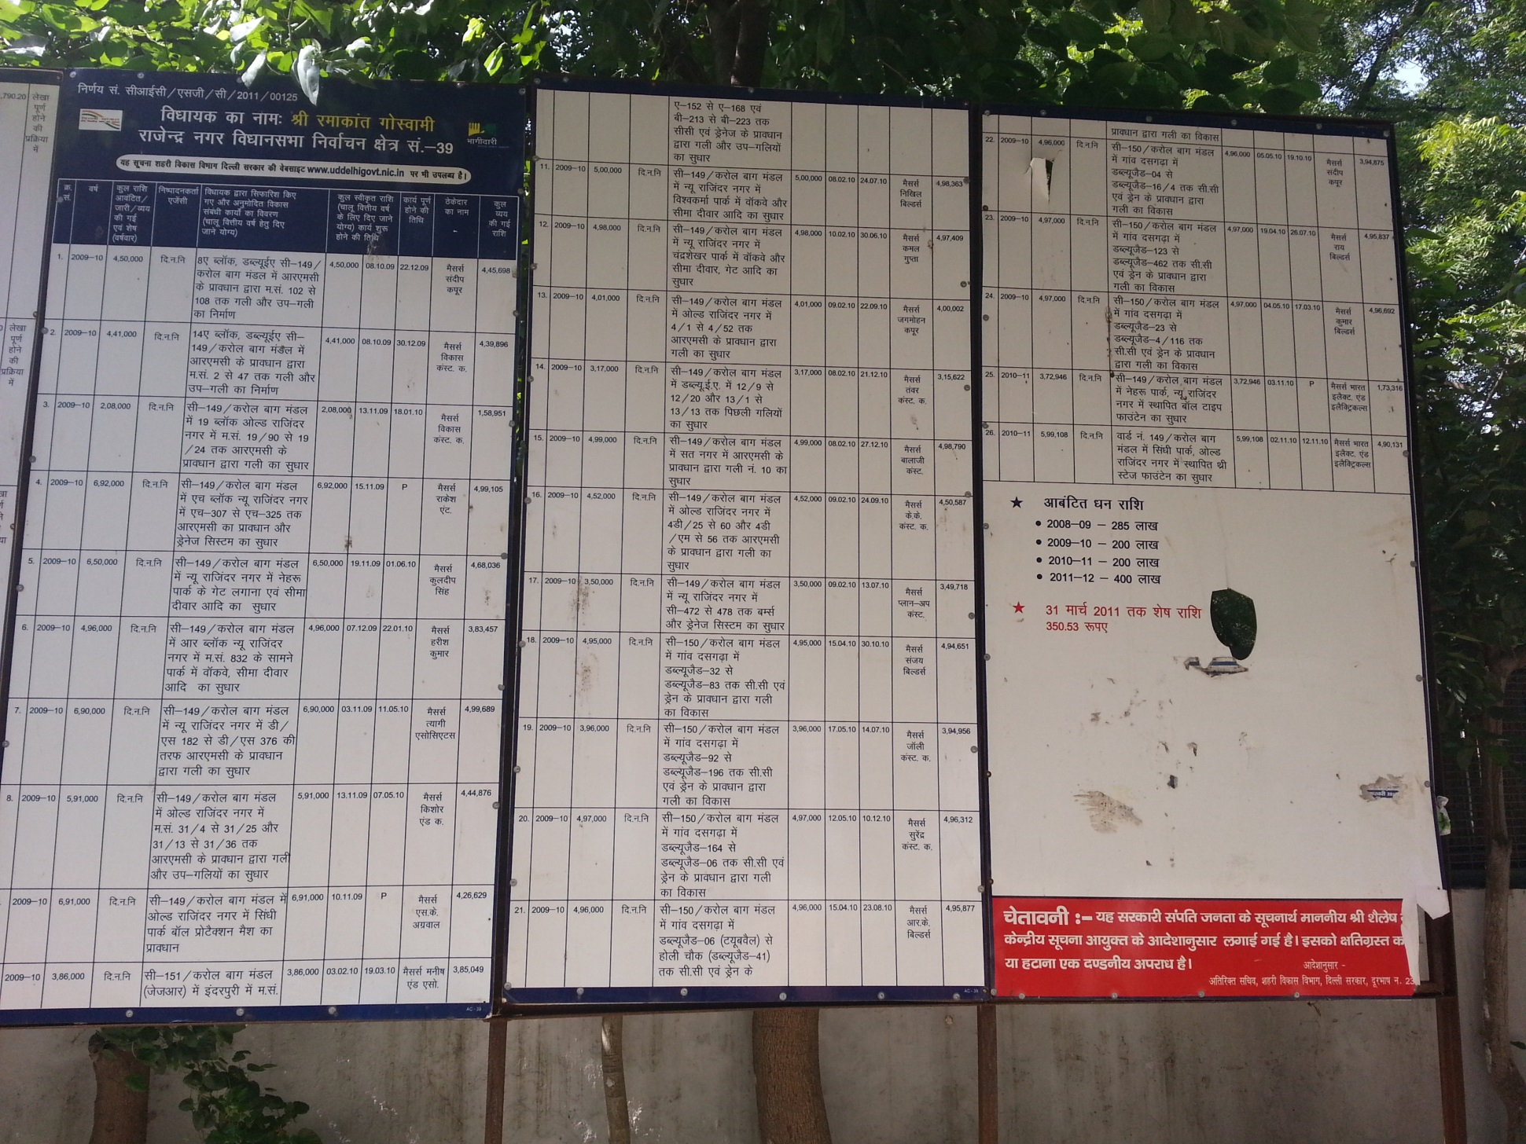
Board displaying details of LAD Funds

Slide 20
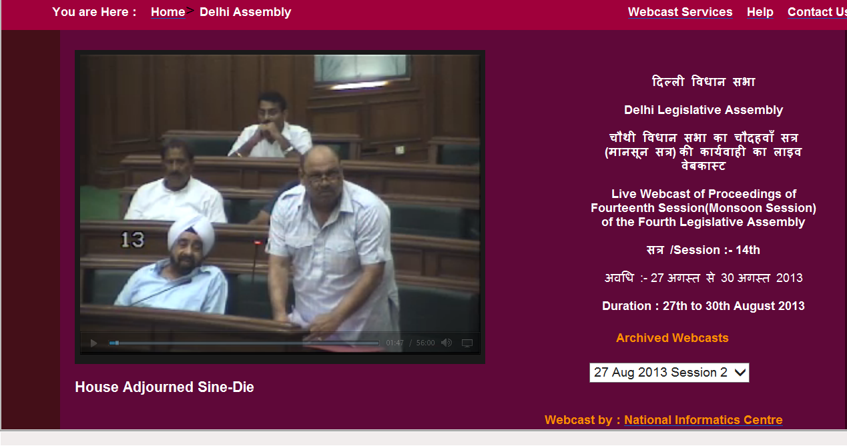
Live webcast of Delhi Assembly proceedings

Slide 21
Social Audit
Social audits of works done from local area development funds

Slide 22
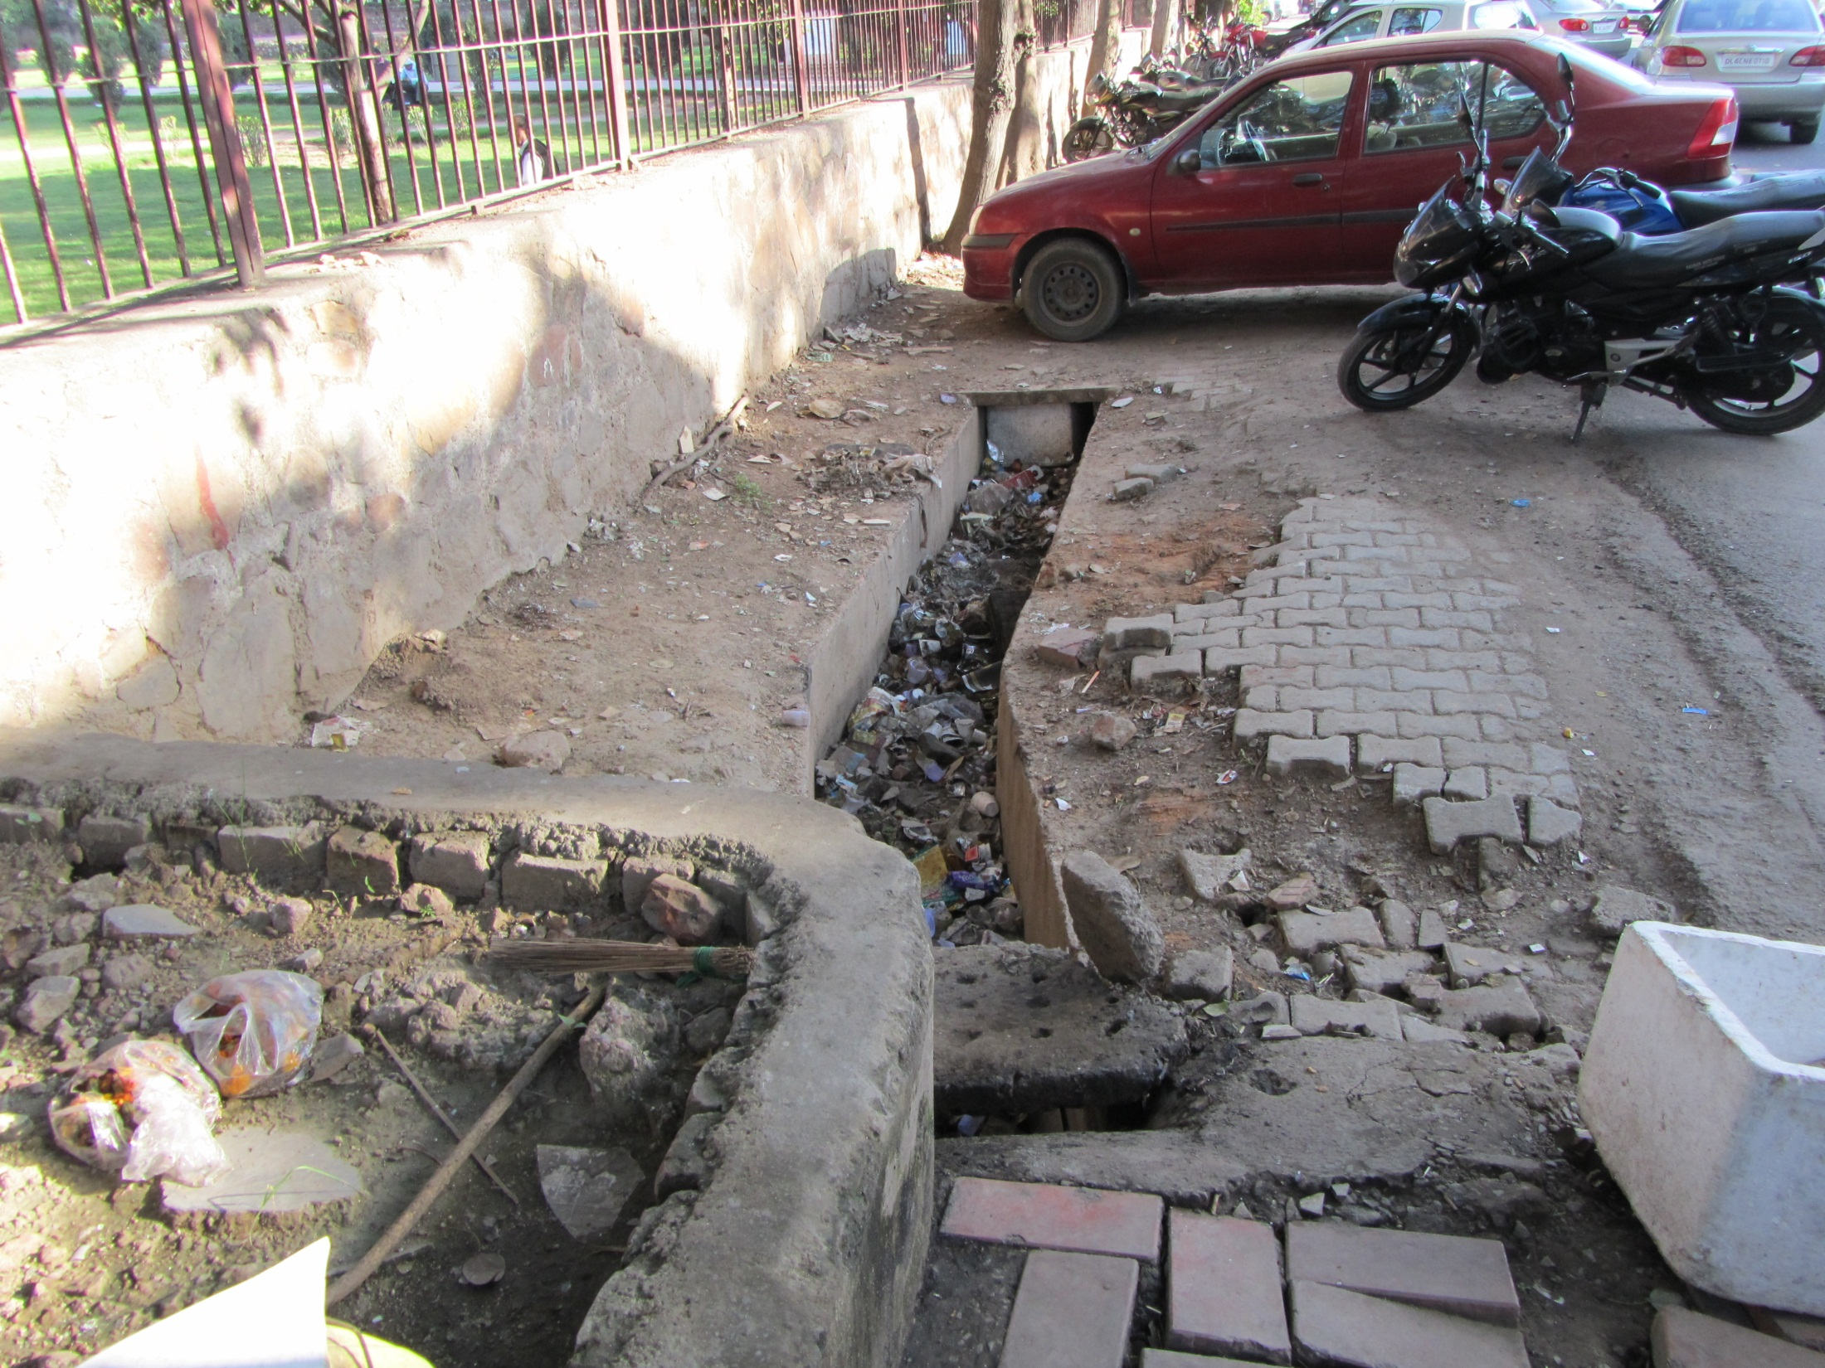
Reconstruction of drain near aggarwal timber store in corner market on Maharishi Dayanand Marg, Rs. 2 lakhs

Slide 23
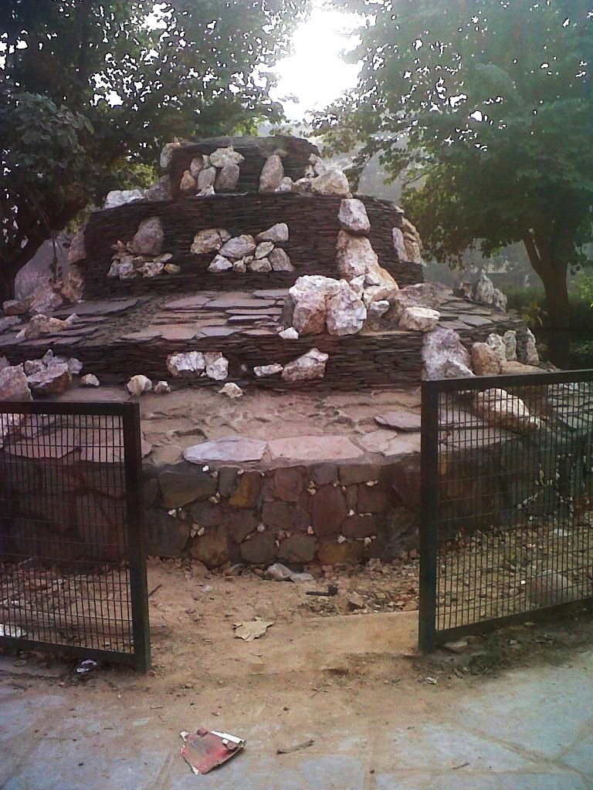
Fountain constructed using MLALADS

Slide 24
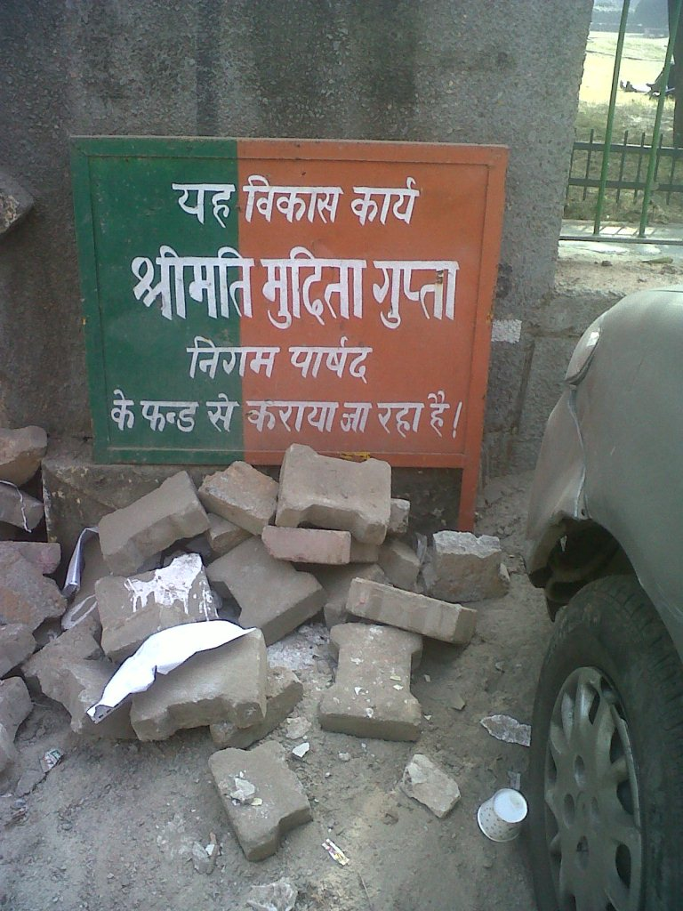
Pavement constructed from Development Funds

Slide 25
Satark Nagrik Sangathan
Facebook- www.facebook.com/SatarkNagrikSangathan
Website-
www.snsindia.org
Email-
satarknagriksangathan@gmail.com

