Slide 1
The Practicalities of Running Randomized Trials: Lecture 8: Measuring Empowerment, Social Desirability Bias and NonSurvey Instruments
Rachel Glennerster

Slide 2
Overview
Definitions
Challenges
Role of formative research
Decision making
NonSurvey Instruments
Conclusion

Slide 3
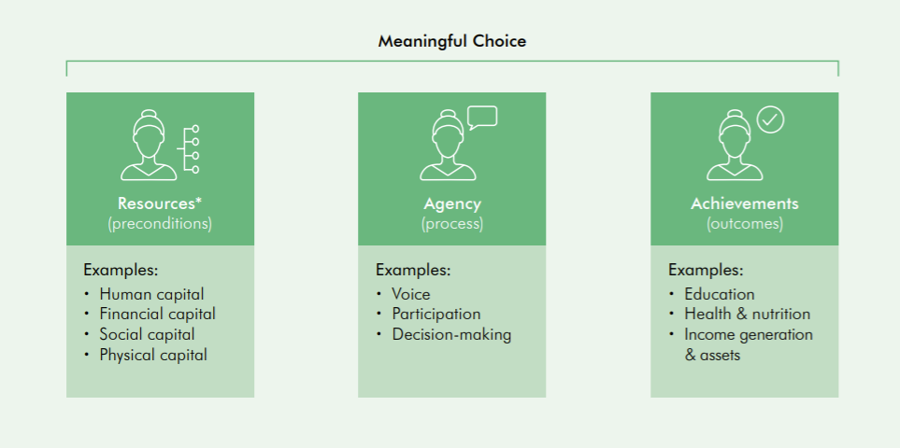
Common Definitions of Women’s Empowerment
Empowerment
“the process by which those who have been denied the ability to make strategic life choices acquire such an ability.”
Naila Kabeer, 1999
Agency
“someone who acts and brings about change, and whose achievements can be judged in terms of her own values and objectives.”
Amartya Sen, 1999

Slide 4
Challenges in measuring empowerment
Empowerment is about about meaningful choice, but we rarely observe decision-making directly
Measure final outcome
Ask people about decision making process
Compare gender preferences to changes in outcomes (Chattopadhyay and Duflo)
Ask about psychological aspects of agency
Observe choices directly
Empowerment is a process: not the final state but how she got there
Track steps along the way
Measure progress over time

Slide 5
Challenges in measuring empowerment
Many aspects of empowerment are susceptible to reporting bias
Triangulate from multiple measures
Frame as hypothetical, or ask about a more specific action
Observe directly
Empowerment means different things in different contexts, but we want to compare across contexts
Use both locally contextualized and internationally common indicators
Empowerment is relevant to many aspects of life, prioritizing outcome measures is difficult
Prioritize indicators more directly related to the program, policy or mechanism we are interested in
Measuring women’s preferences is challenging in contexts where women have internalized society’s views
Disempowerment can heighten data collection challenges

Slide 6
Q: is % of women working outside home a good measure of empowerment?
Less subject to reporting bias
Its an outcome not a process or a measure of choice
What if income of the HH fell and woman had to work, is that empowerment?
Do women want to work but not feel able to?
If so, an increase in working outside the home is an indicator of empowerment
But fewer working and more in college might also be an indicator of empowerment
What if they don’t want to work outside home but that reflects societal pressure to conform to stereotypes?

Slide 7
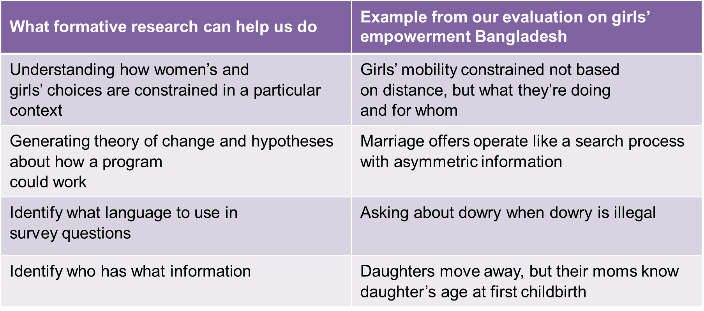
Role of Formative Research

Slide 8
Tips for measuring decision-making
Ask people about specific decision-making processes.
Did Alice/Bill go to school yesterday less subject to social desirability bias than “is it better for a boy to go to school than a girl”
For joint decisions, ask more than one person about the decision-making process.
Measure women’s and men’s preferences at baseline and track whether outcomes move in the direction of women’s preferences after the program. (eg women leaders study in India, Chattopadhayay and Duflo, 2004)
Measure the psychological components of agency: women’s ability to set goals in line with what they value and act on them.
Try to observe a choice directly or create a situation in which you can observe a choice.
Measure fundamental outcomes that might change with empowerment eg related to well-being.

Slide 9
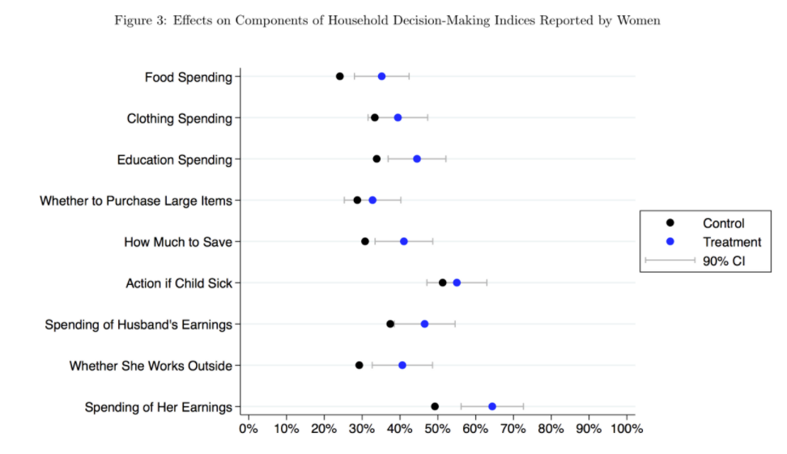
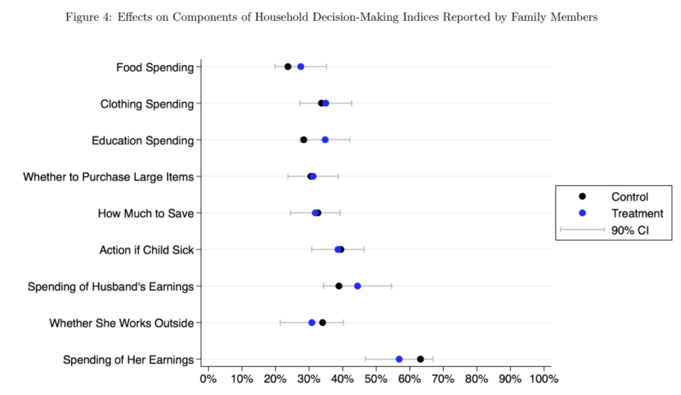
Women’s household decision making: who you ask matters
McKelway 2021

Slide 10
NonSurvey Instruments Help Address Social Desirability Bias
Observing what people do not want to say
Less prone to reporting bias and recall error
Reveals attitudes people may be unaware of
Tools commonly used to measure gender and empowerment
Experimental Vignettes
Games
Direct observation, structured community activities (more below)
Physical tests/biomarkers eg anthropometrics in Bangladesh
Purchase decisions

Slide 11
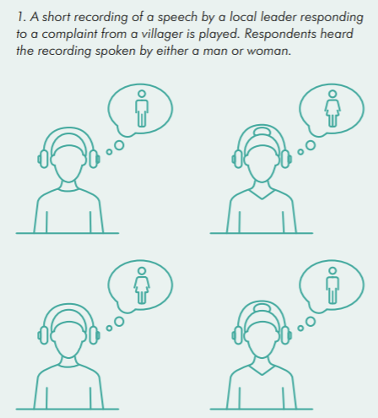
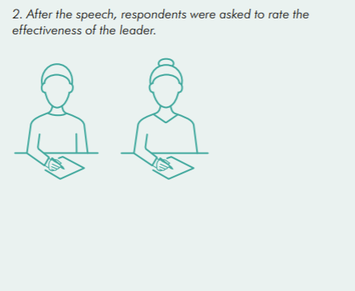
NonSurvey Instruments: Vignettes
Beaman et al 2012

Slide 12
Structured Community Activities: Sierra Leone
Evaluation of community driven development (CDD)
Communities given a grant to spend on local public goods they chose
Heavy facilitation on how to choose projects in an inclusive way, including women & youth
Program sought to change women’s involvement in community decisions
As part of endline, communities offered a choice of thank you gift, observed how choice was made
Did Village Chiefs make the decision without asking anyone? (to increase probability there was discussion we called a meeting before offering the gift)
Recorded how many women spoke, how long they spoke for, whether they were responded to
We can rule out that the program led to one more woman speaking
Complemented by survey questions on gender including:
whether woman in HH went to the last community meeting, whether spoke (all villages will have village meeting)
Participated in decision making in community farm (but not all villages had community farms)

Slide 13
Other NonSurvey Instruments in Sierra Leone CDD RCT
Match opportunity:
communities offered a chance to raise funds for a community project
Money they raised would be matched by us
They took money and match certificate to a local hardware store
store would contact us for the money to match thus easy to trace
Elite capture:
donated a tarp to all study villages
could be used for communal activity (roof for a community building, drying floor for drying grain without getting rocks and dust in the grain).
Could be used for private gain (make chiefs house more waterproof)
Return a few months later and see how being used (mainly it was not used as could not agree on how to use)

Slide 14
Conclusion
Women’s empowerment is hard but not impossible to measure well
Important to understand what aspects of their lives that, locally, women:
Have limited ability to influence
Want to change and/or could be meaningful to change
Which of these does the program or policy being evaluated actually have the potential to change
Investigate which of our topic areas are prone to social desirability bias (locally)
Measure the process of empowerment by tracking: resources, agency, outcomes/achievements
Complement standardized indicators with context-specific ones
Consider using non-survey instruments in addition to surveys

