Slide 1
The Practicalities of Running Randomized Trials: Lecture 7: Field Testing Indicators Measuring Education (Income, Consumption and Agriculture)
Rachel Glennerster

Slide 2
Overview
Piloting
Measurement in education
Enrollment
Student attendance (unconditional, or conditional on enrollment)
Student achievement
Teacher attendance
Teacher pedagogy
Income, consumption and agriculture (very brief)

Slide 3
Piloting surveys: objectives
Logistics:
Are people available?
How long does the survey take? How long does it take to get
Is the code working?
Can enumerators upload data each day?
Can enumerators understand the questions, know how to probe?
Are the skip patterns right? Q: what is a skip pattern?
Quality of questions:
Do people comprehend questions?
Do you have comprehensive dropdown lists (eg of occupation)
Is an outcome so common or so rare its not worth asking about
Are there answers you had not thought about, don’t fit into survey
Is there a better way to ask the question that feels more natural, is more specific, less abstract?

Slide 4
Measurement in Education
Drawing on slides and papers by Karthik Muralidharan and Abhijeet Singh, as well as Angrist et al 2021.

Slide 5
Education concepts frequently measured
Enrollment
Student attendance (unconditional, or conditional on enrollment)
Student achievement
Teacher attendance
Teacher pedagogy
Note, education interventions tend to collect data at school, but can use education questions in more general surveys

Slide 6
Collecting Student Enrollment and Attendance Data
Enrollment
Attendance
Data sources
From school registries or
Ministries of education
Household surveys (rare if doing ed RCT)
Challenges
Unreliable administrative data
Systems that pay schools per student enrolled
Collecting primary data on enrollment (rare)
Constructing census within catchment areas and verify enrollment against those records
Data sources
Household surveys
Surprise visits to classrooms to count the number of children present
Use school records of attendance during time of end-line testing
Attendance rate during end-line tests

Slide 7
What makes a good measure of learning outcomes?
Well-distributed measure of achievement
No ceiling or floor effects
Remember, many children are not “at grade” so “grade appropriate tests” likely to be problematic
Each item should map into a concrete skill that we want to test
Map out what you want to test before you start
Map to what the intervention you are testing is trying to move
Also measure learning that might have been displaced
Subset of items should be repeated across rounds for comparability
Subset of items should be drawn from other assessments
to allow for comparability across tests (although this could fail)

Slide 8
Frequently used Student Tests
 | ASER |  | EGRA/EGMA |  | TIMSS/PISA |  | Ravens
What is it? | Literacy and numeracy |  | Early grade lit and num |  | International subject |  | Test of cognition
 | Designed by Pratham |  | Developed owned by RTI |  | tests (TIMSS math/sc) |  | Owned by Pearson
 | for citizen led survey |  |  |  | PISA-15yr, TIMSS grade 4 & 8
How | Oral, 1:1 |  | Oral, 1:1 |  | Written |  | 1:1 or 1: many
Pros | Easy to use, fast, free |  | Widely used |  | High ceiling |  | Non-verbal
 | Many economists use |  | Linked to TIMSS/PISA |  | Used in multiple countries |  | Used from 5 to 105
 | Clear what is measured |  | Higher ceiling than ASER |  | Now PISA-D for MICs/LICs
 | Good at low levels |  | Good at low levels
Cons | Not linked to PISA/TIMSS |  | Propriatorial |  | High floor (bad for low attain) |  | Cognition not learning
 | Low ceiling, categorical |  |  |  | Can you compare across languages?
Reliability | Consistency across repeat |  | Test/retest reliability
test/retest | administrations 0.76 |  | 0.83 to 0.95

Slide 9
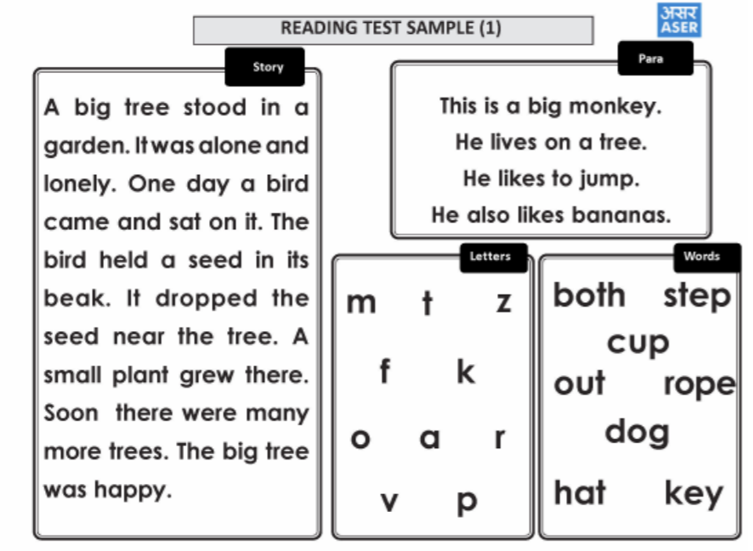
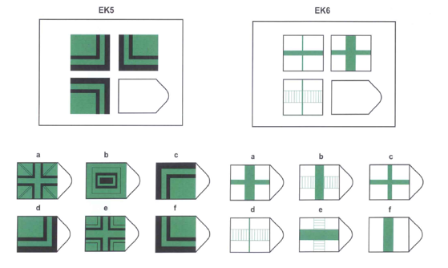
Examples of Tests
ASER reading test
Ravens test

Slide 10
How do you compare learning of different types?
Health has standardized measures to compare across health conditions:
Disability Adjusted Life Years (DALYs)
Based on peoples stated preferences of being blind vs dying early
Education compares learning gained compared to distribution of control in standard deviations
0.2SD is a decent improvement, moves a child from 50th percentile to 58th percentile
Q: what are some of the problems with using SDs to compare education outcomes across studies?
Attempt to create education equivalent to DALYs
Does it even make sense to compare across multiplication/division to addition to subtraction?
Time it takes a child in a high performing school system to learn a concept
Learning Adjusted Years of Schooling

Slide 11
Classroom Observations: Many Alternative Frameworks
Purpose: systematize observers’ perceptions of teacher quality
Examples:
Classroom Assessment Scoring System (CLASS), developed by Prof. Robert Pianta (University of Virginia)
Framework for Teaching (FfT), developed by Charlotte Danielson (The Danielson Group)
Mathematics Quality of Instruction (MQI), developed by Heather Hill (Harvard University)
Protocol for Language Arts Teaching Observation (PLATO), developed by Prof. Pam Grossman (Stanford University)
Stallings Observation System (SOS), developed by Jane Stallings (Stanford University)
Teaching As Leadership (TAL), developed by Stephen Farr (Teach for America)
Teach developed by World Bank

Slide 12
Income, Consumption, Agriculture

Slide 13
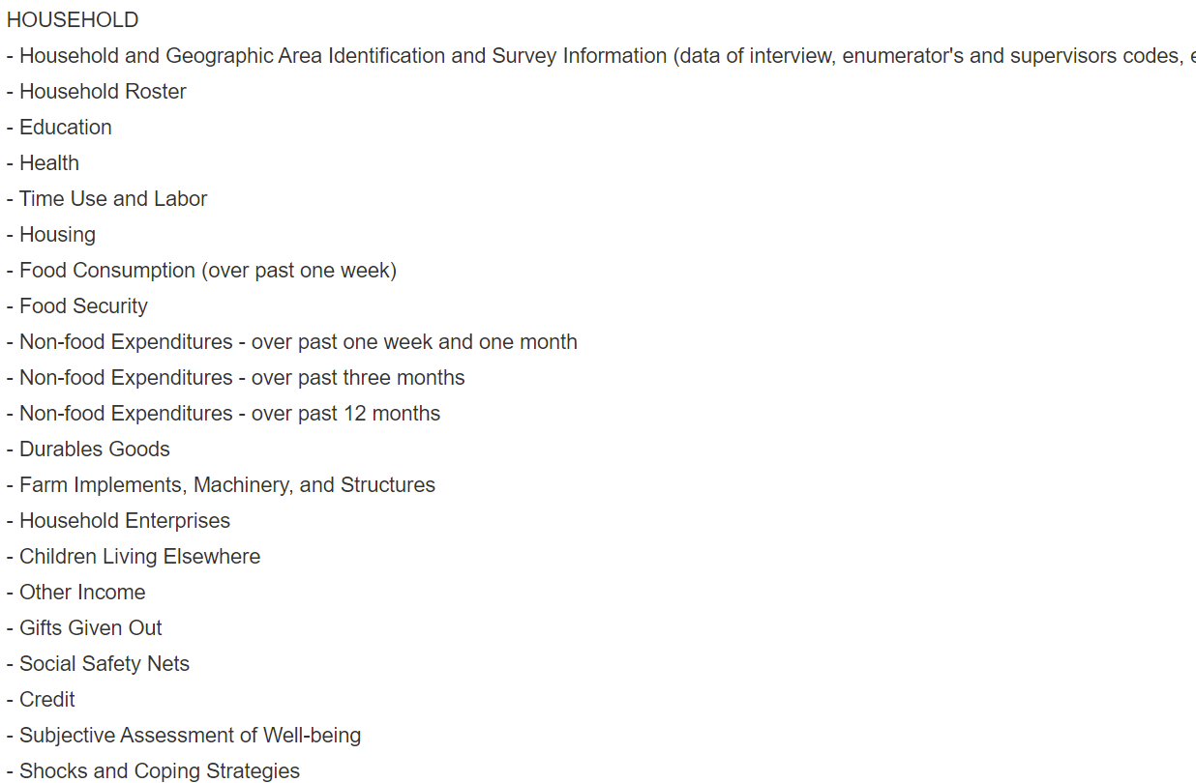
Consumption Needs to Be Comprehensive: Including Imputing
Usually measure consumption not income: covers gifts, loans etc
Measuring consumption can take 2-5 hours, over 1-2 days
Different consumption goods measured over different time periods
LSMS is good place to learn about measuring consumption with questionnaires for many countries
Impute value of goods consumed but not purchased—rental value of home ownership, home produced food
Wealth proxies easier and useful for heterogeneity analysis
Q: what are useful wealth proxies?
Living Standard Measurement Survey: World Bank
Malawi, Household Module
https://microdata.worldbank.org/index.php/catalog/lsms/about

Slide 14
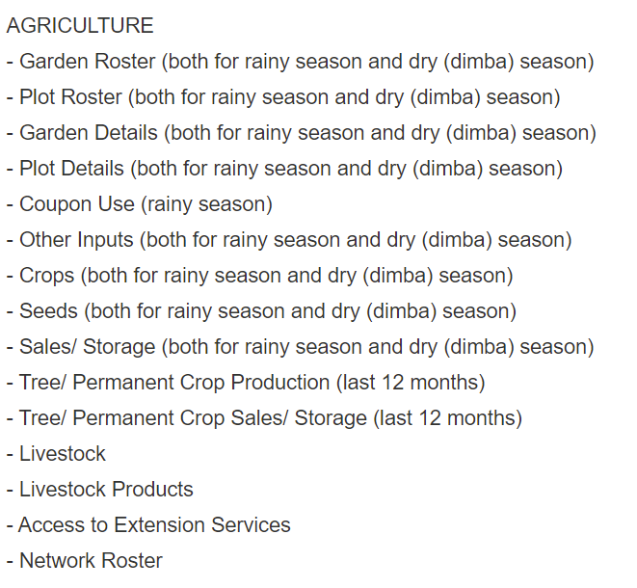
Agriculture
Often many different plots, need to ask separately about each, which crops, inputs, labor etc
One plot may grow different crops at different times
Increasing activity in one area may reduce in another (including change in off farm income), be comprehensive
Output of different crops measured in different units, units may mean different things in different places
Whether an approach is profitable may depend on weather that season

