Slide 1
The Practicalities of Running Randomized Trials:
Lecture 16: Generalizability
(plus concluding thoughts on meta analysis and cost-effectiveness)
Rachel Glennerster

Slide 2
Outline
Wrap up on meta analysis
Cost-effectiveness and cost benefit
Generalizability

Slide 3
Meta Analysis vs Literature Reviews
Meta analyses combine data from multiple studies in a formal analysis. Useful where intervention is the same/similar and outcome is standardized
  Almost always use transparent process to select studies for inclusion
  Better at estimating magnitude of effect for a specific intervention
  Transparent about how different pieces of evidence are weighted
Literature reviews compare results across papers in an area comparing results to theory but without combining data. Traditionally health does more meta analysis, econ more literature reviews.
  Better at drawing parallels between papers studying very different policies but which both support a single theory
  Ability to draw in different types of evidence (eg descriptive evidence and causal evidence)
  Often use judgement about what studies to include
Systematic reviews formal search process and criteria for paper inclusion can be use in meta analysis (standard) or literature reviews.
  Downside is reading hundreds of bad studies which is time consuming, good studies can just get lost if criteria are not carefully set and potentially create a psychological bias

Slide 4
Divergent findings from reviews of education in LICs and MICs
David Evans and Anna Popova 2016, compare results from different reviews of education in LICs and MICs
  Highlights challenges in systematically summarizing results from multiple studies
Patrick McEwan meta analysis of 77 RCTs in education concluded:
  Treatments with computers had largest impacts followed by teacher training and smaller class sizes
  Deworming and monetary grants smallest effects
  Effect of information not robust
  Insufficient data to conclude on relative cost-effectiveness
Krishnaratne et al systematic review for 3ie of RCTs and nonexperimental causal
  CCTs have strongest evidence of effectiveness. Count number of +ve studies in different categories
Kremer et al relative costeffectiveness of RCTs
  Child health (including deworming) and information on ed returns most cost-effective
  Changing pedagogy, including to teach at level of the child consistently effective
  Inputs (including class size and technology) on their own are not effective

Slide 5
What explains differences in the headlines?
Put all the authors in a room with policy makers and (most of us) would probably advise similar things
Evans & Popova highlight difference in studies included (RCTs vs not, those with costs vs not) but even within same studies draw different headline conclusions
Key difference adjusting for cost:
  CCTs have most significant studies but very expensive for education benefit
  Better to draw on CCTs as proof of concept that attendance is responsive to cost, then draw on other studies which test small changes in cost (free uniforms, varying CCT size) to show big impact of small changes in cost
How studies are categorized
  McEwan includes everything that has computers in computer category but many studies show giving computers has no effect but adaptive tech is effective. “Tech is good” unhelpful headline
  Studies that change pedagogy include teacher training, so put in “training” bucket but no studies showing training in standard pedagogy works
Learn more from grouping studies by underlying theory of change

Slide 6
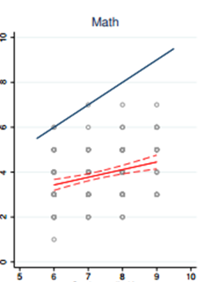
Descriptive data is important complement to interpreting causal results
Actual level of learning
Children’s learning in grade 9 ranges from grade 3-7
Grade enrolled in

Slide 7
Cost-effectiveness and cost-benefit analysis

Slide 8
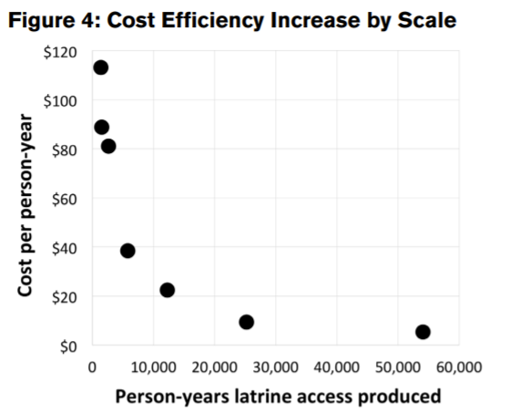
Definitions
Cost-efficiency
  Cost per service provided (eg cash transfer administered, year of latrine access
  Possible even when don’t have estimates of effectiveness
Cost-effectiveness: Q: what is it?
  Measures the amount of output for a given expenditure (how many additional years of schooling generated by a program for $100)
  Requires a causal estimate of effectiveness
Cost-benefit: Q: what is it?
  Ratio of costs vs monetary value of benefits
  Best presented as net present value of benefits

Slide 9
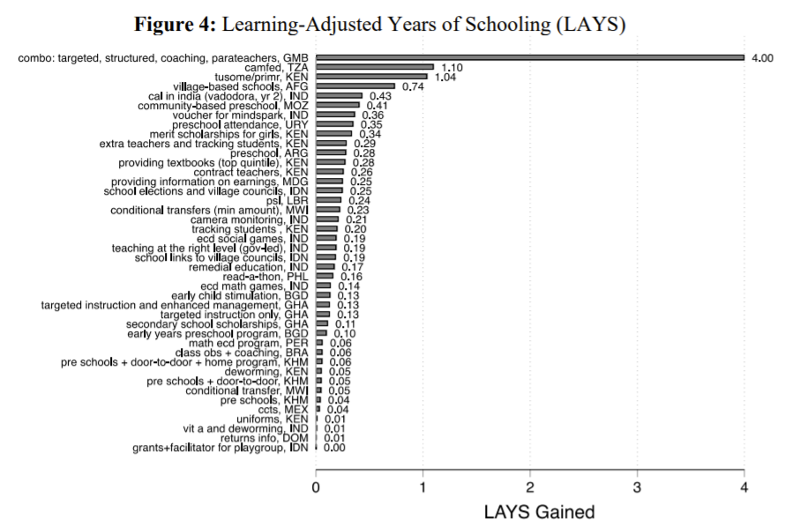
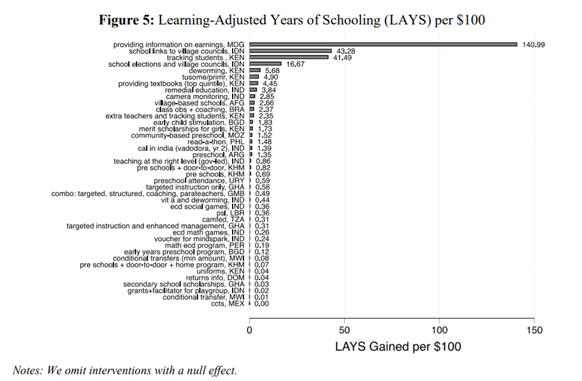
Why do cost-effectiveness and cost-benefit analysis?
Angrist et al 2021

Slide 10
Challenges in doing cost-effectiveness
Collect cost data at the time, always hard to recover costs after the event
Cost-effectiveness from whose perspective?
  To the government, ministry, society, donor?
  Answer influences choices on how to do the analysis eg whether to include participant time cost
Be comprehensive in measuring costs
  Participant and govt costs: eg increasing contraception use increases costs to govt
  Value donations, headquarter staff time (look at IRC and JPAL checklists)
Q: What exchange rate to use? PPP or market rate?
  PPP helps adjust goods basket across countries, but opportunity cost for donor requires market exchange rate

Slide 11
Challenges in doing cost-effectiveness
What discount rate to use? Depends on our question
  Trading off two programs different profile of benefits use Social Time Preference,
  different profile of costs use donors borrowing costs (note rarely makes much difference)
How do we treat transfers?
  Not an economic cost to society, but govts face budget constrains, could discount transfer by distortion cost of taxes
Is it valid to do comparative cost-effectiveness across countries? Q: What are the issues?
  Effectiveness may vary across countries
  Relative costs might vary a lot across countries
  Sensitivity analysis tell us what cost-effectiveness is sensitive to—eg population density
  Often relative cost-effectiveness is so different not very sensitive to different assumptions

Slide 12
Cost-benefit analysis
Cost-effectiveness is helpful for a Ministry of Health to know what to prioritize, does not help donor who wants to know what sector to prioritize or which program to fund across sectors
Cost-benefit puts all outcomes on same basis (usually money) to enable comparisons across outcomes
Challenge is valuing say life saved vs more autonomy for women
Reveal preference can be used to value (eg value of parks from house prices near parks, value of life from choices people make about risky jobs)
  Gives higher weight to preference of those with more money, not value of average person

Slide 13
Cost-benefit analysis
Where data on future income (eg case of education) this can be used to value good
  But assumes no intrinsic value
Good for making explicit assumptions which are otherwise implicit
But error bands around preference weights often swamp carefully estimated impacts
Try and include cost-effectiveness when cost data, only do cost-benefit when relatively simple assumptions

Slide 14
Generalizability

Slide 15
The Challenge of Using Evidence
Dramatic rise in the number of rigorous impact evaluations of policy programs in last 20 years
Unlikely to be rigorous evaluation of the program policy makers want to introduce in exactly same location
How should we respond?
  Wait to act until there is more evidence?
  Always do new RCT before introducing in new context?
  Only use less rigorous local evidence?
  Use results from study conducted in another context?
  Only use evidence from other countries if at least X replications or if replicated in a similar enough context?
What counts as a “new” or “similar” context?

Slide 16
The Challenge of Using Evidence II
Rigorous impact evaluations are hard to do well and we underutilize their potential if we only learn about the precise program and context they evaluate
But understanding local needs, and informal and formal institutions is critical to good policy
We should do more replications of RCTs of similar programs in different contexts but there are limits
Policy makers never have 100% certainty
  Basu (2014) tomorrow is a new context
  Is imperfect evidence likely to be worse than no global evidence?

Slide 17
Structured Approach to Using Evidence
Evidence from single study just one part of the puzzle
  We weigh the evidence based on quality and adjust priors
Combine, theory, descriptive evidence, and results of rigorous impact evaluations to answer:
  Whether results from one country likely to replicate in another
  When we need more evaluation and when we don’t
Draw on a theory based review of 70+ RCTs on health econ in dev countries (Kremer and Glennerster, 2012)
Uses framework set out in Bates and Glennerster

Slide 18
Immunization in India
Seva Mandir program to increase immunization rates in rural Rajasthan, tested with RCT
  Banerjee, Duflo, Glennerster, Kothari, 2010
Fixing supply: regular monthly immunization camps with nurse present without fail
Incentive: 1kg dahl for every vaccination, set of plates on completed immunization schedule

Slide 19
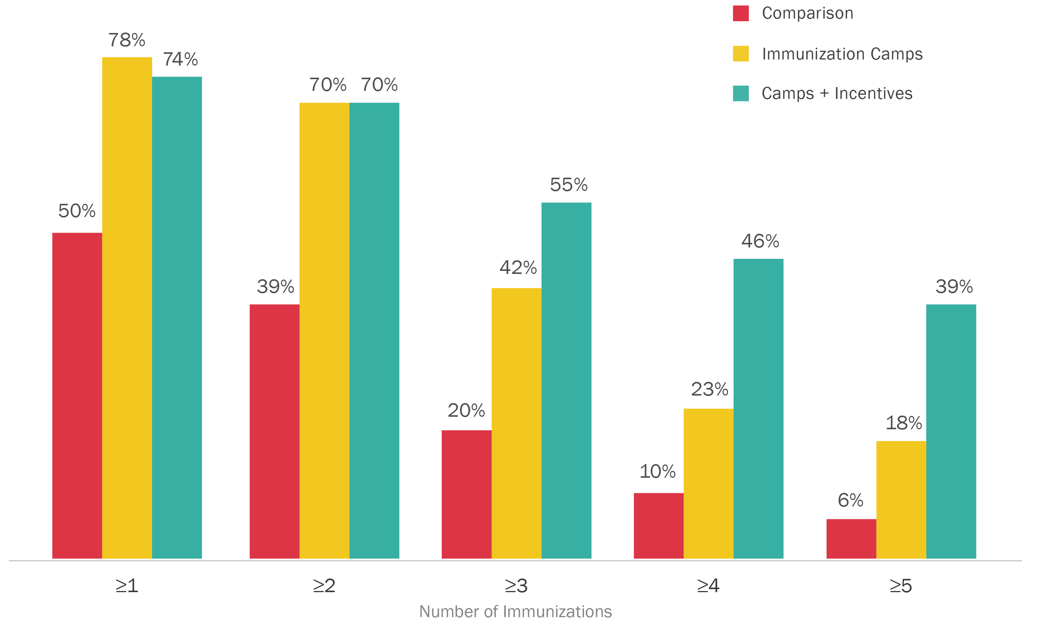
Number of Immunizations per Child

Slide 20

Viewing Evidence in Isolation
If Govt in West Africa wanted to improved immunization rate, should they consider noncash incentives?
Taking the evidence in isolation, how many times has the following been tested?
Only one RCT in South Asia not Africa
Program conducted by NGO not government
Providing small food incentives linked to vaccines
Increase in immunization rates

Slide 21

Parents want to vaccinate.
Parents can access clinic
Provider presence is sufficient.
Full immunization schedule is salient.
Minimal risk from over-vaccination.
People fail to persist with preventative health.
People are highly sensitive to price of preventative health.
Incentives get to clinics.
Incentives delivered to parents.

Slide 22
Descriptive Local Evidence Informs our Hypothesis of Local Drivers
Descriptive evidence:
  54% of households within 1 hour walk of clinic
  Health worker absenteeism 44%
  84% of children receive DPT1
Institutional knowledge:
  unlike India, clinics often have multiple workers, only closed 12%. Immunizations on specific days when absenteeism is lower

Slide 23
Generalized Evidence: People Suffer from Present Bias
People procrastinate and find hard to stick with behavior they believe is good for them and their children
  Good theoretical work showing how small changes to a standard discounting model produces series of testable conclusions and can explain many stylized facts (e.g. Laibson, 1997)
  People are willing to pay to tie their own hands with commitment savings products: difficult to explain unless people know they are present biased (e.g. Gine et al. 2010)

Slide 24
Small Incentives Have Large Effects
Small incentives can have big impacts on behavior
30+ RCTs of CCTs but usually much bigger incentives (Fiszbein and Schady, 2009)
Malawi: smaller CCT same impact as bigger CCT (Baird et al 2010)
Small incentives for HIV testing (Thornton 2008 Malawi), age of marriage (Field et al, in progress Bangladesh)
Note: recently more evidence on small incentives

Slide 25
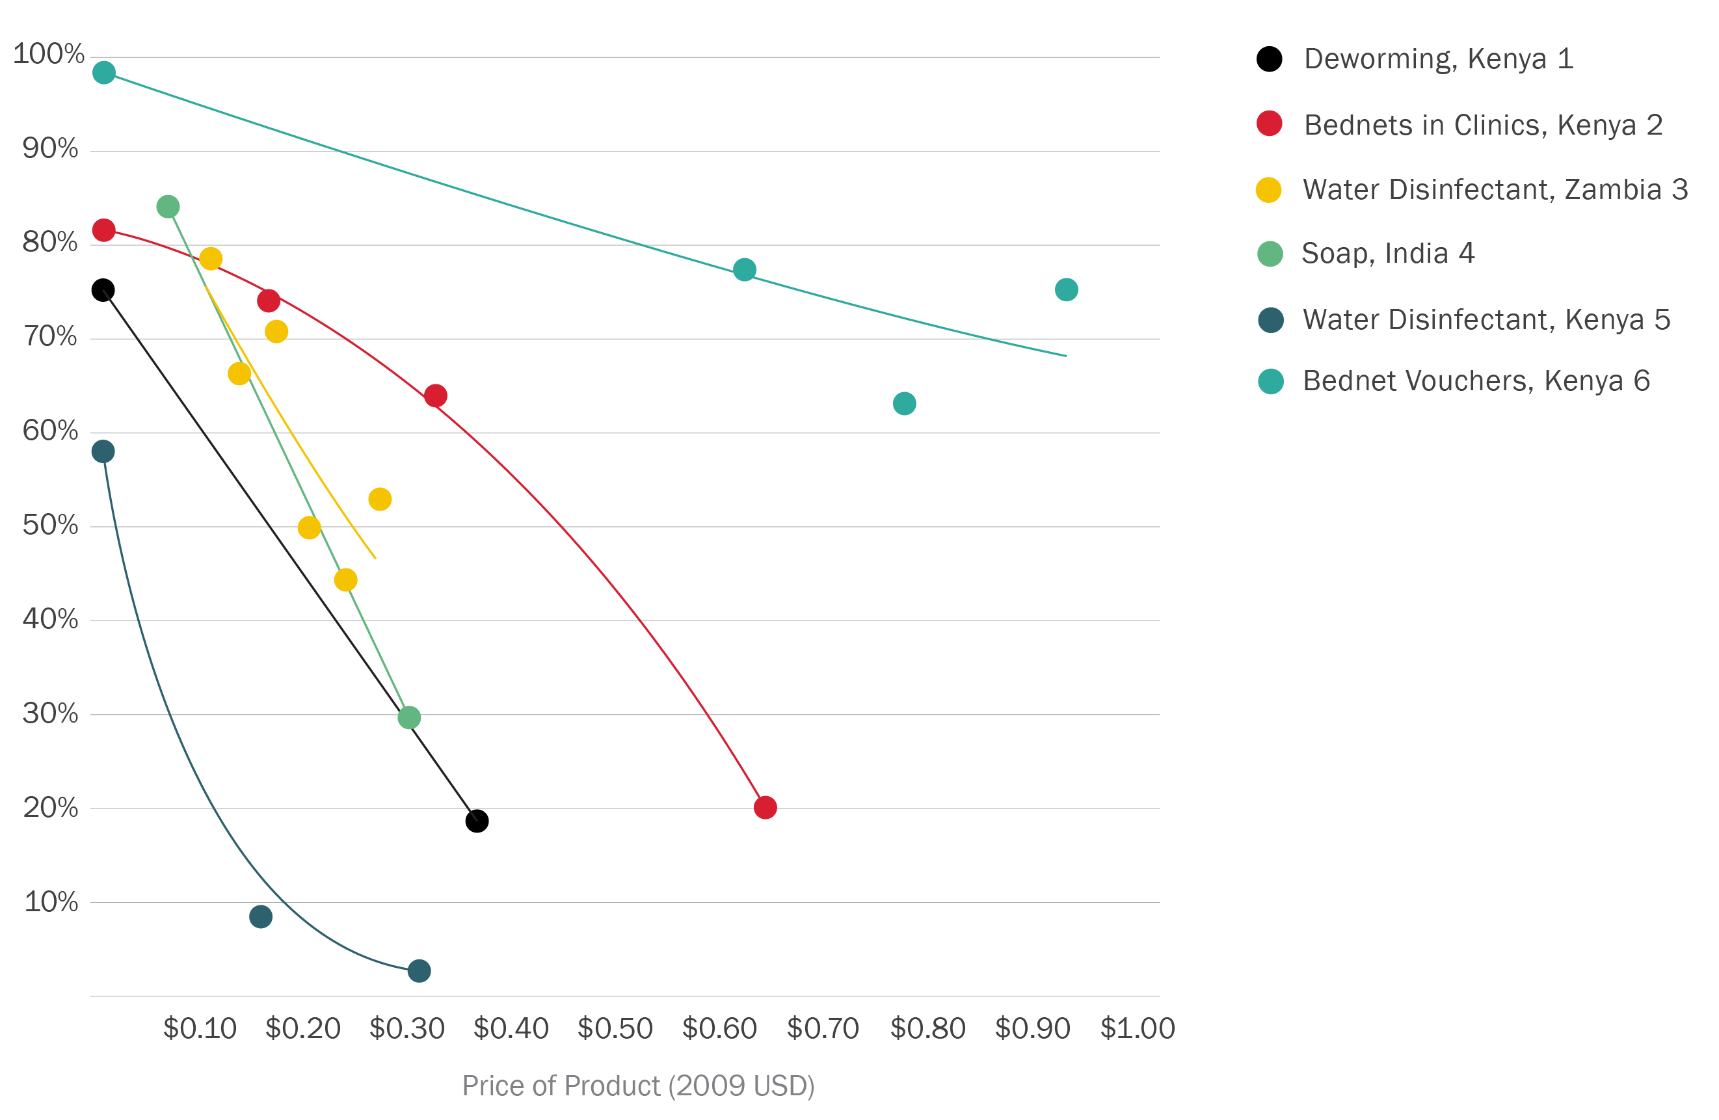
Price Sensitivity of Preventative Health
Source: Kremer and Miguel 2007, Ashraf et al 2010, Spears 2010, Dupas et al in process, & Dupas 2013. All as summarized in J-PAL Policy Bulletin. 2011..

Slide 26
Price Sensitivity Suggests Behavioral Bias
$142
$142
BENEFIT
COST
Source: Kremer and Glennerster, 2010 & Baird et al, ongoing,

Slide 27
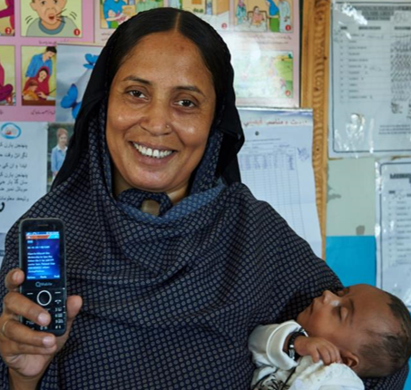


Local Implementation Methods will Vary
Pakistan and India
This is where the switch from reliable NGO to government delivery will be critical
Result with a government might be different than with NGO, should we do an RCT?
What other information, evidence might be useful?
Would be good to have more evidence on how to improve incentives for effective delivery within government
Kenya
Gibson et al 2017
Chandir et al, under review
Banerjee et al, 2021
Sierra Leone
World food program, J-PAL Africa

Slide 28
Parents want to vaccinate.
Parents can access clinic
Provider presence is sufficient.
Full immunization schedule is salient.
Minimal risk from over-vaccination.
People fail to persist with preventative health.
People are highly sensitive to price of preventative health.
Incentives get to clinics.
Incentives delivered to parents.

Slide 29
Conclusion on Generalizability
Does evidence from RCTs replicate to new context? Too big a question, need to break it down
  What is the theory of change behind the RCT?
  Do the local conditions hold for that theory to apply
  How strong is the evidence for the general behavioral change
  What is the evidence that the implementation process can be carried out well?

Slide 30
Conclusion on Generalizability
If we have enough evidence to act, do we have enough evidence to stop evaluating impact? (always monitor)
  we often need to act even when evidence is thin
Often big overlap between when have enough evidence to launch big new initiative and when still worth evaluating
  Questions may remain about best way to implement
Trade off of between evidence in new areas, vs more on improving evidence on refining a program

