Slide 1
The Practicalities of Running Randomized Trials: Lecture 14: PreAnalysis Plans and Cost-Effectiveness
Rachel Glennerster

Slide 2
Overview
Replication crisis?
Possible causes and evidence
Preregistration
Preanalysis plans
When to do one, when not to
Cost-effectiveness vs cost benefit

Slide 3
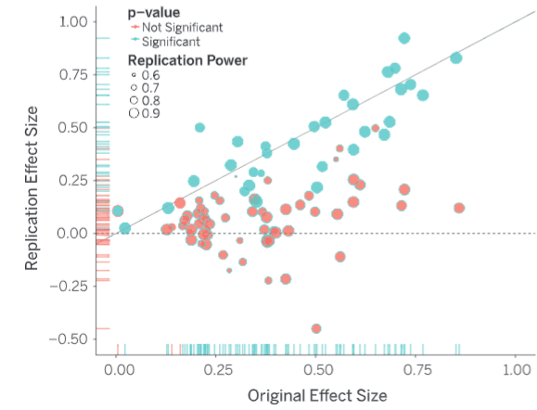
Replication crisis (?)
Concern about failure to be able to replicate studies in psychology and bias in medical studies
Open Science Collaboration 2015 sought to replicate 100 papers from top psych journals. Mean effect of replications was half that of originals
Medical studies funded by for profit sources more likely to have +ve effects than nonprofit research
Several possible explanations
Fraud
Replication misses key details, not enough information in initial study
File draw problem: Q what is it?
A. Studies with significant effects more likely to be published
P-hacking: A. pick specification or subgroup with sign effect

Slide 4
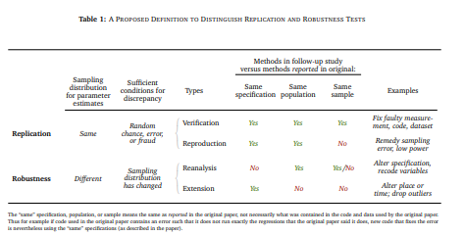
What do we mean by “failure to replicate”
Replication
Same data, same specification, different result
Eg error in code
Same data, same specification, cant replicate because not enough information
Robustness
Same data, different specification (not robust)
Generalizability
Same specification, different location
Replication (in psych) or generalizability?
Same specification, same location, different sample
Can we be sure the intervention is the same?
Clemens, 2015

Slide 5
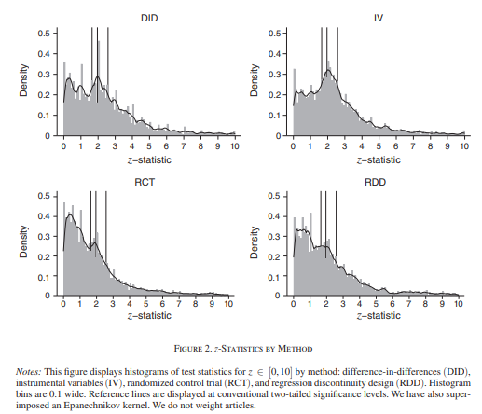
Is there a replication crisis in economics? Or econ RCTs?
Distribution of significance levels by method in top econ papers (less bunching in RCTs, Brodeur et al 2020)
Olken calculates even for non RCTs, only a few papers would need to be manipulated small amount to get this result—instead of rejecting null in 95% of cases (where null is correct) we are rejecting it in 92.75% of cases)
Simonsohn suggests Brodeur test only picks up small manipulations, not publishing the arms that work
Not enough info to replicate (Chang and Li 2015)
only able to “successfully replicate the qualitative findings from 22 of 67 (33%) macroecon papers without contacting authors, replicate 29 of 59 papers (49%) with assistance from the authors.
Brodeur et al 2020

Slide 6
Is there a replication crisis in economics? Or econ RCTs?
To measure publication bias need to know the number of projects started. Franko et al (2014) use applications to Time-sharing Experiments in the Social Sciences (TESS), where authors apply to run survey experiments and see how many get published:
only 48% of the completed studies had been published (contacted other authors)
of studies with null results, just 20% had appeared in a journal, and 65% had not even been written up.
Roughly 60% of studies with strong results had been published.
High-profile arguments about whether there were mistakes in data or analysis and the extent to which the conclusion of several important economics studies should be revised including (in chronological order), Hoxby 2000 (comment Rothstein 2005; and response Hoxby 2007); Donohue and Levitt 2001 (comments Foote and Goetz 2005; and response Donohue and Levitt 2006); Reinhart and Rogoff 2010 (comment Hurndon, Ash, and Pollin 2013; and response Rogoff 2013); and Miguel and Kremer 2004 (comment Davey et al. 2015; and response Hicks, Kremer, and Miguel 2015).

Slide 7
Biases in replication studies
Some of the same incentives original researchers have to find a significant result is also there for replication researchers to find a study does not replicate. In some ways incentives are worse
Specification search (phacking):
if a large number of different specifications are tried in an attempt to test the “robustness” of a result, selective presentation of a few of these specifications may give a misleading impression of how robust the results are;
Publication bias in replication studies:
authors may pursue publication only when they find a study does not replicate, giving a misleading impression of the overall reliability of a broad body of research;
Small sample sizes: failure to distinguish between don’t find a significant result and “cant distinguish from zero or from the original coefficient magnitude” (Simonsohn)
the statistics involved in replication or reproducibility is not straightforward and there is no single agreed standard to judge whether a reanalysis or replication “fails to replicate” the original study
3ie efforts to run replication in development economics ran into some of these problems

Slide 8
Responses to lack of transparency in RCT research
File draw problem
Specification search, p-hacking
Ex-post replication or reproducibility (coding errors, checking for fraud)
Similar results found in new samples
Register that you are doing a study
https://www.socialscienceregistry.org/
https://clinicaltrials.gov/ (required for medical journals)
Pre-analysis plans, theory, machine learning tools
Data access/data publication, publication of code, replication of code prior to publication
See lecture on generalizability

Slide 9
Timing of registration and preanalysis plans
Registration of study should be done before program starts (ideally prior to randomization)
Primary outcome usually specified in registration
PreAnalysis plan usually done during study, before second round data or endline data collected
Some reviewers worry that authors are already learning something when observe the experiment so PAPs should be done before study starts
But, we learn a lot to make PAP better, eg which baseline variables had no variation, possible unintended consequences to test for.
Remember we are only trying to rule out correlations that happen by accident that author might exploit to “find” a result that is not really there
Researchers might observe a chance event they could use to get a result, but highly unlikely
PreAnalysis plan can include a plan to look at control data or data without T identifier prior to finalizing plan (but best to write the basic plan before this and prespecify this step and how it will work)
Much of this step has been overtaken by ML tools

Slide 10
What goes into a preanalysis plan?
Specify primary outcome and secondary outcomes (helps with multiple hypothesis testing).
Be specific eg Fully Immunized Child vs “immunization rate”
Define variables—including what indicators will be contained in an index or family
Specify rules for including/excluding data or observations
Outcomes will be top coded at 1% level, or age 999 is an error (or mixed up with code for missing)
Identify specific regression specifications and statistical test
Machine learning tools? Will income be in logs? One sided test?
Subgroups to be studied
Will control data be used to define specifications, or all data without treatment variables be looked at prior to finalizing preanalysis plan?
Archive it with a data time stamp (possible with AEA registry/socialscienceregistry.org)

Slide 11
Pros and cons of doing a PAP
Pros
Reduces chance of being accused of p-hacking, or subgroup analysis as purely by chance
Provides a basis for doing multiple hypothesis testing
Required to be taken seriously in health and some parts of political science
Note health PAPs are in general less detailed, more like our preregistration (outside FDA trials)
Useful for setting parameters for what counts as success with partners
Cons
We are committing not to learn from data on some variables/subgroups (except in exploratory way)
Extremely hard to do well when multiple arms (requires decision tree for each combination of results)
Very easy to make a mistake or not anticipate possibilities
Makes for a boring paper if you follow the plan exactly (NB write your paper as though no PAP)
When do to a PAP (increasing backlash and alternative tools in econ, so not obvious you should)
When multiple outcomes with no obvious hierarchy
When clear idea of subgroups want to test but worry that wont be obvious expost
When you have time to really think though

Slide 12
Cost-effectiveness and cost-benefit analysis

Slide 13
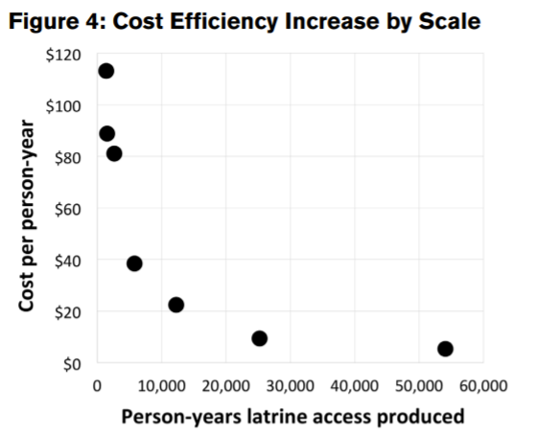
Definitions
Cost-efficiency
Cost per service provided (eg cash transfer administered, year of latrine access
Possible even when don’t have estimates of effectiveness
Cost-effectiveness: Q: what is it?
Measures the amount of output for a given expenditure (how many additional years of schooling generated by a program for $100)
Requires a causal estimate of effectiveness
Cost-benefit: Q: what is it?
Ratio of costs vs monetary value of benefits
Best presented as net present value of benefits

Slide 14
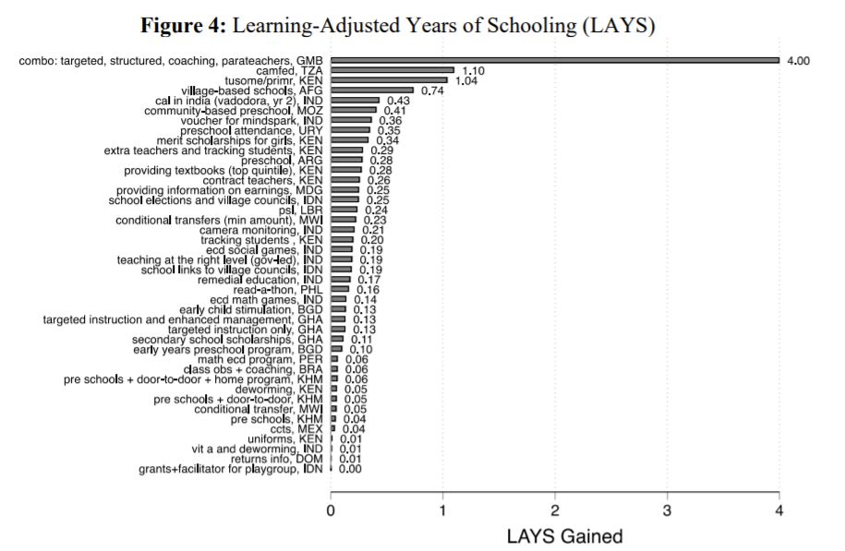
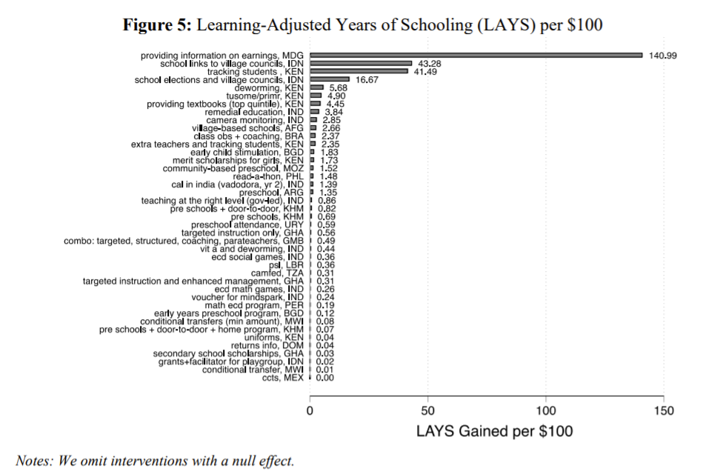
Why do cost-effectiveness and cost-benefit analysis?
Angrist et al 2021

Slide 15
Challenges in doing cost-effectiveness
Collect cost data at the time, always hard to recover costs after the event
Cost-effectiveness from whose perspective?
To the government, ministry, society, donor?
Answer influences choices on how to do the analysis eg whether to include participant time cost
Be comprehensive in measuring costs
Participant and govt costs: eg increasing contraception use increases costs to govt
Value donations, headquarter staff time (look at IRC and JPAL checklists)
Q: What exchange rate to use? PPP or market rate?
PPP helps adjust goods basket across countries, but opportunity cost for donor requires market exchange rate

Slide 16
Challenges in doing cost-effectiveness
What discount rate to use? Depends on our question
Trading off two programs different profile of benefits use Social Time Preference,
different profile of costs use donors borrowing costs (note rarely makes much difference)
How do we treat transfers?
Not an economic cost to society, but govts face budget constrains, could discount transfer by distortion cost of taxes
Is it valid to do comparative cost-effectiveness across countries? Q: What are the issues?
Effectiveness may vary across countries
Relative costs might vary a lot across countries
Sensitivity analysis tell us what cost-effectiveness is sensitive to—eg population density
Often relative cost-effectiveness is so different not very sensitive to different assumptions

Slide 17
Cost-benefit analysis
Cost-effectiveness is helpful for a Ministry of Health to know what to prioritize, does not help donor who wants to know what sector to prioritize or which program to fund across sectors
Cost-benefit puts all outcomes on same basis (usually money) to enable comparisons across outcomes
Challenge is valuing say life saved vs more autonomy for women
Reveal preference can be used to value (eg value of parks from house prices near parks, value of life from choices people make about risky jobs)
Gives higher weight to preference of those with more money, not value of average person

Slide 18
Cost-benefit analysis
Where data on future income (eg case of education) this can be used to value good
But assumes no intrinsic value
Good for making explicit assumptions which are otherwise implicit
But error bands around preference weights often swamp carefully estimated impacts
Try and include cost-effectiveness when cost data, only do cost-benefit when relatively simple assumptions

