Slide 1
The Practicalities of Running Randomized Trials:
Lecture 10: Sample Size and Power
Rachel Glennerster

Slide 2
Power equation: MDE
Significance
Level
Variance
Effect Size
Power
Sample
Size
Proportion in
Treatment

Slide 3
Steps in calculating power
Set desired power (80%, 90%) and significance (95%)
Calculate residual variance (& ICC) using pilot data or data from other studies in similar population (e.g. DHS)
Decide number of treatments
Set MDE size for T vs C and between treatments
Decide allocation ratio
Calculate sample size
Estimate resulting budget
Adjust parameters above (e.g. cut number of arms)
Repeat

Slide 4

Variance and power
There is not much we can do about population variance: it is what it is
But can we help distinguish if endline difference in height is due to:
  Program increasing height
  Chance allocation of tall children to treatment at baseline
Population
Treatment
Control

Slide 5
Residual variance: intuition
Some part of the post-treatment height can be explained by pre-treatment height.
Accounting for this allows a more precise estimate of intervention effect.
Pre-Treatment
Post-Treatment
Control
Treatment

Slide 6
Residual variance
Variance reduces power because of the risk that we might pick “successful” people for treatment
Some variation can be explained by observables
  Older kids are taller
Using controls in analysis soaks up variance, impact more precisely estimated, more power
Calculate residual variance by regressing outcome on controls in existing data
Baseline value of outcome good control
  In Stata and R, can adjust for multiple rounds of data
  Need to provide estimate of correlation in outcome between rounds
  In R, simulate data based on observed distribution (and distribution conditional on covariates) and correlations over time

Slide 7
Estimating rho
Rho must be between 0 and 1
Depends on context and outcome variable
To estimate Rho need big samples
Calculate power for different estimates of rho
Malawi: Households produces maize | 0.003
Sierra Leone: Households produce cocoa | 0.57
Sierra Leone: Average rice yields | 0.04
Busia, Kenya: Math and language test scores | 0.22
Busia, Kenya: Math test scores | 0.62
Mumbai, India: Math and language test scores | 0.28

Slide 8
Number of treatment arms
Different treatment arms help disentangle different mechanisms behind an effect
Tempting to have large number of treatment arms
But more arms requires lots more sample size
Have to worry about two different MDEs
  for comparing T vs C
  Comparing T1 vs T2

Slide 9
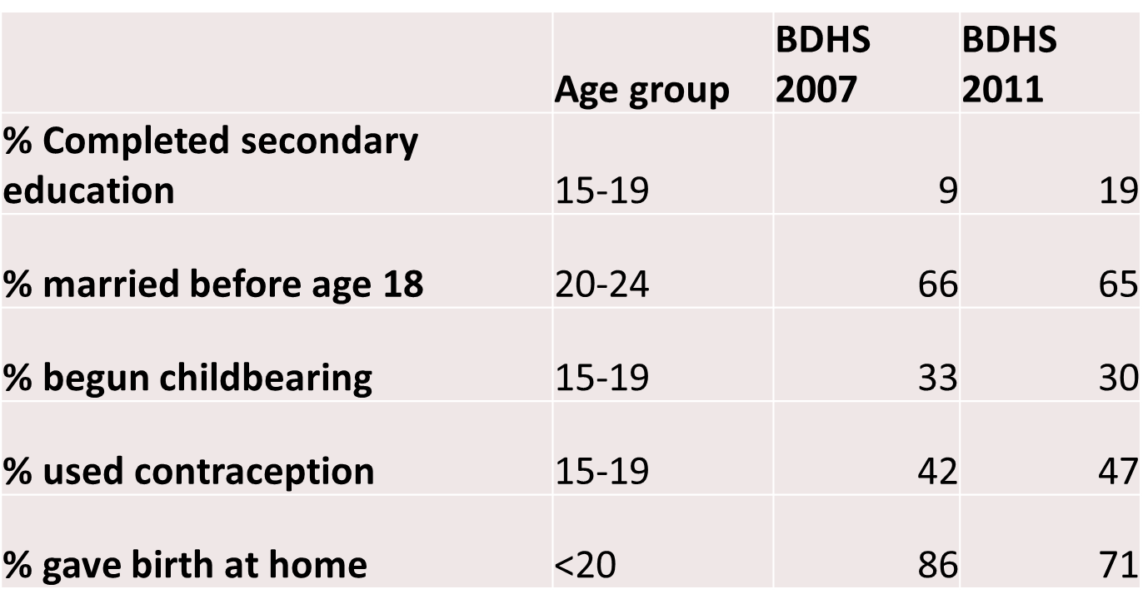
Multiple arms: Bangladesh example

Slide 10
Kishore Kontha (KK) in Bangladesh
Does basic KK work?

Slide 11
Kishore Kontha (KK) in Bangladesh
Marginal impact of fin lit

Slide 12
Kishore Kontha (KK) in Bangladesh
Did KK work?
153
153

Slide 13
Kishore Kontha (KK) in Bangladesh
Impact of delayed marriage
154
153

Slide 14
Kishore Kontha (KK) in Bangladesh
Impact of savings clubs

Slide 15
Multiple treatment arm tips
Different treatment arms help disentangle different mechanisms behind an effect
Tempting to have large number of treatment arms
But more arms requires lots more sample size
Have to worry about two different MDEs
  for comparing T vs C
  Comparing T1 vs T2
Usually good to have at least one intensive arm, where a zero would be surprising
In the analysis, will it be useful to pool all the treatment arms, creating an “any treatment” arm?

Slide 16
When to have an unequal allocation ratio
Usually, we want equal sample in T vs. C because marginal power from additional sample per cell declines
If budget covers treatment and evaluation, more expensive to add one person to T than C
  Unequal allocation ratio gives a bigger total N, which may be worth it
  Try different allocation ratios within a given budget and explore tradeoff
With multiple treatments put more sample behind most important question
  If going to pool treatments, have bigger control
  If really care about between treatments need bigger sample in treatment groups

Slide 17
What effect size should you use as an MDE when designing an RCT?
Smallest effect size that is still cost effective
Largest effect size you expect your program to produce
Estimated effect size in similar RCTs

Slide 18
Minimum detectable effect size
The most important ingredient for calculating power
MDE is not the effect size we expect or want
MDE is the effect size below which we may not be able to distinguish the effect from zero, even if it exists
  i.e. below which effect might as well be zero
Useful questions to ask when determining MDE:
  Below what effect size would the program not be cost effective
  How big an effect would we need to make the result interesting?
MDE may be smaller between arms than between T and C
  Common mistake is powering on T vs. C so don’t have power to distinguish between arms

Slide 19
Which statement is not correct?
In general, cheaper programs can be tested with smaller sample sizes
When calculating MDE we need to think about likely take up rates
A smaller MDE means the effect will be estimated more precisely (all else equal)
MDE has a big influence on power, for a given sample size

Slide 20
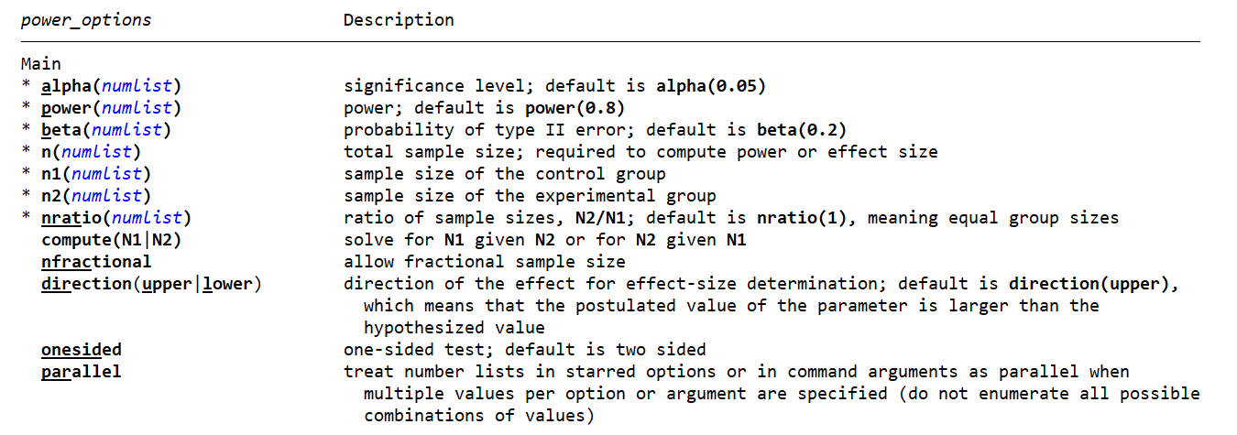
Calculating power in stata
Note: you need to look at power for a particular comparison eg T1 vs C, make sure to scale up if multiple treatments.

Slide 21
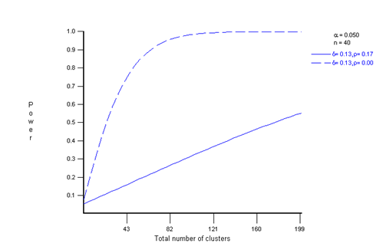
Power in optimal design
Optimal design is a free software specifically designed for power calculations
MDE must be entered in standardized effect size (i.e. effect size divided by standard deviation)
OD allows multiple levels of clustering and works with dropdown menus

Slide 22
Using simulations to estimate power
Statistical packages don’t always allow us to test precisely the question we want to ask
Alternative is to simulate the data based on assumptions
  Estimate variance from existing data to generate a distribution and randomly pull from that distribution for treatment and control groups
  Use past data to estimate shocks and how much of shocks are cluster level vs individual level
  Put in a treatment effect equal to your MDE
Then run multiple simulations (ie with different treatment and control groups selected and random distribution of shocks) to get endline data
Run the estimating regression you plan to run for your analysis
Is the treatment effect significant? What proportion of times is it significant?
That gives you estimate of power for different MDEs—ie the proportion of times you find a statistically significant effect when the real effect was of a specified size

Slide 23
Q: When might it be useful to use simulations to estimate power?

Slide 24
Tips to increase power
Keep number of treatment arms low (or at least allow for combining them)
Encourage high take up (eg sampling those most likely to increase use): nothing kills power like low take up
Randomize at the lowest level possible (trade off with risk of spillovers)
Collect data on variables that will soak up variance
Stratify
Optimize people per cluster vs number of clusters (note that travel time means surveying costs less for additional person per cluster)
Use outcome measures that are proximate to treatment
Limit attrition

