Slide 1
The Practicalities of Running Randomized Trials:
Lecture 4: Mechanics of randomization
Rachel Glennerster

Slide 2
Hybrid strategies of randomization
We use randomized allocation more than once in an evaluation
We can randomize at two different levels:
  Some communities randomized to get some treatment,
  Then who within the treatment community gets the program is randomized at individual level
  This is an effective way to measure spillovers
If we combine simple lottery and phase in we can maintain a control group throughout and examine the impact of more or less years of exposure to the program

Slide 5
Outline
Ingredients needed for randomization:
  a sample frame
  allocation ratio
  device for creating random number
    public or private
    replicable code (if doing by computer)
  stratification plan

Slide 6
Sample frame
A sample frame is a comprehensive list of units from which we can randomize.
It defines the outlines of our study even if we dont survey everyone in it
There are several different types of ways we may use randomization (both randomized allocation and randomized sampling) in a study and each needs a sample frame
  To pick which gets the treatment allocation (eg a list of clusters in a clustered RCT or individuals)
  To pick people within clusters to survey (ie random sampling)
  To pick fields on a farm, children in household, to study in more depth within a survey

Slide 7
Approaches to creating a sample frame
Use existing lists: eg census (if you are lucky), list of health clinics, schools, enumeration areas, current clients, applicants to a training program. These can come from government offices, NGO etc
  Need to ground truth these lists to make sure it is accurate. Could include ghost workers, or not include newly opened schools.
Create your own list
  Do a census (ie map every single household or woman or baby under 2 in a given area)
  Use participatory assessment techniques to crowd source local knowledge--eg map local wells
Use a random walk (for random sampling)
  Don’t randomize from a list but get enumerators to go to every third house
  This approach has problems
Continuous enrollment (common in health), doesnt have a sample frame at the start but instead enrolment criteria which clearly define the scope of the study.

Slide 8
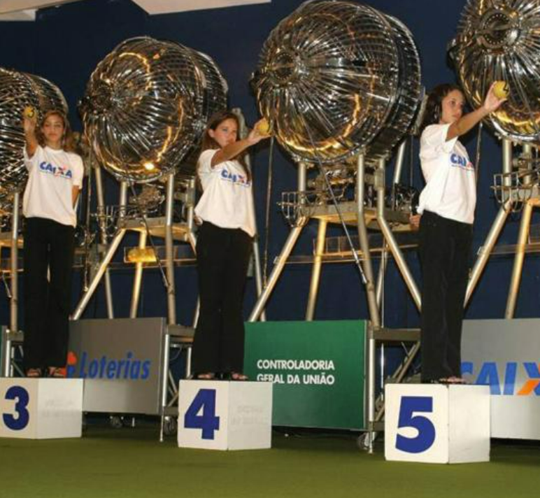
Public vs private randomization
Public lottery methods include pulling balls from bag, choosing envelope, flipping coin, rolling dice,
Private lottery, excel, stata, R, random number lists
Q: what are the benefits of randomizing in public?
  Can build trust in the randomization
  Public commitment to the randomization
Q: What are the challenges?
  Hard to do randomize large samples
  Hard to stratify beyond two groups
  Many mechanical randomization devices are not reliable (ie give everyone an equal chance)
  Cant replicate ie cant prove it was random

Slide 9
In field randomization
Eg, nurses choose an envelope from a pile: inside envelope says which type of treatment to offer
Random walk to pick houses to interview is form of infield randomization
Evidence from health studies that implementers often manage to subvert the randomization
Usually not worth the risk
Exception is when you can verify randomization
  Eg enumerator fills in details of each child/farming plot into electronic data collection device
  Device then randomizes which child or plot enumerator should ask about
  Even this is not failsafe
  Q: what are the incentives, what could go wrong?
Continuous enrolment often requires implementers/enumerators to request and deliver randomization result. Eg Pakistan immunization RCT

Slide 10
How do you actually randomize? (simple randomization)
Create a list with only one line per unit eg if you have a list of households in different villages, and are randomizing by village you need to drop all but one observation per village. Keep the variables you are going to stratify on!
Generate a random number for each observation in your list (do this in a way that is replicable)
Order the list of eligible units by the randomly generated number
Allocate units from the randomly ordered list into groups, depending on the allocation fraction eg if two groups with equal allocation, top half is group A, bottom half B
Randomly choose which of the groups will receive treatment A, treatment B, and so on, and which will be the comparison group.
  It is increasingly common to avoid deciding which group is treatment versus control until the very last step. Use the same procedure above but with the list of groups.
  Important to determine the exact procedure before you start the process

Slide 11
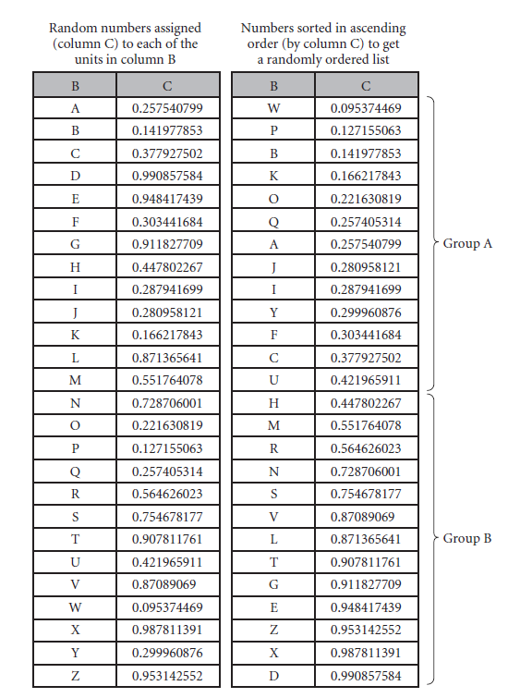

Slide 12
Using a statistical package: sample Stata procedures (from JPAL website)
Create a file that contains only one entry per randomization unit
Sort this file in a replicable and stable way using (in Stata, sort varlist in , stable). This ensures you always get the same order when sorting.
Set the seed for the random number generator (in Stata, set seed). Make sure that the seed is Preserved and Used only once across parallel operations
Randomly assign treatment groups to each randomization unit
Merge the random assignment back with the original file to obtain a list of all observational units with treatment assignments.
Example: using school_id as the cluster variable:
* treat each cluster as a single observation and drop duplicates
duplicates drop school_id
sort school_id, stable
setseed #
sample x // x denotes % of clusters in the population to select sort school_id
* merge sampled clusters back with original list
merge 1:m school_id using “original_dataset”
For any even slightly more complex randomization procedure, extensively test balance
Notes:
The cluster is the sampling unit.
The procedure involves separating the population into clusters/groups (e.g., villages or schools), randomly drawing a sample of clusters, and sampling units in the cluster (either all or a random sample of them).

Slide 13


Sample R procedures (from Declare Design website)
Install randomizr package:
randomizr has different random assignment functions (see reference library), of which cluster_ra() implements a clustered random assignment procedure
Load package:
To ensure the randomization process is replicable, use set.seed() function
cluster_ra implements a random assignment procedure in which groups of units are assigned together (as a cluster) to treatment conditions.
set.seed(10)
Z <- cluster_ra(clusters = clusters, m_each = c(13, 13),
conditions = c("control", "treatment"))
table(Z, clusters)
clusters
Z a b c d e f g h i j k l m n o p q r s t u v w x y z
control 1 2 3 0 5 6 7 0 0 0 0 0 0 14 0 0 0 18 0 20 0 22 23 24 0 26
treatment 0 0 0 4 0 0 0 8 9 10 11 12 13 0 15 16 17 0 19 0 21 0 0 0 25 0

Slide 14
Randomizing for different group sizes
When the probability of ending up in different treatments is different (for example, 30 percent are allocated to treatment A, 30 percent to treatment B, and 40 percent to the comparison group), we usually have to accomplish our randomization slightly differently. Both of the following approaches are valid:
  Decide the rule by which units will be allocated to different treatment arms and the comparison group (first 30 percent to treatment A, second 30 to treatment B, last 40 to the comparison group).
  Divide into more groups (eg 10 groups) follow procedure above, and then allocate several to different arms (eg 3 to treatment A, 3 to treatment B and 4 to comparison)
Whatever methodology is used, it is important to agree on it and document it beforehand.

Slide 15
Randomization with continuous recruitment
For some study designs we dont have the list of participants at the start but enroll them according to agreed criteria
  this is common in medical trials
We then have to randomize as they arrive
One approach is to produce a randomized order ahead of time
An alternative is to set an algorithm on a device used by those who enroll the person into the study
Its important that those doing the enrollment dont know the order in which treatment and control are to be allocated before the enrollment into the study is complete
  otherwise they can switch the order in which they enroll people
  this allows a way to verify that the randomization protocol was followed

Slide 16
Stratification

Slide 17
What is stratification?
With stratification we divide our sample into different sub samples that share certain characteristics and then randomly choose some from each subsample
Stratification can be used for random sampling (i.e., who we interview) and for random allocation (treatment vs control)
Usually, we pick the same proportion from each subsample, although not always
  We might want to over sample people from a rare group if we want to analyze impact by group
  Might want to give poorest higher chance of getting a program

Slide 18
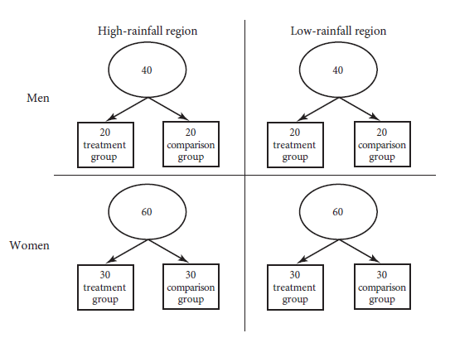
Example: Stratified random assignment of 200 farmers
Imagine this set up:
200 farmers
80 men, 120 women
½ from a high-rainfall region
½ from a low-rainfall
Region
One way to stratify:
Divide by region, then gender
Then randomly assign half of the people to cell A, half to cell B
Then randomize whether A or B is the Treatment group

Slide 19
When to stratify
There are three main reasons to stratify:
To achieve balance
  The smaller the sample size, the higher the chance that simple randomization may return unbalanced groups, so the greater the need for stratification.
To increase statistical power
  Stratifying on variables that are strong predictors of the outcome can increase our statistical power. We will come back to this in a later lecture on power
To analyze impact by group
  We should also stratify when we want to learn how the intervention affects subgroups, such as ethnic minorities or gender.
A nontechnical reason for stratification is to comply with implementer or political constraints. E.g.
half the treatment groups need to be in the north of the country and half in the south, or there must be exactly equal numbers of men and women.

Slide 20
Steps to perform stratified random assignment
Divide the pool of eligible units into sublists (strata) based on chosen characteristics.
Do simple random assignment for each sublist (stratum) by
a. ordering the sublist randomly and
b. allocating units to randomization cells from the randomly ordered sublist.
As a final step, randomly pick which cell is treatment and which is comparison.
When doing analysis control for strata using dummies for each strata (bar one). Guido Imbens suggests its not always required to add strata dummies but it almost always improves your power to put in strata dummies.

Slide 21
Which stratification variables to use
Variables that are discrete.
  Stratification involves placing units into different buckets and then randomizing within those buckets. Hence it’s not possible to stratify on a continuous variable, like income or test scores, because there might be only one person in a bucket.
  E.g., only one child might have a test score of 67, and perhaps no child has a test score of 67.5 or more. Instead, we put people into high test- score or low-test-score strata, or 10 percentiles
Variables that are highly correlated with the outcomes of interest and possible shocks.
  We want balance because it simplifies the interpretation of our findings, increases their statistical power, and reduces the chance that differences in treatment and comparison groups could be driven by trends in confounding variables or shocks.
  Baseline value of the outcome of interest is a particularly important stratification variable
  Geographic units (esp admin units) summarize many variables and can be important for shocks
  Q: why?
Variables on which we will do subgroup analysis.
  If we are going to be analyzing subgroups by gender. We should stratify by gender.

Slide 22
How many variables to stratify on
Objective: stratify on variables that will explain a large share of the variation in the outcomes that interest us.
Challenge: we cant stratify on all of them, strata get too small
  The more variables we stratify on, the less balance we get on the original variables
E.g.: Say we are measuring the impact of an education program on test scores many factors correlated with test scores.
  If we just stratify on baseline test scores only, can create subsamples with very similar test scores
  If we stratify on 10 different variables, we might only be able to stratify test scores by top half vs bottom half of the test score distribution
Note: we need to have at least as many units in our strata as we have randomization cells (ie things we are randomizing to, like treatment 1 treatment 2 and control= 3 randomization cells)
If attrition in units, then we need many more units in our strata than we have randomization cells
Q: why?

Slide 23
Paired random assignment (full stratification)
How it works:
  two units are matched on a list of important characteristics
  one of them is randomly assigned to treatment and the other to comparison
If there are three randomization cells (two treatments and one comparison):
  the units are placed into triplets
  within each triplet we randomly assign one unit to each of the three randomization cells.
Paired random assignment is stratification with as small strata as possible.
  Create pairs from those units most similar on continuous variable, e.g., children test scores
  Or using multiple variables till only 2 in each strata
Potential loss of degrees of freedom with a dummy for each strata in analysis (usually worth it)
Warning: never do pairwise randomization if there may be attrition at level of randomization unit.

Slide 24
What to do with leftovers/misfits?
District C
District A
Misfits arise when the number of units in a strata cant be exactly divided by number of randomization cells
One option is to allocate the “remainders” or “misfits” into a special lefterover strata
If there are lots of units in your “misfits” strata, you can do stratified randomization within the misfits strata.
1
2
3
3
2
1
1
2
3
District B
Leftovers
1
2
2
1
3
3

Slide 25
Misfits – programming solution (from JPAL website)
Simple example: two treatment arms (one treatment and one control) assigned in equal proportions, the procedure in Stata is as follows:
clear all
Set the version for upward compatibility
(e.g., Stata 15 users can use Stata 14) version 14.2
use “randomizationdata.dta”, clear
isid uniqueid // check for duplicates in the list of individuals sort uniqueid, stable // sort on uniqueid for replicability set seed 20200520
/* generate a random (pseudo-random) variable consisting of draws from the uniform distribution */
generate random = runiform()
bysort stratum: egen temp = rank(random), unique
bysort stratum: gen size=_N
* assign treatments to observations that fit evenly into treatment ratios: gen treatment = temp>size/2+.5
* randomly assign the misfit: replace treatment = round(random) if temp==size/2+.5
The procedure for assigning the misfits becomes increasingly tedious as the number of strata and treatments (and, hence, potential number of misfits) grow, or as treatment allocations change.

Slide 26
Sample Stata code: stratified sampling (from JPAL website)
Proportionate stratification
The share of each stratum in the sample is proportionate, ensuring that the sample is representative of the overall population and especially small groups are not undersampled.
For example, if widowed households comprise 5% of the population, then they comprise 5% of the sample.
In Stata, this can be done as follows:
  by stratum: sample x
  /* strata denotes the (categorical) stratifying variable (e.g., widow) and x denotes the percent to be sampled within each stratum. */
  * to draw x rather than x% from each stratum, specify the count option by stratum: sample x, count

Slide 27
Sample Stata code: stratified sampling (from JPAL website)
Disproportionate stratification
The strata sample is not proportionate to the strata population (e.g., widowed HHs comprise only 5% of the population but 20% of the sample).
It is useful when you want to ensure sufficient power to detect heterogeneous treatment effects by stratum.
In Stata, this can be done as follows:
sample x if stratum==1
sample y if stratum==2
/* x denotes the fraction of the sample that will be comprised of respondents from stratum 1 and y the fraction of the sample comprised of respondents from stratum 2 */

Slide 28
Achieving balance through multiple randomizations
It used to be common to achieve balance by running multiple randomizations and then choosing randomly from those allocations that achieve balance
However, using this approach imposes constraints on the data that we might not be aware we are imposing
When we use stratification we know exactly what constraints we are imposing (eg if we stratify by gender and have equal allocation ratios we are imposing the constraint that precisely half of men are in treatment and half in control)
  We know how to account for this in stratification
Preferable to use stratification than rerandomization to achieve balance

Slide 29
Summary
Random allocation needs a sample frame (or eligibility criteria), a device, and an allocation ratio
It may take time and effort to get a good sample frame.
Unless there are strong reasons against, office-based randomization using statistical software is preferable, because we can stratify and replicate what we have done (prove we randomized)
Stratification (on variables correlated with our outcome) is nearly always a good idea, even though it means adding control variables (for each strata) to our analysis, because strata help achieve balance and dummies for strata usually soak up variance.
Stratification by units that may face common shocks (eg district) is useful to help ensure shocks are spread evenly across treatment and control

