Slide 1
The Practicalities of Running Randomized Trials:
Lecture 3: How to randomize
Rachel Glennerster

Slide 2
Outline
Partners (from last lecture)
What can be randomized
Unit of randomization
  Including with spillovers
Types of randomization

Slide 3
How to be a good research partner
Answer questions the partner wants to answer—they have to get something out of this
Be flexible in the evaluation design (within limits)
Share expertise
Provide intermediate outputs
Have a local presence and have frequent contacts
Investment pays off

Slide 4
How much would an RCT cost?
Rigorous impact evaluations vary enormously in cost, important to balance cost and benefits
What makes an evaluation expensive?
  Collecting new data vs using administrative data
  Randomizing by group (rather than individual)
  Rural and remote locations drive up transport costs
  When skilled labor is expensive (much of Africa)
  Multiyear evaluations
  Many treatment arms
  Non-survey outcomes (like biological tests)
Small cheap programs can be very expensive to evaluate because you need to be able to pick up small changes.

Slide 5
What can be randomized?
Different ways to randomize come from three basic elements of a program which can be randomized
Access: we can choose which people are offered access to a program
Timing: we can choose when people are offered access
Encouragement: we can choose which people are given encouragement to participate

Slide 8
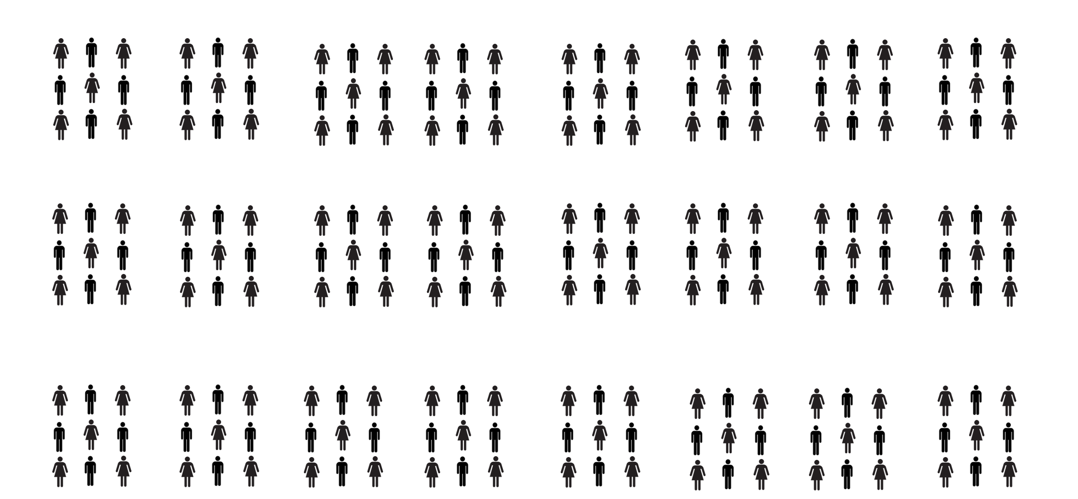
Unit of Randomization: Individual?

Slide 9
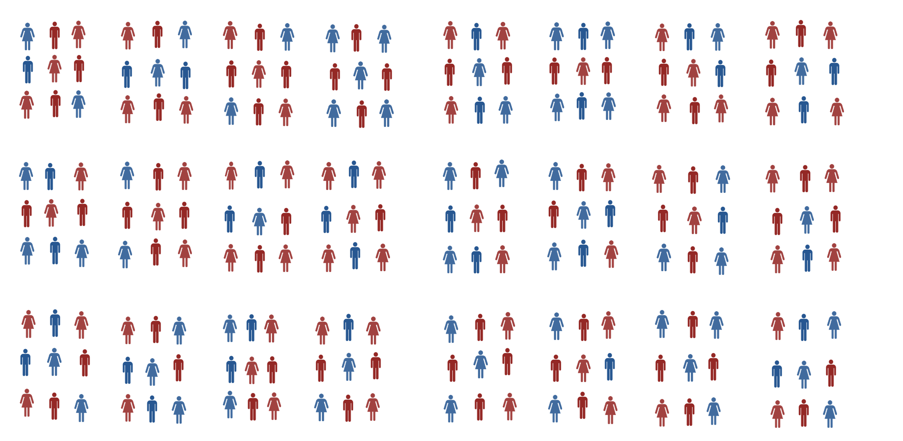
Unit of Randomization: Individual?

Slide 10
Unit of Randomization: Cluster?

Slide 11
Unit of Randomization: Which Cluster?

Slide 12
Unit of Randomization: Class

Slide 13
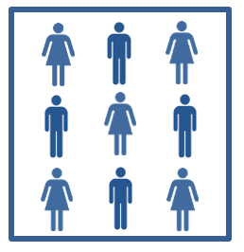
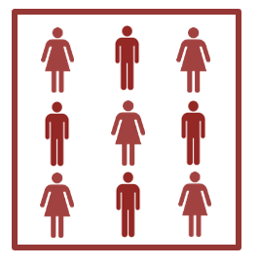
Unit of Randomization: Class?

Slide 14
Unit of Randomization: Class?

Slide 15
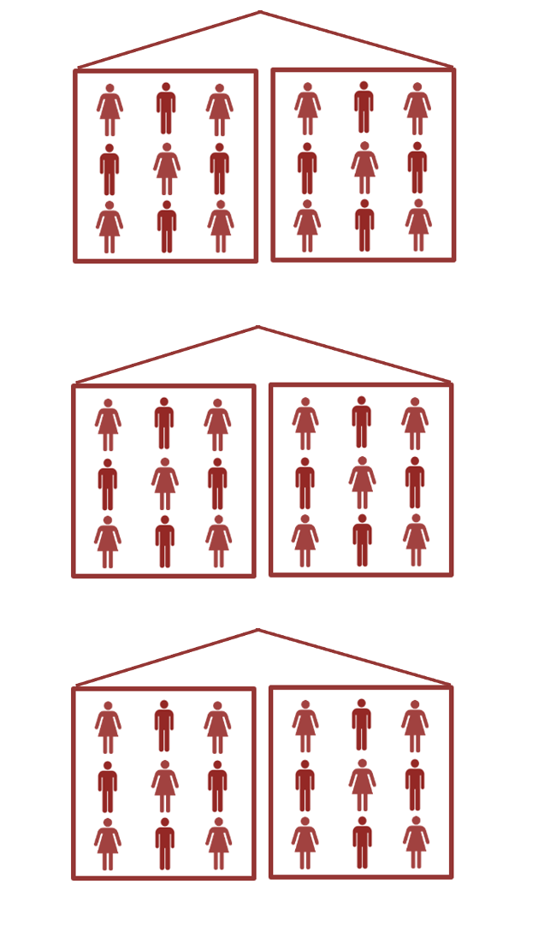
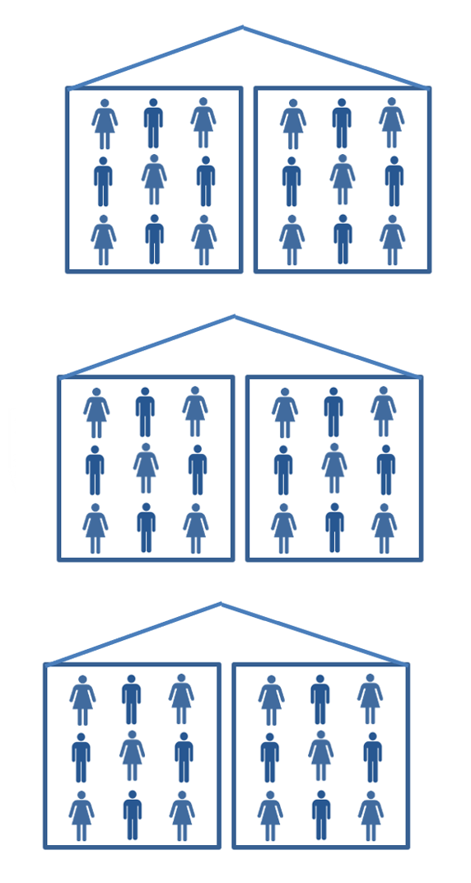
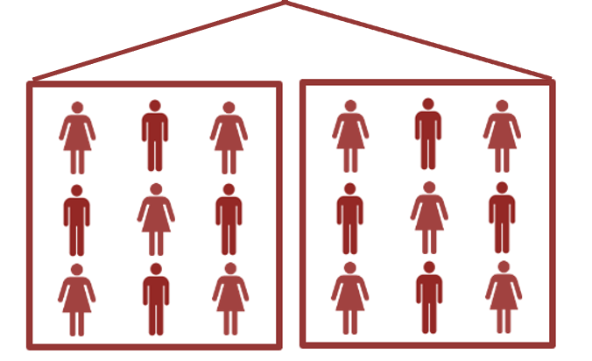
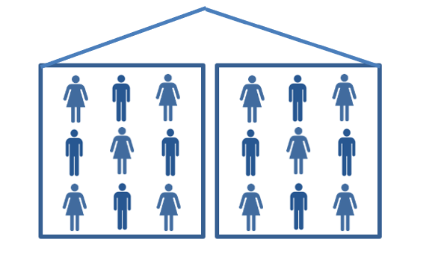
Unit of Randomization: School

Slide 16
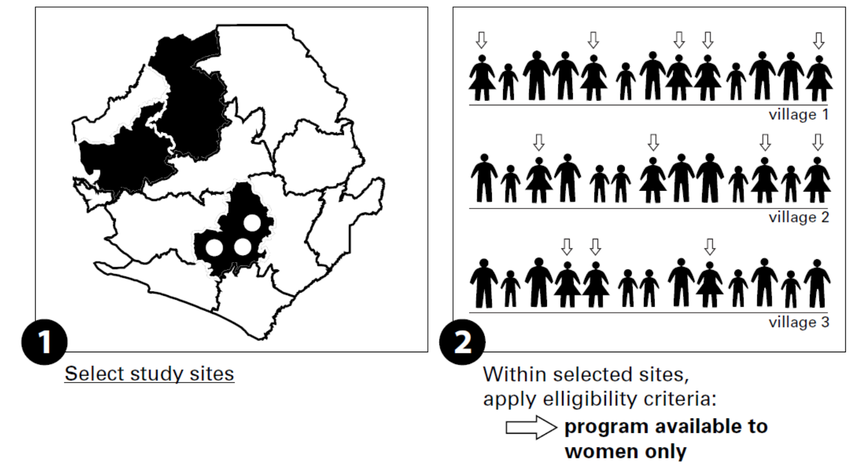
Steps in individual level randomization

Slide 17
Steps in individual level randomization

Slide 18
Steps in group level randomization

Slide 19
Steps in group level randomization

Slide 20
Considerations for level of randomization
Unit of measurement
Feasibility and fairness
Spillovers
Attrition
Compliance
Statistical power
Clustering on the ground

Slide 21
Measurement and unit of randomization
Randomization cannot take place at a lower level than our outcome is measured
Outcome is quality of school building, can’t randomize at level of class, teacher, or child
Outcome is election of MP from a minority group, can’t randomize at level lower than MP constituency
  Note if our outcome is self reported voting for a minority candidate then can randomize individually

Slide 22
Feasibility and unit of randomization
Usually, randomization is at the level at which the program is implemented
Community health program is randomized by community
School improvement program is randomized by school
Randomizing below this level means changing how program implemented
  Eg nutritional supplement program normally done by school but randomized by individual has to keep track of which children are treatment, adding to cost of program

Slide 23
Political feasibility and perceived fairness
  Randomizing at a higher level can make randomization be perceived as fair
  Important to understand what is seen as fair in a given context
  It may seem fair that some schools are selected for a pilot program, if schools have a fair (random) chance of being selected for the pilot
  Providing some individual students with a program and excluding others within a school may be seen as less fair

Slide 24
Spillovers
When a program changes outcomes for those not directly participating, we call this impacts “spillovers”
Physical spillovers
  a farmer draws water from an aquifer and there is less for others (negative spillover)
Behavioral spillovers
  if some children go to school more this may encourage others to go (positive spillover)
Informational
  if one mother learns the benefits of breastfeeding she may tell her friends (positive spillover)
Market or general equilibrium
  If some firms reduce cost of production and price this may affect the price other firms can charge for their product (negative spillover)

Slide 25
Spillovers and randomization unit
Spillovers mean outcomes for the comparison groups may be impacted by the program
The comparison group is no longer a good counterfactual
Q: if positive benefits of the program spillover to the comparison group, will this lead to an under or overestimate of program impact?

Slide 26
Positive spillover bias
measured
impact
true
impact
True impact = 3 months
Measured impact = 2 months
Bias = Measured impact – True impact = - 1 month

Slide 27
Attrition and unit of randomization
Attrition is when we cannot collect data on all our sample
Usually, attrition occurs when people move or are not at home when enumerators call
If people feel a study is unfair, they can refuse to cooperate, leading to attrition
Sometimes providing benefits to some but not their neighbors is seen as unfair and can cause attrition
It is important that randomization is seen as fair for many reasons, reducing attrition is one of them
Randomizing at a higher level can help

Slide 28
Compliance and unit of randomization
Full compliance is when all those in the treatment group get the program and all those in the comparison don’t get it
Low level randomization may lead to sharing which undermines compliance
Example: iron supplements in Indonesia
  Iron supplements aimed at older people
  Only providing supplements to some in the family might lead to sharing with others, diluting effect
  Providing supplements to everyone in the family increased compliance
Source: Thomas et al, 2006.

Slide 29
Compliance and unit of randomization
Simple to implement designs achieve higher compliance
Avoid having one person implement two versions of a program
Example: adding health insurance to micro credit
  One microcredit officer serves 10 groups in an area
  If randomize some groups to be offered health insurance and some not, credit officer will need to keep straight who can apply for insurance and who cant
  May need to randomize at the credit officer level

Slide 30
Power and unit of randomization
Statistical power is the ability to detect an effect of a given size
Individual randomization gives more power than group randomization (for a given sample size)
We get more information from 20 children individually randomized than from 20 children in two schools (one treatment and one comparison)
We will return to this subject in much more detail
Many factors push us to randomize at higher levels, power pushes us to randomize lower

Slide 31
Clustering on the ground
Ideally, clusters by which we randomize should make sense on the ground
Administrative boundaries do not always correspond to how people interact with each other
People may cluster and interact in smaller groups than administrative neighborhoods or villages
  We can randomize by these natural neighborhoods and have more power than if we randomized by administrative neighborhood
Or administrative neighborhoods may blend into each other with little real difference evident on the ground
  Risk that implementers may not know who is in treatment and who in comparison

Slide 32

Example: hamlets vs. villages in India
Rural areas in India are divided into villages or panchayats, but in much of India a lot of social interaction happens within a hamlet
Some interventions can be randomized by hamlet
Villages
Hamlets

Slide 33
Example: farmers in Western Kenya
In some parts of Kenya people live on their farms and randomizing by administrative “village” may make little sense
Some researchers have randomized farming programs by which school households send their children to as this may represent a more natural locus of interaction (Duflo, Kremer, Robinson, 2007)
Schools
School related clusters

Slide 34
Types of randomization

Slide 35
Lottery around the cutoff
Individuals or groups are scored on some eligibility criteria
  High scores all admitted, low scorers not admitted
  Those with intermediate scores randomized into or out of program
Most workable/useful when:
  Clear eligibility criteria
  The program is over subscribed, there are limited resources

Slide 36
Example: credit scoring in Philippines
100
Credit score
Accept all
60
85% treatment
15% comparison
45
Sample for study
60% treatment
40% comparison
30
Reject all
0
Karlan and Zinman, 2011

Slide 37
Lottery around the cutoff
Q: what are the advantages of this design?
  Program keeps lot of control over who admitted
  Measures the impact on the marginal person
Q: what are the disadvantages of this design
  Does not measure the impact of program on the average participant
  Some less eligible people admitted above those more eligible

Slide 38
Randomized phase-in

Slide 39
Randomized rotation
Program rotates from one area/group to another randomly
Most workable/useful when:
  Resources limited and will not increase over time
  Rotation is a natural part of a program– eg location of health outreach centers rotate between local schools each month, which councilor acts as mayor rotates each year
Advantage:
  Everyone gets the program but always have a control group
Disadvantage
  Only works when there are no lingering effects, ie when program is taken away benefits do not persist
  Only works when no anticipation effects

Slide 40
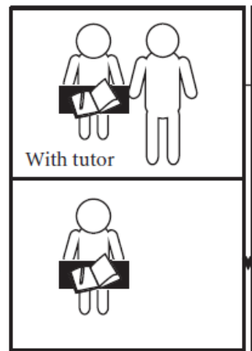
Schools in Group A
Grade 3
Impact of tutor for Grade 3
Grade 4
Schools in Group B
Impact of tutor Grade 4
Grade 3
Grade 4

Slide 41
Year 1
Year 2
Schools in Group A
Grade 3
Grade 4
Impact of tutor for 2 years
Schools in Group B
Grade 3
Grade 4

Slide 42
Encouragement design
People given an encouragement to take up the program
  E.g. randomly chosen to receive help applying for benefits
  E.g. randomly chosen to receive incentive to get cancer screening
Most workable/useful when:
  Everyone is already eligible but take up is low
Advantage:
  No one is denied access
  Can evaluate a program that is already fully rolled out
Disadvantage
  Encouragement needs to be big enough to sharply change take up but not have an effect in itself
  Measures the impact on those who are encouraged to take up, not average person

Slide 43
Encouragement design
People who take up program
Difference in take up caused by encouragement

Slide 44
Hybrid strategies
We can randomize more than once in an evaluation
We can randomize at two different levels:
  Some communities randomized to get some treatment,
  Then who within the treatment community gets the program is randomized at individual level
  This is an effective way to measure spillovers
If we combine simple lottery and phase in we can maintain a control group throughout and examine the impact of more or less years of exposure to the program

