Slide 1
Impact of Voter Knowledge
Initiatives in Sierra Leone
Rachel Glennerster (International Growth Center, J-PAL)
With Kelly Bidwell (IPA) and Katherine Casey (Stanford GSB)
Freetown, February 2014

Slide 2
Voters are poorly informed about politics in Sierra Leone
Election Day (Nov 2012) exit polls in control villages reveal that:
Only 28% of voters could name the two Parliamentary candidates
64% couldn’t name a single MP job responsibility
3% knew the amount of the MPs’ constituency facilitation fund
35% knew the proposed quota for women’s representation in government and 17% knew the candidates’ positions on the bill
70% of voters have zero years of schooling, 31% have no radio
Can giving voters information about candidates and
policy facilitate more informed voting and greater accountability?

Slide 3
Strong support for gender equity and CFF transparency
81% of voters in control areas supported gender equity bill
93% supported transparency of CFF
Most MP candidates made a public commitment to support gender equity bill and CFF transparency
Seeing the debate strengthened support for the gender equity bill

Slide 4
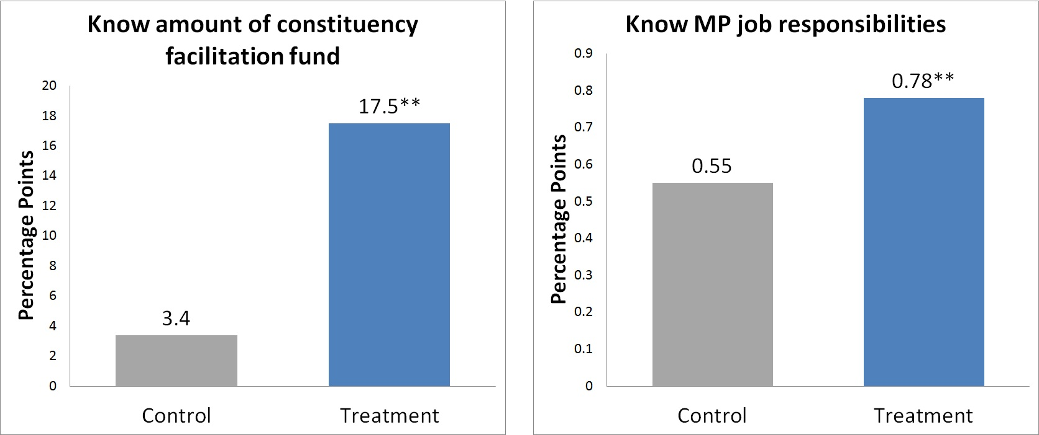

Debates increased general political knowledge
Number of observations = 5,415 voters surveyed in exit polls
** = 1% significance *=5% +=10%

Slide 5
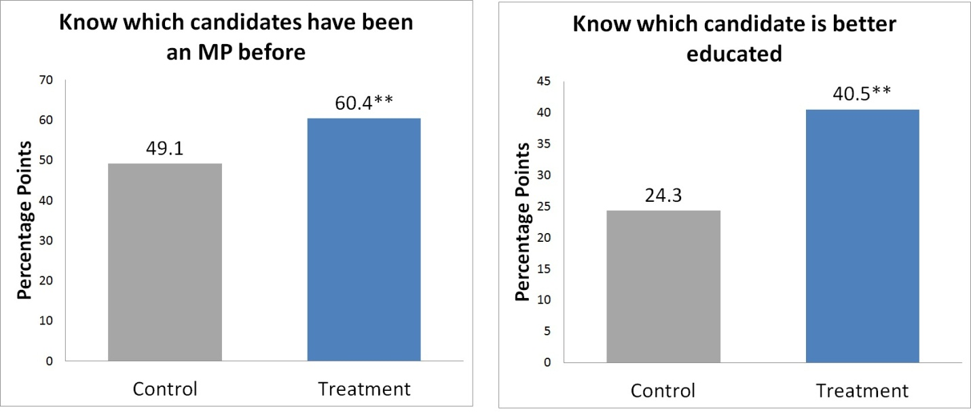
Debates increased knowledge of candidate
Number of observations = 5,415 voters surveyed in exit polls

Slide 6
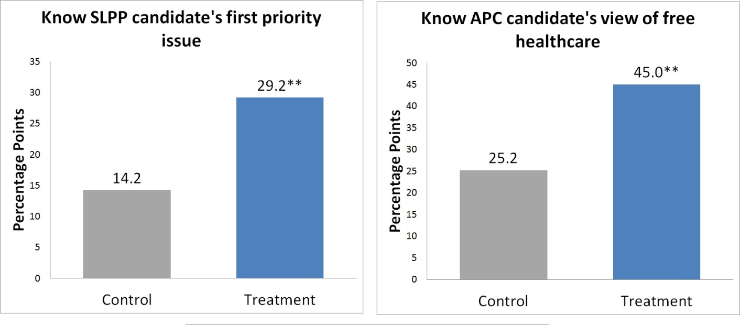
Debates had strong positive effects on policy knowledge
Number of observations = 5,415 voters surveyed in exit polls; t-tests are onesided.

Slide 7
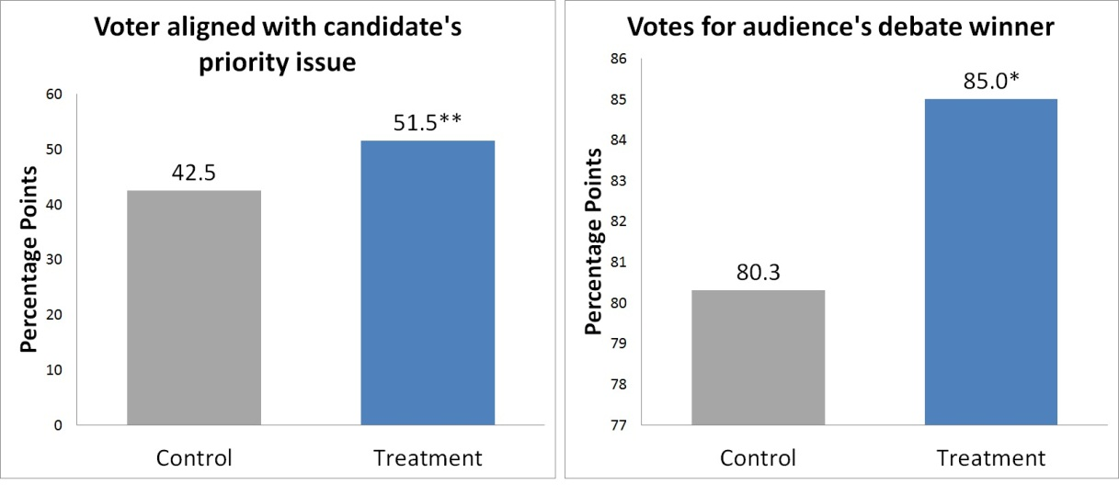
Debates had strong positive effects on vote choices
Mean effect on policy alignment 0.11** SD
Mean effect on voting for the winner 0.08* SD
No effect on voting across party lines
Number of observations = 5,415 voters surveyed in exit polls; t-tests are onesided.

Slide 8
Which aspects of the debates do voters respond to?
How much do voters care about
personality, and physical appearance, compared to
policy stance and qualifications?
Some voters shown only certain aspects of the debate to unpack the different types of information conveyed:
Debate, viewed on tablet
Get to know you video: Candidate personality only
Radio report: Journalist summary of policy stances and professional qualifications only

Slide 9
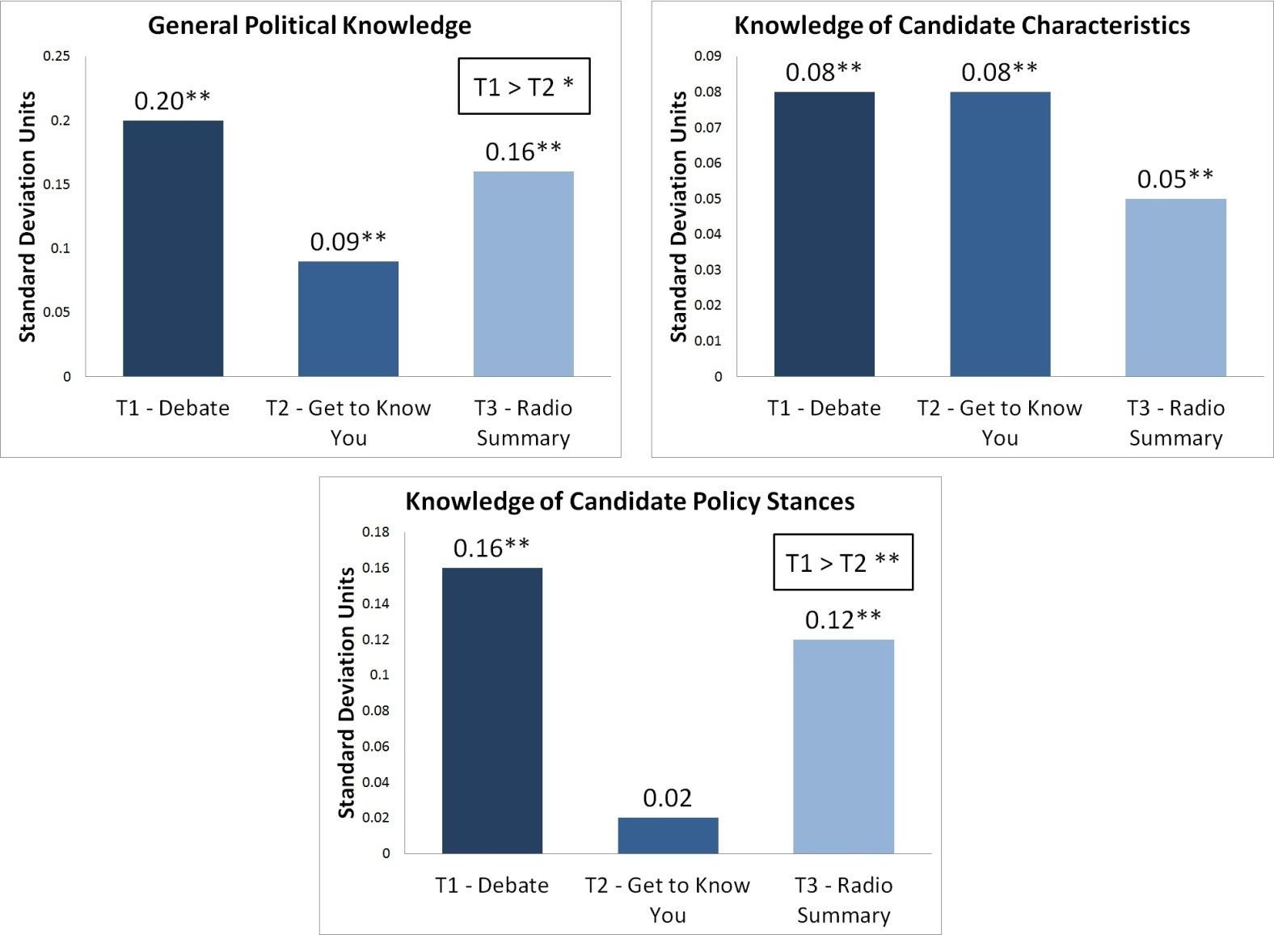
Debates combine persona and policy information

Slide 10
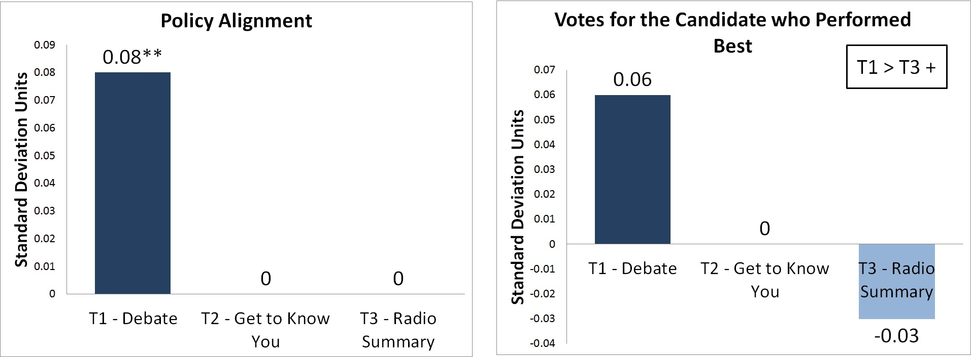
Only debates impact policy alignment and voting choice
Number of observations = 1580
** = 1% significance *=5% +=10%

Slide 11
How do findings fit with those from other studies?
Hear shortly about very similar experience in India
  Voters respond in very sophisticated way to better information about politicians
Other evidence from Sierra Leone shows that
  Voters twice as likely to know name of and have been visited by local councilors than MPs
  11% more voters cross traditional partly lines for councilor than MP
  Radio is second most important source of information about politics
  Even stronger willingness to cross party lines for local councilors when there are local radio stations
Evidence from Brazil also suggests local radio is important for linking politicians and voters

Slide 14
Conclusion and thoughts on maintaining links
Voters know very little about MP candidates
  about the roles of MPs, or about their policy positions
Care about and respond to discussion about specific policy issues
Debates have the potential to make political contests more competitive, which is likely why candidates responded with increased campaign effort
Providing information and continued interaction between elections important for strengthening links

Slide 15
Conclusion and thoughts on maintaining links II
Radio is important source of information, but also visits
Strong support for gender equity bill and transparency of the CFF
MPs made commitments during debates, can go back and talk about how they are keeping them
Increased transparency (including through freedom of information act) can be a way to keep voters informed
  Eg NGOs and radio reporters and find information they can report back

