Slide 1
The Practicalities of Running Randomized Trials: Lecture 1: RCT start to finish
Rachel Glennerster

Slide 2
Logistics
Time change to allow us all to attend Becker seminar
Office hours on Wed 11-noon, 4th floor Siaeh Hall, room 432
Syllabus, problem sets posted on canvass, as is grading rubric
TA, Michael Cuna (michaelcuna@uchicago.edu)
EA Jiya Nair, for meetings outside of office hours. (jiyanair@uchicago.edu)
RA Tam Trinh (tamtrinh@uchicago.edu)
Cant talk after class today as have presentation at 9:30

Slide 3
Objective of the course
What is your objective?
My objective:
Equip you with the tools to design and run RCTs with a focus on the practical tradeoffs researchers face.
Provide feedback on student designed RCTs.
Questions:
Is it just for those doing development RCTs?
What if I am not planning to do an RCT?
How technical is it?

Slide 4
Course schedule
Class 1 – Monday, September 27th Introduction, overview of an RCT | Class 9 – Monday, October 25th Statistical Power
Class 2 – Wednesday, September 29th Why randomize and what questions | Class 10 – Wednesday, October 27th Increasing statistical power in practice
Class 3 – Wednesday, October 4th Opportunities to randomize/types of randomization | Class 11 – Monday, November 1st Threats (part 1)
Class 4 – Wednesday, October 6th Mechanics of randomization, stratification | Class 12 – Monday, November 3rd Threats (part 2)
Class 5 – Monday, October 11th Ethics and human subjects approval | Class 13 – Monday, November 8th Analysis (part 1)
Class 6 – Wednesday, October 13th Outcomes: principles, education and health | Class 14 – Wednesday, November 10th Analysis: integrating big data techniques
Class 7 – Monday, October 18th Outcomes: field testing, income, consumption, agriculture | Class 15 – Monday, November 15th Analysis: preanalysis plans
Class 8 – Wednesday, October 20th Outcomes: nonsurvey instruments, women’s empowerment | Class 16 – Wednesday, November 17th Generalizability

Slide 5
Course schedule
Thanksgiving Break
Class 18 – Monday, November 29th Cost-effectiveness
Class 19 – Wednesday, December 1st Conclusion and taking research to policy
Finals Week

Slide 6
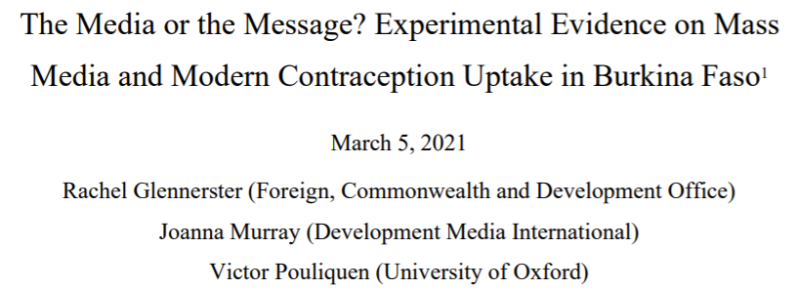
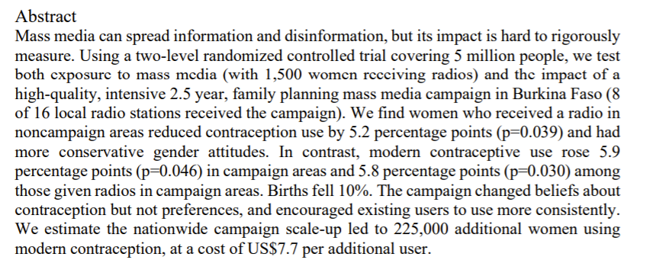
The story behind the RCT: “The Media or the Message”

Slide 7
The Prequel: Finding a Match
The dead-end: measuring the impact of radios in Sierra Leone
Checking each other out: DMI and Sierra Leone (2009)
A date: technical advisor to DMI and LSHTM (2012)
An offer I couldn’t refuse: agreement to work together with DMI (2015)
Final steps to the agreement: finding a coauthor, technical committee, funding (2015)

Slide 8
Lessons from previous 14 radio station RCT
“Post-neonatal under-5 child mortality decreased from 93·3 to 58·5 per 1000 livebirths in the control group and from 125·1 to 85·1 per 1000 livebirths in the intervention group. There was no evidence of an intervention effect (risk ratio 1·00, 95% CI 0·82-1·22; p>0·999). In the first year of the intervention, under-5 consultations increased from 68 681 to 83 022 in the control group and from 79 852 to 111 758 in the intervention group.” Sarrassat et al 2018
Unbalanced: - randomization done before baseline collection
- hard to compare trend when initial level is so different
- few clusters means imbalance is quite likely without stratification
Low power: - relatively rare outcomes are going to be hard to pick up - survey data did not include intermediate outcomes
- note, clinic data did have intermediate outcomes
- no alternative source of variation to triangulate

Slide 9
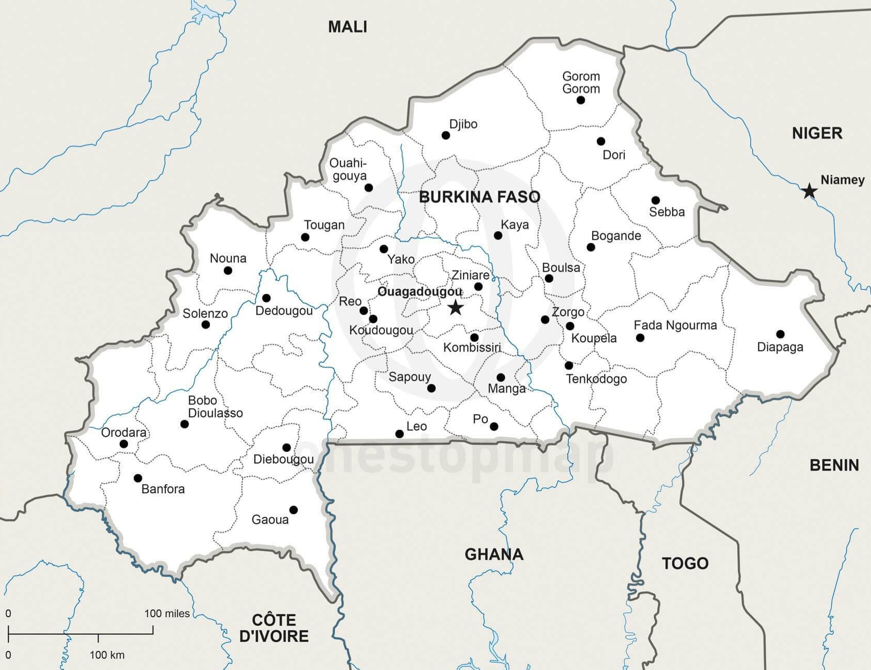
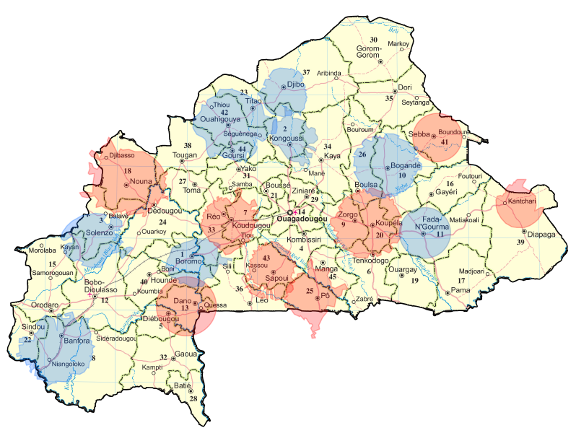
Initial randomization plan
Selected 16 radio stations with relatively little overlap and where radio listenership is high
Collected census data (data on electricity), admin data and location data of clinics from previous RCT
Decided to exclude villages with electricity (TVs), urban areas, those >5km from clinic
Power calcs to decide on number of communities vs number of women per community
Census of all women in selected communities
Weighted stratified sample to (artificially) make clusters more similar.
Pairwise randomization to avoid imbalance
8 radio stations broadcasted the family planning campaign for 2.5 years
8 radio stations in a comparison group

Slide 10
Adding the individual level radio distribution
Still worried about power
Sought funding to distribute radios to those who did not have one in household
Would spillovers be a problem with an individual level randomization
Control women in treatment areas might learn messages from radio
But they would still be exposed less than those with a radio
How could we separate out impact of radio from impact of DMI campaign?
Give radios in control areas too
Would women keep the radios?
Give incentive to those who had them at endline

Slide 11
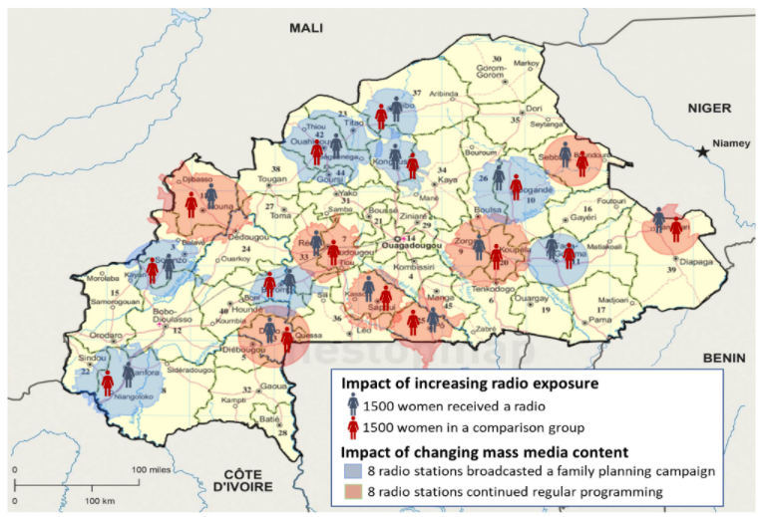
Final randomization design

Slide 12
Outcome of interest
Primary outcome: Modern contraceptive methods- standard health measure
Should we include effective nonmodern methods?
Power calculation suggested fertility would not be possible to measure with precision
First stage indicators
Are people listening to the radio, to target radio station, hear programs about family planning?
Did women who received radio keep the radio, listen more to the radio
Theory of change indicators (based on discussions with DMI about what they planned to cover):
Change in knowledge about contraception, different methods, combat misinformation
Change in preferences, how many children, birth spacing
More discussion between spouses to address differences in preferences
Make hidden views socially acceptable by talking about them (common knowledge)

Slide 13
Three independent sources of data to triangulate estimated impact
Women’s survey
7,500 women in rural villages without electricity, <5 km from clinic
Attitudes, knowledge, use of contraception
Clinic survey
461 clinics near or used by women in sample
Consultations, distribution
Administrative data
45 months, pre and during program
Distribution of contraceptives by clinic

Slide 14
Timeline and data
2015
2016
2017
2018
J F M A M J J A S O N D J F M A M J J A S O N D J F M A M J J A S O N D J F M A M J J A S O N D
Radio campaign in 8 radio stations
June 2016 - Dec 2018 (2.5 years)
Program
Randomization
May 2016

Slide 15
Timeline and data
2015
2016
2017
2018
J F M A M J J A S O N D J F M A M J J A S O N D J F M A M J J A S O N D J F M A M J J A S O N D
Radio campaign in 8 radio stations
June 2016 - Dec 2018 (2.5 years)
Program
Randomization
May 2016
Distribution of 1,130 Radios
March - June 2017

Slide 16
Timeline and data
2015
2016
2017
2018
J F M A M J J A S O N D J F M A M J J A S O N D J F M A M J J A S O N D J F M A M J J A S O N D
Radio campaign in 8 radio stations
June 2016 - Dec 2018 (2.5 years)
Program
Randomization
May 2016
Distribution of 1,130 Radios
March - June 2017
Data
Collection
Baseline survey
7,515 women
461 Clinics Apr - Jun 2016
Endline survey
6,728 women (90%)
446 Clinics (97%) Nov - Dec 2018
Administrative data
Monthly clinic data on contraceptive distribution: 838 clinics x 45 months
Apr 2015 - Dec 2018

Slide 17
Timeline and Data
2015
2016
2017
2018
J F M A M J J A S O N D J F M A M J J A S O N D J F M A M J J A S O N D J F M A M J J A S O N D
Radio campaign in 8 radio stations
June 2016 - Dec 2018 (2.5 years)
Program
Randomization
May 2016
Distribution of 1,130 Radios
March - June 2017
Data
Collection
Baseline survey
7,515 women
461 Clinics Apr - Jun 2016
Endline survey
6,728 women (90%)
446 Clinics (97%) Nov - Dec 2018
Administrative data
Monthly clinic data on contraceptive distribution: 838 clinics x 45 months
Apr 2015 - Dec 2018

Slide 18
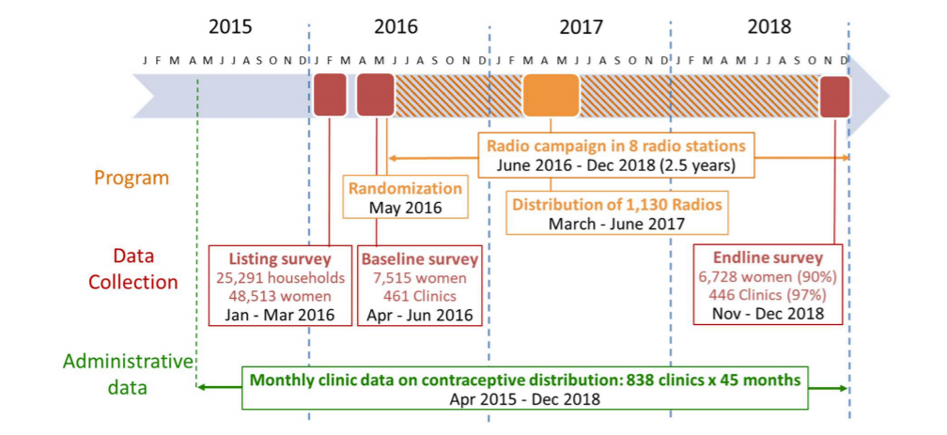
Time-line and data, not shown in the paper
2019-20
2021
Data cleaning and analysis
Presentation to DMI and tech committee
First draft
Early presentations
Reframing, rewriting
Presentations to academic and nonacademic audiences
Paper finalized and submitted
First rejections
Rewriting, reframing, new analysis
Visit Burkina Faso

Slide 19
Responding to lessons from previous radio RCT
Low power: look for more clusters (trade off with no overlap)
Make contraceptive use not fertility our main outcome.
Randomized radio distribution (after a delay to raise more money). Brought new element to study.
Unbalanced: do baseline before randomization,
pairwise randomization,
make clusters artificially more similar

Slide 20
Challenges along the way
Calculating power: binomial, small clusters, had to use simulations
Other programs focus on controls: work with them for more even spread, explain the threat to our RCT, but remains an issue
Admin data hard to get and hard to interpret: persistence, build relationship with ministry, multiple ways to deal with zeros
Threats to radio station: one treatment radio station drops out, keep original treatment assignment but this reduces power
Violence during endline: backup phone survey
Making results salient: Reframe and rewrite paper repeatedly.

