Slide 2
Public Policy & Evidence: How to discriminate, interpret and communicate scientific research to better inform society.
Rachel Glennerster
Executive Director J-PAL Global

Slide 3
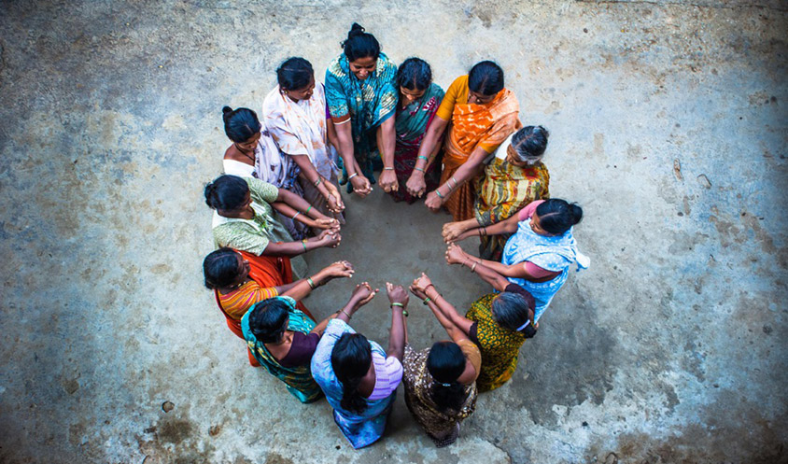
Press coverage of microcredit: 2000s

Slide 4
Many success stories…

Slide 5
We started to get some bad stories…

Slide 6
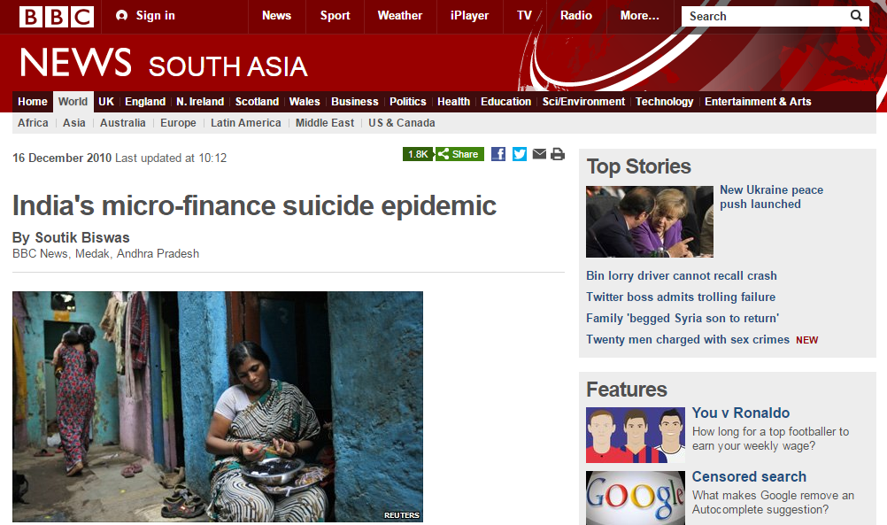
And some even worse…

Slide 7
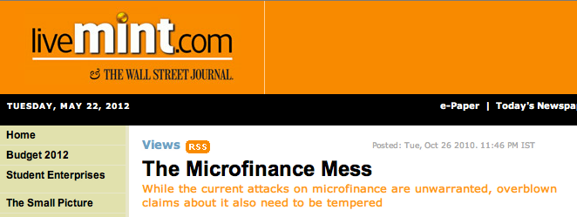
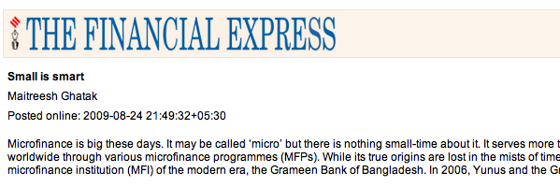
Rigorous evidence: in between

Slide 8
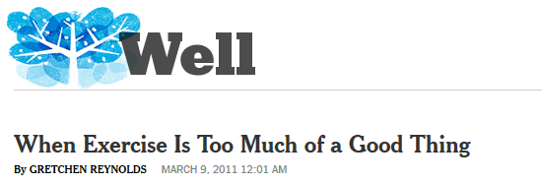
Claim then reversal is common

Slide 9
The problem
An NGO or politician promotes a program or policy
There are good stories to tell:
you interview a woman who turned her life around after receiving credit
Sometimes there is a correlation:
women who take out microfinance do better at business
People assume this means the program or policy caused the change
But “causal change” means change would not have happened in absence of the policy—hard to know
Later studies find no effect, everyone is disillusioned with science and journalism

Slide 10
Different tools for different questions

Slide 11
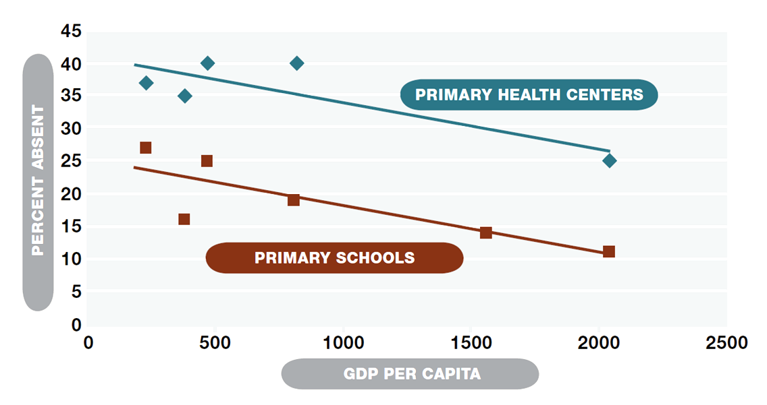
Descriptive data describes conditions
Examples: % of those in elite universities coming from poor families
Good descriptive data are representative
press stories of skyrocketing food prices from Ebola (source: food seller near my hotel), but national survey showed no rise

Slide 12
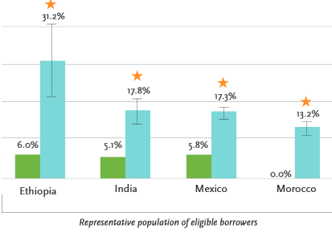
Process data on implementation
Did the textbooks arrive? Did subsidies go to the rich or to the poor?
Example: take up rates of microcredit

Slide 13
Correlations: interesting not causal
Women who give birth as teenagers are less likely to get good medical care and have more complications
Women who give birth as teenagers also have less education, were doing less well in school before dropping out, come from poorer homes, etc etc
Are they less likely to seek care because they give birth as teenagers or because they are less educated, poorer…
This matters: if root problem is poverty then reducing teenage pregnancy may not reduce complications
Correlations warn us of issues: don’t tell us how to fix them

Slide 14
Understanding causation is hard

Slide 15
Causal impact requires knowing what would have happened without program
Impact
Intervention
Start of the program
2013
2014
2015
Year

Slide 16
Participants might be better off with the program
Impact
Intervention
Impact
What would have happened
Start of the program
2013
2014
2015
Year

Slide 17
Or they might have been worse off
Impact
Intervention
Impact
Start of the program
2013
2014
2015
Year

Slide 18
Example: Microcredit
Comparing pre and post program assumes changes over time are due to the program
Many women are better off 5 years after taking out microcredit loans
But economy is growing, might have been better off over time even without microcredit
What is wrong with studies comparing women in same village who took up microcredit vs those who did not?
How might those who took up microcredit be different?
Power of statistical manipulation is limited.
Can compare women of similar age or education “observables”
No way to adjust for whatever made a woman take up microcredit

Slide 19
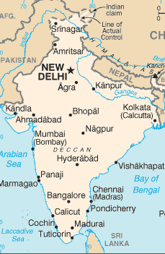
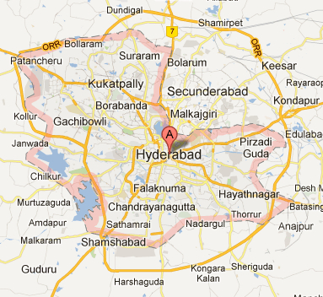
Spandana was expanding…
Hyderabad
Hyderabad, India

Slide 20
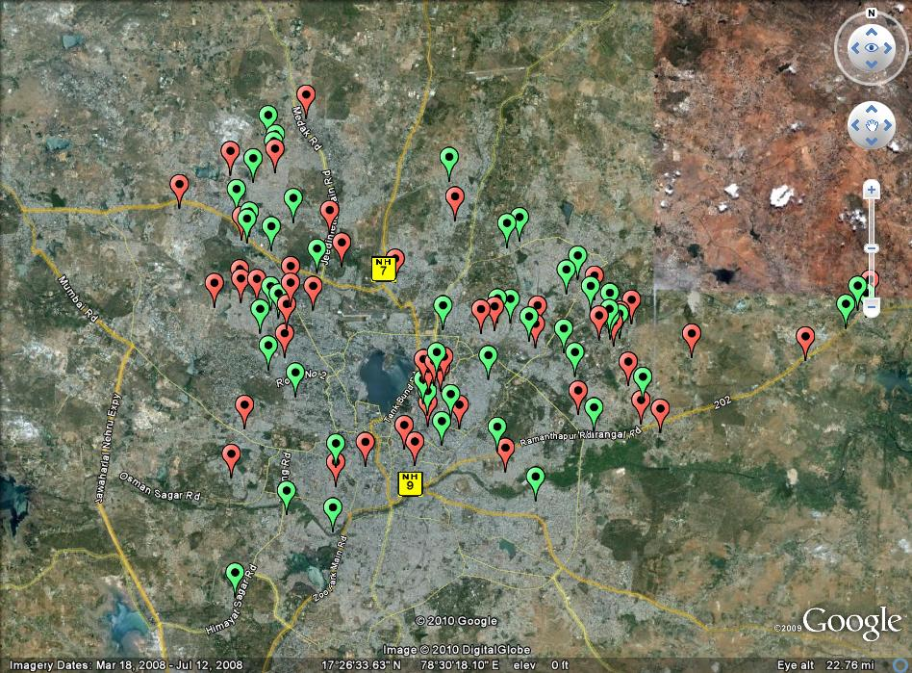
We randomly picked where Spandana would expand:

Slide 21
Microcredit: Randomization for evaluating impact
Randomizing who has access to microcredit helps disentangle impact of microcredit from other factors:
Motivation
Entrepreneurial activity
Business opportunity growth
Randomization creates two groups, treatment and comparison that (on average) are the same in all characteristics
Observable characteristics like income
Unobservable characteristics like motivation and entrepreneurial ability
Can directly compare outcomes of those in treatment group and those in comparison group: difference is due to microcredit

Slide 22
Evidence: useful not transformative
Seven randomized evaluations of microcredit in 7 countries
Take up of microcredit was relatively modest amongst eligible borrowers
In 2 of the studies there was an increase in the number of new businesses started
Borrowers used the flexibility of credit: for example allowed them to purchase large durables and pay for them over time
No increase in consumption
No increase in women’s empowerment

Slide 23
Other methods for measuring impact
Any study that seeks to measure causal impact must have a counterfactual:
Group that shows what would have happened without the program
RCTs/experiments, comparison chosen at random
Quasi-experimental methods require very specific assumptions to hold to be valid, hard to judge
Examples of quasi-experimental methods
Regression discontinuity
Instrumental variables
Difference-in-difference
JPAL is a resource on the assumptions needed for these different approaches to be valid

Slide 24
Telling a larger story with different kinds of evidence

Slide 25
Present bias and preventative health
Descriptive evidence tells us there is a problem
The poor spend a lot of money on health but a lot of this is on ineffective acute interventions
There are many cost-effective prevention technologies that people don’t invest in eg good diet to hand washing
People bad at managing chronic disease
Behavioral economic theories suggest a reason and solution:
Small inconsistencies about how we discount the future can cause big problems (place a lot of weight on today vs tomorrow but not tomorrow vs day after)
Small changes in price/convenience today will have big impacts
RCTs show small changes in prices of preventative health have big impacts, and convenience very important (causal)

Slide 26
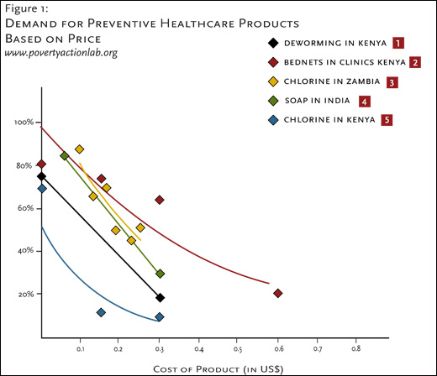

Slide 27
Journalists help people interpret claims

Slide 28
When reporting a claim always ask
What type of claim is this: descriptive, process, correlation, or causal impact?
Does the type of evidence match the claim? Is the claim causal but the evidence only a correlation?
If the claim is descriptive, is the sample representative? If you only ask people who bought a product if they like it, its not telling you much.
If the claim is causal (ie about impact), what is the counterfactual—how do we know what would have happened otherwise?
Are there reasons to think that the people who participated in the program are different from those who did not participate?

Slide 29
Some tips for describing evidence
Only use terms like: impact, led to, cause, or the result of when there is causal evidence—ie we know what would have happened in the absence of the program
Descriptive results are interesting and important, just be clear that they are only descriptive
Explain why a correlation is not necessarily causal: eg more of those on antidepressants commit suicide BUT those on antidepressants are depressed!
Academic studies can be written in complex language but the key ideas can often be explained in simple language, but to do so needs really understanding the results:
Ask authors how they would explain their results simply, run language by them, ask JPAL for help
Trust reliable journals but make sure to check your source (and do not hesitate to ask if you have doubts).

Slide 30
How can we promote use and understanding of evidence?

