Slide 1
Pathways to Evidence Informed Policy
Iqbal Dhaliwal
Director of Policy, J-PAL
Department of Economics, MIT
iqbald@mit.edu / www.povertyactionlab.org
3ie, Mexico, June 16, 2011

Slide 2
Outline
We recognize that:
There are many channels to inform policy, though focus here on those used by J-PAL
There is no “one size fits all” strategy to use impact evaluations to inform policy (example of four different scale up models)
Generate Evidence More Likely to Influence Policy
Promote policy relevant evaluations
Intensive partnering in the field to improve program design
Replicate evaluations
Use Evidence Effectively to Influence Policy
Adapt Policy Outreach to Organizations
Notes:
*PLEASE KEEP ONE SPACE BETWEEN THE BULLET POINT AND THE FIRST WORD

Slide 3
I. Promote Policy Relevant Evaluations
J-PAL tries to increase feedback of policy into research priorities via multiple channels:
Matchmaking Conferences to facilitate dialogue between researchers and policymakers (e.g. ATAI)
Research Initiatives to identify gaps in knowledge and direct resources there (e.g. Governance Initiative)
Joint Commissions to identify country’s most pressing problems and design evaluations (e.g. Government of Chile-JPAL Commission, 2010)
Innovation Funds to provide rapid financing for innovative programs and their evaluations (e.g. Government of France Youth Experimentation Fund, 2011)
Notes:
Example of specific question: “How do we increase adoption of ITN (Insecticide treated bednets).” But more fundamental question: Should health products be provided for free or a positive price charged to increase off take AND usage?

Slide 4
II. Partnerships in the Field
Evaluations by J-PAL affiliates are done in partnership with implementing organizations, and start long before any data is collected
Generally begins with extensive discussion of underlying problem and various possible solutions, and researchers can share results of previous research
In pilot phase, feedback from the field can help refine the program further
Helps build capacity in partner organization, potentially increasing their ability to generate and consume evidence on other projects
Qualitative methods including logbooks to inform “why” programs work or not
Structure of a partnership can have a significant effect on resulting evidence, how it can be used
Close enough partnership to understand relevant questions and implementation, autonomous enough to be independent
Notes:
*PLEASE KEEP ONE SPACE BETWEEN THE BULLET POINT AND THE FIRST WORD

Slide 5
III. Replicate Evaluations
Even when evaluations test fundamental questions, may encounter difficulty in using evidence from one region or country to inform policy in other areas
Resistance to using evidence from poorer or more marginalized areas
Worries that program success will not generalize to their context
Replicating evaluations in new contexts or testing variations to the program can helps strengthen initial evidence
Strengthens understanding of fundamental question being tested
Demonstrates generalizability beyond one specific context
Provides critical information (process, cost, impacts) for rapid scale up
Notes:
*PLEASE KEEP ONE SPACE BETWEEN THE BULLET POINT AND THE FIRST WORD

Slide 6
Outline
Generate Evidence More Likely to Influence Policy
Use Evidence Effectively to Influence Policy
Build Capacity of Policymakers to Consume and Generate Evidence
Make research results accessible to a wider audience
Synthesize policy lessons from multiple evaluations
Cost-effectiveness analysis
Disseminate evidence
Build partnerships
Scale up successful programs
Adapt Outreach to Organizations
Notes:
*PLEASE KEEP ONE SPACE BETWEEN THE BULLET POINT AND THE FIRST WORD

Slide 7
I. Build Capacity of Policymakers to Consume and Generate Evidence
Consumers: Stimulate demand for evidence by explaining the value of evidence, and how it can be incorporated into decision-making processes
Executive Education: In 2010 ran five executive education courses on four continents, training 188 people from governments, NGOs, and foundations
Explain the pros and cons of different types of impact evaluations (RCTs, Regression Discontinuity, Difference in Differences, Matching)
Give concrete examples of how evaluations can be structured, and evidence can be used to inform decision-making
Generators: Partner with organizations to institutionalize culture of evidence based policy
Government of Haryana Education Department: Build internal capacity with an Evaluation Unit, partnering on evaluation projects with J-PAL
Notes:
*PLEASE KEEP ONE SPACE BETWEEN THE BULLET POINT AND THE FIRST WORD

Slide 8
II. Make Research Results Accessible to Policy Audience
Results of impact evaluations most often presented in working papers and journals, in technical language which limits potential audience
Policy staff write evaluation summaries, a two-page synopsis of the relevant policy questions, the program being evaluated, and the results of the evaluation
Collaborate with study PIs for best possible understanding of the evaluation
Targeted at non-academic audiences, useful to convey information about an individual evaluation, or to put together packets on all evaluations in a region or thematic area
Make these tools available to researchers to support their own outreach work
Particularly relevant evaluations turned into longer printed “Briefcases”, usually around six pages long
Printed and mailed to key policymakers, allowing it to reach a broader audience
Notes:
*PLEASE KEEP ONE SPACE BETWEEN THE BULLET POINT AND THE FIRST WORD

Slide 9
III. Synthesize Policy Lessons from Multiple Evaluations
As evidence base grows, we’re able to draw out general lessons about a certain topic from multiple evaluations in different contexts
This kind of analysis takes two forms: cost-effectiveness and printed “bulletins”
Bulletins draw general lessons from a number of evaluations
Include both J-PAL and non-J-PAL RCTs
Show sensitivity of a program to context and assumptions like costs and population density
Challenging to get consensus among a large number of PIs
But extremely valuable to develop consensus on key issues to further established knowledge and identify next key research questions
Notes:
*PLEASE KEEP ONE SPACE BETWEEN THE BULLET POINT AND THE FIRST WORD

Slide 10
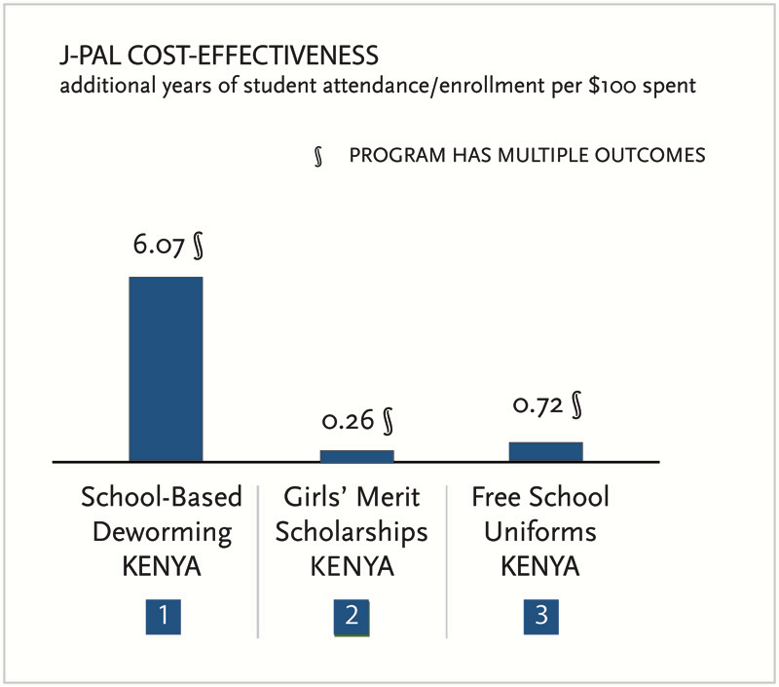
IV. Comparative Cost-Effectiveness Analysis
Cost-effectiveness can be used to summarize a complex program in terms of a simple ratio of costs to effects for one outcome (e.g. program cost per additional year of student attendance)
Comparative CEA when ratio is calculated for several programs
Goal is to help policymakers decide between alternative approaches to address a particular problem
Arose in response to specific demand from policymakers with limited time and technical resources, and increasing body of evidence from evaluations
J-PAL and non J-PAL RCTs
Not just “proof of concepts” but scalable interventions
Notes:
NOTE: Our initial use of cost-effectiveness analysis came in response to demand from policymakers (DFID in particular) that they wanted this info). Proof of concepts may not be scalable (e.g. providing personal tutors to children at schools or intensive handwashing promotion).

Slide 11
V. Disseminate Evidence to Policymakers
J-PAL runs a website that serves as a clearinghouse for evidence generated by J-PAL researchers, and provides policy lessons that have been drawn from that evidence base:
Evaluation Database: Summary pages for more than 250 evaluations and data
Policy Lessons: Cost-effectiveness analyses, bulletins
Scale-Ups: Pages outlining specific instances where evidence has contributed to a change in policy
Targeted evidence workshops, organized around a particular geographic region or research theme.
Notes:
*PLEASE KEEP ONE SPACE BETWEEN THE BULLET POINT AND THE FIRST WORD

Slide 12
VI. Build Long-Term Partnerships
Increasing Returns to Scale of Building long-term relationships by:
Dissemination of Evidence
Capacity building of the staff to consume and generate evidence
Evaluation of field programs
Scale ups
Identifying organizations to build partnerships with is both opportunistic (key contacts) and strategic (extent and salience of problem in that area, policy relevance of completed studies to that context, availability of funding due to donors’ regional or thematic priorities)
Examples include Government of Chile, State Government in India (Bihar, Haryana)

Slide 13
VII. Scale-Ups
Leveraging Evidence by implementing organization to expand existing programs and get more funding (e.g. Pratham)
Independent organizations can use evidence to replicate or scale-up programs found to be highly cost-effective, and/or simple to implement (e.g. Deworm the World)
Governments evaluate their pilot programs to demonstrate usefulness to public, gather support for their expansion and learn lessons to make it more effective (e.g. Progresa)
If an evaluation helps provide evidence on a very policy relevant and salient topic, it gets a huge amount of traction very easily (e.g. Pricing)
Notes:
Four RCTs that have greatly helped inform policy did so because of completely different reasons Pratham (by leveraging evidence to secure funds for scale up), DtW (cost effective to replicate), Progresa (working with a government that has the capacity and desire to scale it up ex ante), Pricing (answering a very salient and policy relevant question).

Slide 14
Outline
Generating Evidence More Likely to Influence Policy
Using Evidence to Influence Policy
Adapting Outreach to Organizations
Notes:
*PLEASE KEEP ONE SPACE BETWEEN THE BULLET POINT AND THE FIRST WORD

Slide 15
No Single Strategy for Policy Outreach
 | Governments | Int’l Dev. Organizations | Large Foundations | Local NGOs
Advantages of Partnership | Scale ups reach millions Many programs Funds available | All advantages of governments Cross-country experience Highly qualified staff (expertise + interest) | Highly qualified staff (expertise + interest) Can provide funding | Implementers Flexible and innovative
Challenges of Partnership | Bureaucratic procedures Transfers, change of government Busy staff Variance in staff quality | Priorities often dictated by home country politics, can change Differences between regional and headquarters priorities | Not implementers | Small Scale No funding Variance in staff quality
Notes:
As discussed earlier, Four RCTs that have greatly helped inform policy did so because of completely different reasons Pratham (by leveraging evidence to secure funds for scale up), DtW (cost effective to replicate), Progresa (working with a government that has the capacity and desire to scale it up ex ante), Pricing (answering a very salient and policy relevant question). SIMILARLY, POLICY OUTREACH ALSO REQUIRES CUSTOMIZING STRATEGY TO DIFFERENT PARTNERS.
International Development Organizations include country AID organizations (DFID, USAID), multilateral groups (World Bank, ADB), and large international NGOs (CARE).

Slide 16
Most Effective Approaches by Organization
 | Governments | Int’l Dev. Organizations | Large Foundations | NGOs
Publications |  |  | 
Website |  |  |  | 
Evidence Workshops |  |  | 
One-to-one networking |  |  |  | 
CEA |  |  | 
Commissions | 
Initiatives |  |  | 
Capacity Building |  |  |  | 
Inform Umbrella Organizations |  |  |  | 
Notes:
Not the gospel truth of what can and can’t be done- J-PAL would still talk to a local NGO. Just some tools to think about what may be particularly effective strategies for different kinds of organizations. Umbrella organizations are for example an association of all MFI (microfinance institutions).

Slide 17
Summary
There are a number of roadblocks from impact evaluations to impacting policy, but we feel they can be overcome
A priori, ensure policy relevant evidence generated by asking the right questions, providing feedback on initial program design and replications
Matchmaking Conferences, Research Initiatives, Joint Commissions, Innovation Funds
Many strategies to make existing evidence available to policymakers –others could be equally effective, but only highlighted J-PAL’s today:
Capacity building, making research accessible, synthesizing information from multiple evaluations, cost-effectiveness analysis, dissemination of evidence, building partnerships, and scale ups.
There is no “one size fits all” strategy to use impact evaluations to inform policy – need to tailor to organization and context
Notes:
*PLEASE KEEP ONE SPACE BETWEEN THE BULLET POINT AND THE FIRST WORD

Slide 18
Factors that Help or Hinder the
Use of Evidence in Policymaking
Iqbal Dhaliwal
Director of Policy, J-PAL
Department of Economics, MIT
iqbald@mit.edu / www.povertyactionlab.org
3ie, Mexico, June 17, 2011

Slide 19
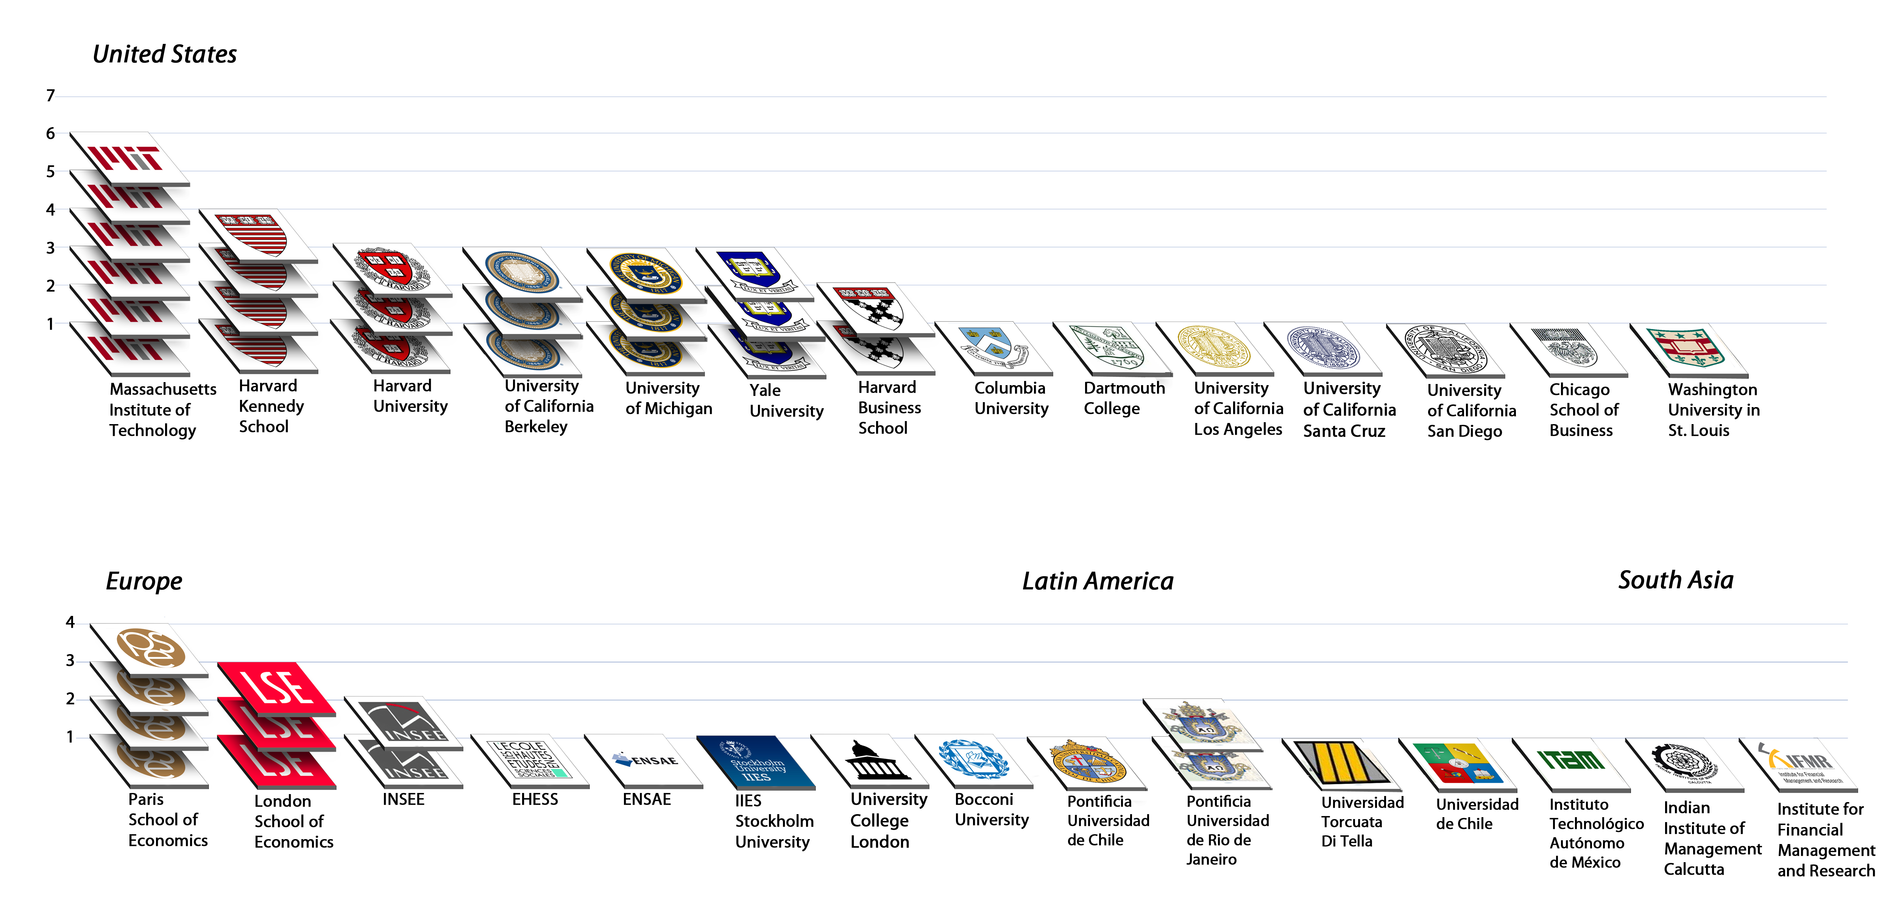
J-PAL is a Network of 55 Professors from 29 Universities using Randomized Evaluations in Development. But Mission is Broader: Policy is based on evidence and research is translated into policy
A B D U L L A T I F J A M E E L P O V E R T Y A C T I O N L A B
Notes:
Updated 11.29.2010. (MIT includes AB and ED, but not RG)
HKS=Rema, Rohini, Dan, Asim; HBS: Nava, Shawn; Harvard: Erica, Michael, Sendhil

Slide 20
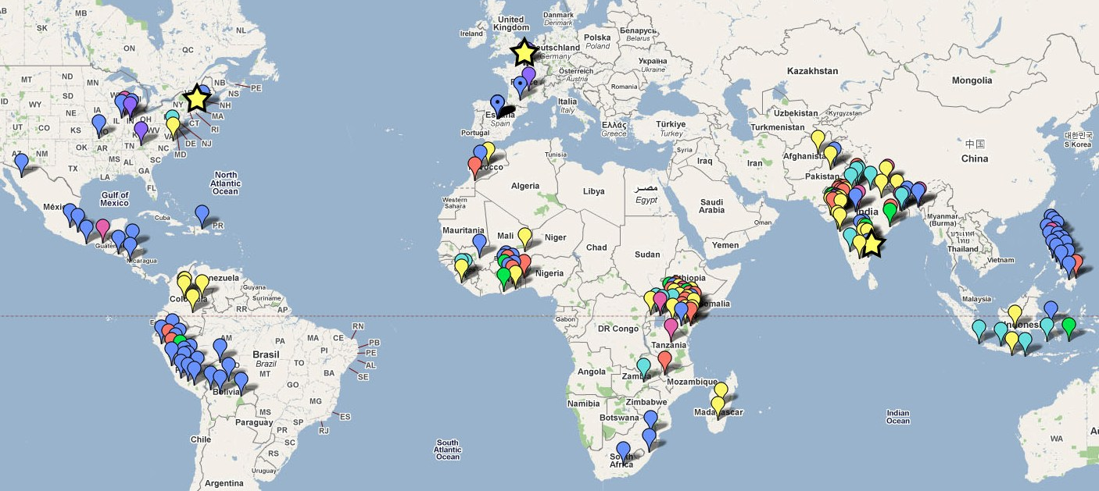
With 250+ projects in 42 countries, we deal with lots of policymakers, but recognize that:
There are many channels to inform policy, though focus here on those used by J-PAL
There is no “one size fits all” strategy to use impact evaluations to inform policy (example of four different scale up models)
Fields include Agriculture, Education, Environment, Governance, Health, Microfinance…
education
rural development
finance/ microfinance
environment
health
participation
gender/ discrimination
J-PAL offices

Slide 21
Outline
What sort of evidence would you want as a policy maker?
Factors that Help or Hinder the use of Evidence in Policy (How could these cases have had more policy influence)
Is it the job of researchers to influence policy?
Do governments only want to evaluate programs they think work?
Notes:
JPAL’s mission is to make sure that policy is based on evidence and
We have a network of 55 affiliates who have more than 250 evaluations in over 42 countries. Today’s presentation is based on JPAL’s experience of taking evidence to policymakers around the world.

Slide 22
What sort of evidence would you want as a policy maker?
Unbiased: Independent evaluation and not driven by an agenda
Rigorous: Used best methodology available and applied it correctly
Substantive: Builds on my knowledge and provides me either insights that are novel, or evidence on issues where there is a robust debate (find little use for evidence that reiterates what are established facts)
Relevant: To my context and my needs and problems
Timely: When I need it to make decisions
Notes:
I am going to answer this question based on both what we see in our interaction in the field and also my own 6-years in the Indian Civil Service working on both policy formulation and implementation in the field.
POLICY IS HOW RESOURCES ARE ALLOCATED, PROGRAMS DESIGNED AND IMPLEMENTED. SO POLICYMAKERS ARE ANYONE WHO DO THIS – GOVERNMENTS, FOUNDATION, INTERNATIONAL DEVELOPMENT ORGANIZATIONS, NGOs.
Policymakers just hate it when research results are questioned on methodology issues that they don’t understand.

Slide 23
What sort of evidence would you want as a policy maker?
6. Actionable: Comes with a clear policy recommendation
7. Easy to Understand: Links theory of change to empirical evidence and presents results in a manner easy to understand
8. Cumulative: Draws lessons from not just one program or an evaluation, but the body of evidence
9. Easy to Explain to constituents:
Helps if researchers have been building up a culture of getting the general public on board with Op-Eds, conferences etc.
Notes:
Example of specific question: “How do we increase adoption of ITN (Insecticide treated bednets).” But more fundamental question: Should health products be provided for free or a positive price charged to increase off take AND usage?

Slide 24
Outline
We recognize that:
There are many channels to inform policy, though focus here on those used by J-PAL
There is no “one size fits all” strategy to use impact evaluations to inform policy (example of four different scale up models)
What sort of evidence would you want as a policy maker?
Factors that Help or Hinder the use of Evidence in Policy
Is it the job of researchers to influence policy?
Do governments only want to evaluate programs they think work?
Notes:
*PLEASE KEEP ONE SPACE BETWEEN THE BULLET POINT AND THE FIRST WORD

Slide 25
Factors that Help or Hinder the use of Evidence in Policy: Research Side
Hinder | Help
1. Disconnect of evaluator from Program Design | Willingness to engage with policymaker in the concept and design of the program to be evaluated. E.g. Rajasthan Police
2. Unilateral decisions on design of evaluation | Work with policymakers to understand their main program concerns, and how the evaluation can be structured to answer them. E.g. Immunization
3. Inflexibility in evaluation approach | Consider alternate evaluation design to accommodate political constraints and field realities without compromising rigor and objectivity. E.g. Minister’s District
4. Only measuring “ideal”, but long term outcomes | Construct additional short term evaluation outcomes while continuing to design long-term measures. E.g. NRHM attendance vs. health outcomes.
Notes:
Disconnect: Program does not benefit from the knowledge of the evaluator, and the implementers see the evaluator as not essential partner to the program.
Flexibility: Example of political constraint – need to do evaluation in minister’s district as well; field realities: doctors never show up for work on Sunday.
Long Term: e.g. of short term outcomes (attendance of doctors) and long term (e.g. health outcomes, reduced corruption)

Slide 26
Factors that Help or Hinder the use of Evidence in Policy: Research Side
Hinder | Help
5. IE that only measure impact, not reasons | Qualitative data collection during IE to understand if program implemented per plan, and what worked or not. E.g. Nurses breaking machines
6. Begin policy engagement only at start of project | Actively participate in policy conferences, meet key policymakers, contribute to civil society debate via op-eds, books etc. in region of interest. E.g. Bihar conference
7. End relationship at completion of project | Willingness to stay engaged as a “technical” resources for policymaker even after publication, especially for scale-ups. E.g. Pratham (they provided expertise for TCAI).
8. Not report negative results | Maintaining rigor and absence of bias in evaluation and reporting results despite above close relationship. E.g. Flour fortification with Seva Mandir.
Notes:
Flexibility: Example of political constraint – need to do evaluation in minister’s district as well; field realities: doctors never show up for work on Sunday.
Long Term: e.g. of short term outcomes (attendance of doctors) and long term (e.g. health outcomes, reduced corruption)

Slide 27
Factors that Help or Hinder the use of Evidence in Policy: Research Side
Hinder | Help
9. Shifting evaluation objective | Register hypothesis ahead of time to avoid allegations of data mining. E.g. JPAL and partners for RCTs
10. Discuss only one study (own research) and information overload | Explain “policy findings” from the entire body of research, not just own narrow research and how this evaluation links to the body of evidence. E.g. DC Education Evidence Workshop, Cost Effectiveness Analysis
11. Original evaluation vs. replications | Be willing to evaluate the replication of a program found to have succeeded in another context and well suited for this problem, not just “new and innovative” programs. E.g. Bihar immunization, our partner IPA
Notes:
Own Research: One single program will find it hard to influence policy. Example JPAL Bulletins and Cost effectiveness analysis that make it easy to compare programs.
Replications: Example, IPA
Customize Outreach: e.g. ministers vs. bureaucrats; government vs. foundations

Slide 28
Factors that Help or Hinder the use of Evidence in Policy: Research Side
Hinder | Help
12. Technical jargon | Frame discussion in easy to understand language, communicate in a style policymakers are familiar with, and customize outreach to audience. E.g. Policy Bulletins, Briefcases, academic papers
13. Funding may be difficult | More and more organizations require impact evaluations in the programs they fund and dedicated funding groups makes this easier. E.g. DIME @ WB, 3ie, IGC, JPAL Initiatives, IPA Funds
Notes:
Own Research: Example JPAL Bulletins and Cost effectiveness analysis that make it easy to compare programs.
Replications: Example, IPA
Customize Outreach: e.g. ministers vs. bureaucrats; government vs. foundations
Organizations requiring evaluations: World Bank (DIME) and foundations (Hewlett)
New funding groups: 3ie, IGC and JPAL (Initiatives)

Slide 29
Factors that Help or Hinder the use of Evidence in Policy: Policy Side
Hinder | Help
1. Political agenda trumps evidence | Target those who are open to evidence, so they use it as an input along with other factors like political agenda, budget constraint and ability of bureaucracy. E.g. TCAI in Ghana
2. Low capacity to consume, generate or institutionalize evidence | Help train staff, establish M&E divisions, recruit technically competent people and motivate them by giving credence to their research and via formal linkages with leading academics. E.g. Government of Haryana
3. Short term horizon | Combine short term outcome measures with long term outcomes via phased rollout. E.g. NRHM
Notes:
Political agenda: E.g. TCAI - Remedial education in Ghana with contract teachers required union discussions.
Low capacity: E.g. Government of Haryana Education Department, CONEVAL, MSD-Evaluation Group (Brazil)

Slide 30
Factors that Help or Hinder the use of Evidence in Policy: Policy Side
Hinder | Help
4. Risk aversion and failure-avoidance | Setup institutions that allow innovation and risk tolerance. E.g. Chile Compass Commission, French Evaluation Fund
5. Inability to build coalitions to support new programs | Work with other government agencies that are most receptive to evidence, even if not social development departments. E.g. Finance, Governor’s Special Cell
6. Change in “rules of the game” viz. evaluation or lack of institutional continuity | Sign MoU and stick to the agreement in terms of phased roll out, control group, sample size, data publication, and scale up if found to be successful. MoU to survive change of personnel and governments. E.g. Government of Karnataka state in India
Notes:
Political agenda: E.g. TCAI - Remedial education in Ghana with contract teachers required union discussions.
Low capacity: E.g. Government of Haryana Education Department, CONEVAL, MSD-Evaluation Group (Brazil)

Slide 31
Factors that Help or Hinder the use of Evidence in Policy: Policy Side
Hinder | Help
7. Lack of pressure from civil society or legislature to conduct evaluations | Convince these institutions to demand evaluations via contribution of civil society debate (Opeds, workshops, legislation). E.g. Mexican legislature created CONEVAL.
Notes:
Political agenda: E.g. TCAI - Remedial education in Ghana with contract teachers required union discussions.
Low capacity: E.g. Government of Haryana Education Department, CONEVAL, MSD-Evaluation Group (Brazil)

Slide 32
Outline
We recognize that:
There are many channels to inform policy, though focus here on those used by J-PAL
There is no “one size fits all” strategy to use impact evaluations to inform policy (example of four different scale up models)
What sort of evidence would you want as a policy maker?
Factors that Help or Hinder the use of Evidence in Policy
Is it the job of researchers to influence policy?
Do governments only want to evaluate programs they think work?
Notes:
*PLEASE KEEP ONE SPACE BETWEEN THE BULLET POINT AND THE FIRST WORD

Slide 33
Is it the Job of Researchers to Influence Policy
Normative Perspective
Research should not be the end in itself, just a tool / means
If research is not translated into policy, it is a huge waste of the resources that go into funding it (universities, NSF, 3ie, foundations, etc.)
Benefit to Policymakers
Researchers bring credibility to evidence - unbiased and rigorous research has better potential to influence policy if disseminated well
Knowledge of overall literature / field so can synthesize what would work best in a context
You understand the underlying program the best - closely involved with the program design, independently observed the implementation (qualitative data) and measured the impacts
Notes:
*PLEASE KEEP ONE SPACE BETWEEN THE BULLET POINT AND THE FIRST WORD

Slide 34
Is it the Job of Researchers to Influence Policy
3. Benefit to Researchers (aka “Selfish” reasons)
Facilitates research: If you have contributed to program design, then you are integral part of the project and implementer will safeguard your interests (control group contamination, data access)
Follow up research / work: If you stay engaged with policymakers, then they will ask you next time for program concept, design and evaluation
Funding: There is great interest currently in funding evaluations, but if after a few years donors find no linkage with policy, your research funds will dry out, as also the relevance of your field because it is so dependent on external funding
Opportunity to influence the field: Engaging with policymakers stimulates interest in related research and draws in others (e.g. Cap and Trade Environment project in India)
Notes:
*PLEASE KEEP ONE SPACE BETWEEN THE BULLET POINT AND THE FIRST WORD

Slide 35
Outline
We recognize that:
There are many channels to inform policy, though focus here on those used by J-PAL
There is no “one size fits all” strategy to use impact evaluations to inform policy (example of four different scale up models)
What sort of evidence would you want as a policy maker?
Factors that Help or Hinder the use of Evidence in Policy
Is it the job of researchers to influence policy?
Do governments only want to evaluate programs they think work?
Notes:
*PLEASE KEEP ONE SPACE BETWEEN THE BULLET POINT AND THE FIRST WORD

Slide 36
Do governments only want to evaluate programs they think work?
Yes: If the program finalized and the government has put its full political capital behind it:
Rely on internal M&E departments to undertake evaluations and tightly control the results emerging from the evaluations
Best resolution maybe to evaluate variations in program (benefits, beneficiary selection and program delivery process)
No: If evaluator involved in the program conception and design from beginning, then may be able to convince the government to:
Conduct pilot programs to test the proof of concept
Phased rollouts that allow you to conduct evaluations and also influence policy
Notes:
*PLEASE KEEP ONE SPACE BETWEEN THE BULLET POINT AND THE FIRST WORD

